Slide 1
KS1
Phonics Screening Check

Slide 2
KS1 Phonics Screening Check
The Year 1 phonics screening check is not a formal test, but a way for teachers to ensure that children are making sufficient progress with their phonics skills to read words, and that they are on track to become fluent readers who can enjoy reading for pleasure and for learning.

Slide 3
What is phonics?
Children are taught to read by breaking down words into separate sounds or ‘phonemes’. They are then taught how to blend these sounds together to read the whole word.
Children have a 20-minute phonics lesson each day and they are encouraged to use these strategies to read and write in other lessons.
There are around 40 different sounds.

Slide 4
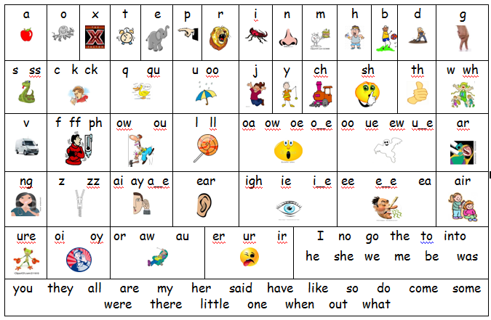

Slide 5
WHAT IS THE YEAR 1 PHONICS SCREENING CHECK?
The phonics screening check will be taken individually by all children in Year 1 in June. It is designed to give teachers and parents information on how your child is progressing in phonics. It will help to identify whether your child needs additional support at this stage so that they do not fall behind in this vital early reading skill.
Any children who do not pass the check, will be given the opportunity to retake it in Year 2.

Slide 6
HOW IS THE PHONICS SCREENING CHECK COMPLETED?
There will be two sections in this 40-word check and it will assess phonics skills and knowledge learned throughout Reception and Year 1.
Your child will read up to four words per page for their teacher and they will probably do the check in one sitting of about 5-10 minutes.

Slide 7
WHAT SORT OF CHECK IS IT AND IS IT COMPULSORY?
It is a school-based check to make sure that your child receives any additional support promptly, should they need it. It is not a stressful situation as the teacher will be well-equipped to listen and understand your child’s level of skills. There will be a few practice words first to make sure your child understands the activity.

Slide 8
WHAT WILL IT CHECK?
It will check that your child can:
Sound out and blend graphemes in order to read simple words.
Read phonically decodable one-syllable and two-syllable words, e.g. cat, sand, windmill.
Read a selection of nonsense words which are referred to as pseudo words.

Slide 9
WHAT ARE NONSENSE, PSEUDO OR ALIEN WORDS AND WHY ARE THEY INCLUDED?
These are words that are phonically decodable but are not actual words with an associated meaning e.g. brip, snorb. Pseudo words are included in the check specifically to assess whether your child can decode a word using phonics skills and not their memory.

Slide 10
WHAT ARE NONSENSE, PSEUDO OR ALIEN WORDS AND WHY ARE THEY INCLUDED?
The pseudo words will be shown to your child with a picture of a monster and they will be asked to tell their teacher what sort of monster it is by reading the word. This not only makes the check a bit more fun, but provides the children with a context for the nonsense word which is independent from any existing vocabulary they may have.
Crucially, it does not provide any clues, so your child just has to be able to decode it. Children generally find nonsense amusing so they will probably enjoy reading these words.

Slide 11
IS THERE A PASS MARK?
Currently, the pass mark for the last 5 years has been 32 out of 40. However, if children do not reach the required standard, then the teacher will be in touch to discuss plans and offer additional, tailored support to ensure that your child can catch up.
Children progress at different speeds so not reaching the score does not necessarily mean there is a problem. Your child will re-sit the check the following summer term in Year 2.
Notes:
As a school, we really do take the teaching of phonics seriously, and make sure all children, unless they have really genuine SEND, reach the level expected. An example to show this is that last year, we attained 95% passing the check - which put us in the top 20% of schools nationally.

Slide 12
HOW CAN I HELP?
Encourage your child to use their sounds when reading and writing if they are stuck on a word.
Read daily – home reading books are linked to the sounds your child is learning in school.
Read aloud.
https://home.oxfordowl.co.uk/reading/phonics/
https://www.phonicsplay.co.uk/parents
https://www.youtube.com/channel/UC7sW4j8p7k9D_qRRMUsGqyw (Mr Thorne Does Phonics)
Suggestions from parents -
https://www.katiesclassroom.com/
https://www.teachyourmonster.org/

Slide 13
HOW CAN I HELP?
Digraph- 2 letters making one sound = cow
Trigraphs- 3 letters making one sound = night
Split digraphs- 2 vowels with a consonant inbetween. It used to be known as the magic e!
spine - i_e
Encourage your child to ‘sound out’ when reading or writing. Focusing particularly on spotting more unusual sound patterns.

Slide 14
PLEASE REMEMBER...
Phonics is not the only thing needed to become a fluent reader. Please continue to read with your child each night and encourage them to:
Sound out
Re-read to check that it makes sense
Use pictures for clues
Ask questions about the book
Discuss and recap what they have read
And most importantly ENJOY READING!

Slide 15
QUESTIONS?

