Slide 1
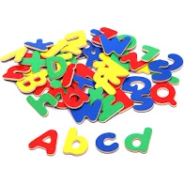
Bearwood Primary School Early Years Foundation Stage Phonics Workshop October 2022

Slide 2
Our Vision…
"We aspire to be an outstanding, values based school at the heart of our diverse community.
Striving for excellence, our focus is to enable our children to be resilient and independent learners whilst also considerate of others.
Through an all-encompassing curriculum, our children will achieve their highest potential, and have a firm foundation on which to build successful and productive lives in an ever-changing world."

Slide 3
Aims of this workshop
Develop an understanding of what phonics is and why we teach phonics
Briefly introduce Essential Letters and Sounds
Introduce some of the terms used in phonics
Demonstrate what a daily phonics lesson looks like in school
Give you some strategies to use at home to support your children

Slide 4
What is systematic synthetic phonics?
'Synthetic Phonics' comes from the idea of 'synthesising', which means 'putting together' or 'blending‘, in reading the sounds prompted by the letters on the page and are put together in order.
Synthetic phonics develops phonemic awareness along with the corresponding letters.
Notes:
In SSP the graphemes and corresponding phonemes are taught before the introduction of words containing those letters/sounds. To read these words, children are taught to pronounce the individual phonemes (sounds) associated with the graphemes (letters) they see, and then to blend them together (synthesise) to form the word.

Slide 5
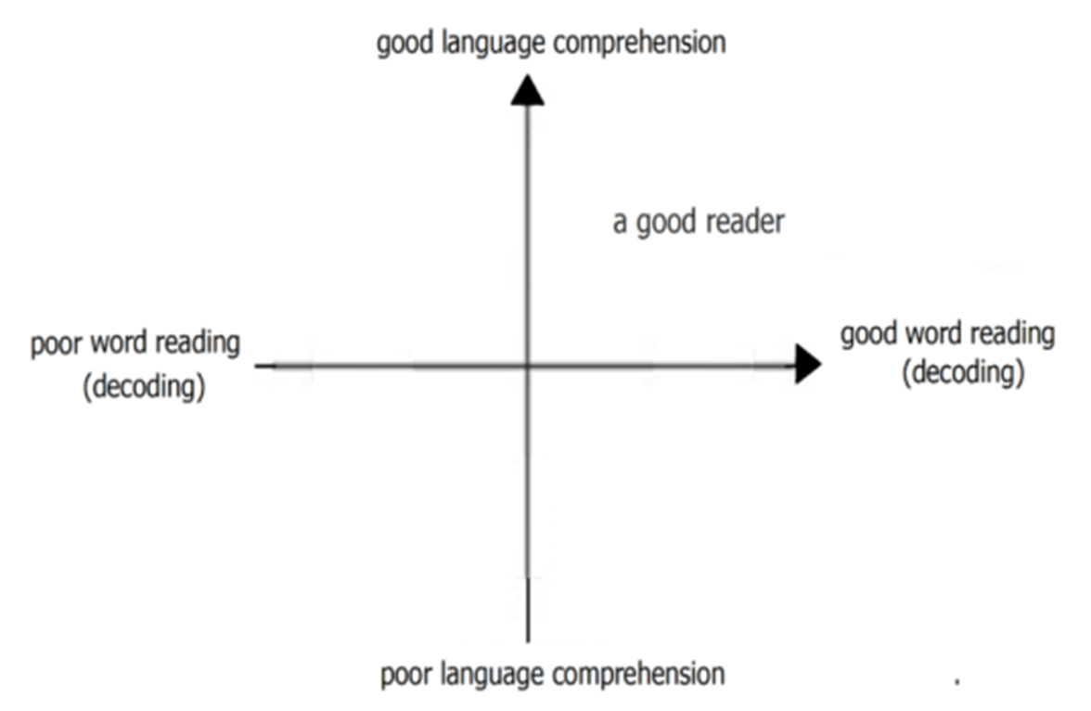
Why do we teach phonics?
We use phonics as the building blocks for teaching reading and writing.
Notes:
This graph has been taken from the Reading framework published in July 2021.
It is really important when thinking about reading to consider the whole approach to reading.
The report says:
When children start learning to read, the number of words they can decode accurately is too limited to broaden their vocabulary. Their understanding of language should therefore be developed through their listening and speaking, while they are taught to decode through phonics. However, when they can read most words ‘at a glance’ and can decode unfamiliar words easily, they are free to think about the meaning of what they read. They can then begin to develop their understanding of language through their reading.
We might think of writing similarly. Composition might be considered as the reverse of language comprehension; encoding (spelling) is the reverse of decoding (word reading). Writing might therefore be described as the product of composition and transcription. But before children can write independently, they need to be able to say (aloud or just to themselves) what they want to write. A wide spoken language gives them more that they can write about and more words for what they want to say. Their expressive and receptive language develops through talk and listening. In learning phonics, children learn to spell familiar words accurately and how to form letters. When they can do this, and can spell any word in a way that is at least phonically plausible, they can begin to write down what they want to say.

Slide 6
Year One Phonics Screening Check In 2019, 82% of our Year One children passed the Phonics Screening Check. This is in line with National Average. Our phonics screening check results for 2022: Year 1 – Bearwood: 95% passed, Wokingham: 82% passed National: 72%

Slide 7
Phonics Schemes
At Bearwood, we follow the Essential Letters and Sounds (ELS) programme. Essential Letters and Sounds is a validated phonics scheme, based on the Letters and Sounds progression resource published by the Department for Education which consists of six phases.
We follow ELS through Reception and Year 1. Children in Nursery have a daily Phase 1 phonics session, and children in Year 2 and beyond have phonics interventions as required.

Slide 8
Terminology
Phoneme - the smallest unit of sound in speech
Grapheme – one or more letters representing a phoneme
Segmenting – identifying the individual phonemes in a word
Blending – identifying the word made by a string of phonemes
Digraph – two letters which make one phoneme
Trigraph - three letters which make one phoneme
CVC word - Consonant Vowel Consonant eg: cat
Tricky words (hard to read and spell words) – words that cannot be sounded eg: the
High frequency words – words that appear often but can be sounded eg: and
GPC –Grapheme Phoneme Correspondence

Slide 9
Phase 1 Delivered in our Nursery
There are 7 aspects:
A1 – Environmental Sounds
A2 – Instrumental Sounds
A3 – Body Percussion
A4 – Rhythm and rhyme
A5 – Alliteration
A6 – Voice sounds
A7 – Oral blending and segmenting.

Slide 10
Phase 2 Autumn Term in Reception
Introduces phoneme/grapheme (letter/sound) correspondence. Children learn a small selection of common consonants and vowels and begin to put them together to read and spell CVC words and simple sentences using only the GPC and tricky words they have learned.
Set 1: s, a, t, p
Set 2: i, n, m, d
Set 3: g, o, c, k
Set 4: ck, e, u, r
Set 5: h, b, f, ff, l, ll, ss
Tricky words: I, no, to, go, the, into,

Slide 11
Phase 3 Autumn and Spring Term in Reception
Teaches one grapheme for each phoneme in order to read and spell simple regular words. Continue to read and spell words and sentences using the GPC and tricky words they have learned.
Set 6: j, v, w, x
Set 7: y, z, zz, qu
Consonant digraphs: ch, sh, th, ng
Vowel digraphs: ai, ee, igh, oa, oo, ar, or, ur, ow, oi, ear, air, ure, er
Tricky words: he, she, me, we, be, was, you, they, all, are her, my,

Slide 12
Phase 4 Summer Term in Reception
This phase consolidates all the children have learnt in the previous phases, including words containing adjacent consonants eg. stamp, and polysyllabic words eg. shampoo, and continue to apply all their phonic knowledge to read and spell to write.
Tricky words: said, have, like, so, do, some, come, were, there, little, one, when, out, what,

Slide 13
Phase 5 Year 1
Children will be taught new graphemes and alternative pronunciations for these graphemes.
Vowel digraphs:, ay, ou, ie, ea, oy, ir, ue, aw, ew, oe, au,
Consonant digraphs: wh, ph, kn, gn,
Split digraphs: a_e, e_e, i_e, o_e, u_e
Tricky words: oh, their, people, Mr, Mrs, looked, called, asked, could

Slide 14
Phase 6
The focus is on learning spelling rules for suffixes to develop their skills and automaticity, creating an increasing capacity for reading complex words and reading for meaning.
-s -es -ing -ed
-er -est -y -en
-ful -ly -ment -ness
Homophones: there, their, they’re, here, hear, where, wear,

Slide 15
Segmenting
Breaking down words for spelling.
cat
c a t

Slide 16
Segmenting
Queen
qu ee n

Slide 17
Blending
Building words from phonemes to read.
c a t
cat

Slide 18
Blending
Qu ee n
queen

Slide 19
What does a phonics lesson look like?

Slide 20
What you can do to help
Practise reading the sounds on their sound card with them – the ones they have learned so far. Make sure that you are saying the pure sounds. See here if you are not sure: https://www.youtube.com/watch?v=UCI2mu7URBc
Practise writing the letters they have learned the sounds for.
Practise reading and writing the tricky words that they have learned.
Correct pencil grip and letter formation
Listen to them read regularly at home. Encourage saying the sounds for each word, then saying the word, and finally reading the sentence.
Encourage re-reading the book to develop fluency
Sign the reading record.
Talk to your child’s teacher if you have any questions.

Slide 21
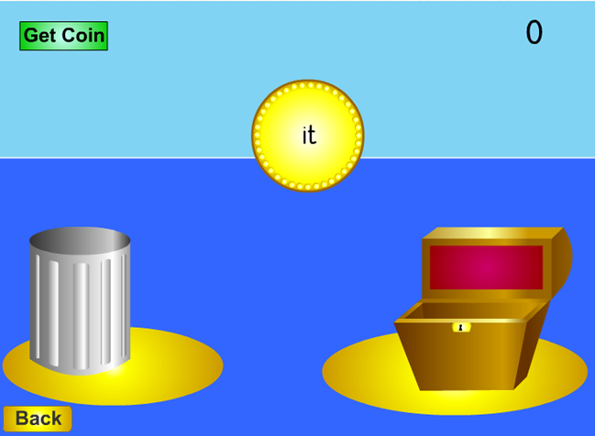
Resources and more information
Sound card for each phase
Letter formation ditties
The fully decodable reading books that the children read with you at home. This is how they practise and apply their phonics knowledge. Research and Government guidance states that children should re-read their books to develop fluency.
Please come to our Early Reading Workshop on Wednesday 19th October at 9am.
Essential Letters and Sounds: https://essentiallettersandsounds.org/
Phonicsplay: http://www.phonicsplay.co.uk

Slide 22
Any questions?

