Slide 1

Safer Internet Parent Workshop
February 10th 2026
Bearwood Primary School

Slide 2

What Is Safer Internet Day?
Staying safe online is a vital skill to be put into practise every day. Sometimes, it can be useful to have a fresh reason to focus on something that we have to do every day, to revive enthusiasm and give us the chance to reflect and make improvements. Safer Internet Day provides just that reason!
Safer Internet Day takes place every year in February and is a chance to promote and celebrate online safety.
It is a perfect opportunity to think about the online world and discuss with your child how they can stay safe there.

Slide 3
Parent / Carer Internet Concerns
What are your concerns around Internet safety for your child(ren)?
Notes:
If large group – talk to person next to you and then share.
If small group – share with whole group.

Slide 4

The positives of being online…
59%
3/4
of children say the internet has a positive impact on their wellbeing*
% of children who say spending time online makes them feel confident**
of children say the internet/tech is important for their independence**
*Internet Matters tracker survey, Wave 19 (2024)
**Children’s Wellbeing in a Digital World, Year Three, Internet Matters (2024)
Notes:
First, it’s important to remember that there are plenty of benefits for children who go online.
Research from online safety organisation, Internet Matters, found that the majority of children believe going online positively impacts their wellbeing. This is based on a survey given to children aged 9-17 who self-reported these feelings.
Other research from Internet Matters found that children who go online are increasingly confident; the stat on screen shows the change from 2022 to 2023. With so much information and opportunity for connection, this confidence could be related to finding spaces that support who they are and their interests.
Additionally, the same research found that 75% of 9-17-year-olds saw technology and the internet as an important part of their independence.
Overall, children enjoy going online, so our role as educators and yours as parents is to give them the tools to keep enjoying their time by staying safe and becoming resilient.

Slide 5


The potentially negative impacts…
Sleep cycles are often affected by blue light from too much screen use, which can impact their daytime activities like school;
Excessive screen use might result in less movement, leading to physical health issues
Platforms use persuasive design to keep people using it, which children are particularly vulnerable to
More time online means more opportunity to come across potential harms.
Notes:
Despite many positives, there are also potentially negative impacts from being online. For example, research shows that blue light from screens can impact sleep cycles, and using screens while sitting or lying down can have impacts on physical health.
Platforms also use what’s called persuasive design to keep people engaged. Children are often more susceptible to this, which can lead to feelings of too much screen time.
And the more time a child spends online, the more likely they are to come across potential harm. However, if they have the right skill, they can often identify these risks.

Slide 6

Why Is Online Safety Important?
It is never too soon to start good online safety habits with your child.
Just as you would want to protect your child from harm in the real world, it is vital to do the same in the digital one. It is important to give children the skills they will need to explore and engage with the digital world in a positive way.
Technology and the way in which we interact with it has a vast impact on both our mental and physical health so we need to think carefully about:
screen time;
interacting with others online;
online content;
privacy and security;
digital footprints.

Slide 7
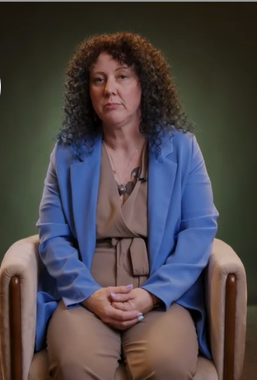
Short video clip
https://www.internetmatters.org/advice/6-10/
Notes:
Show the video clip.

Slide 8
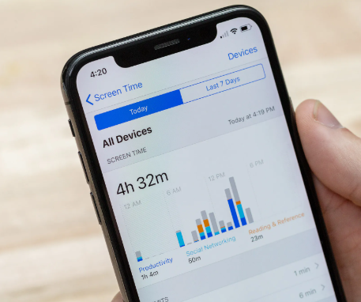

Screen Time
Screen Time
Monitor Screen Time
Children often do not realise how long they have been online.
It might be useful to set a screen limit. You could discuss this together and create a timetable or use a timer to help them stick to the time limits.
It is also important to discuss what they are using their screen time for, to ensure that it includes a balance of activities. This could include watching TV, doing homework, playing games and chatting with friends online.

Slide 9
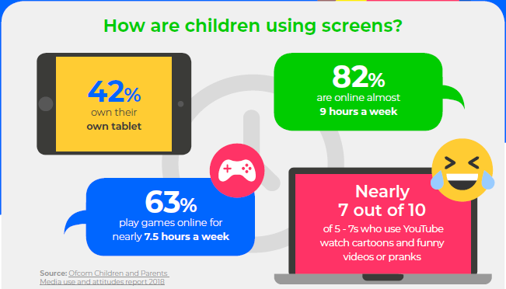
Screen Time Key Stage One: 5 – 7 year olds

Slide 10
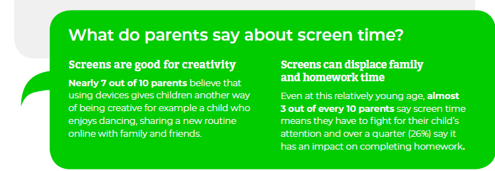
Screen Time Key Stage One: 5 – 7 year olds

Slide 11
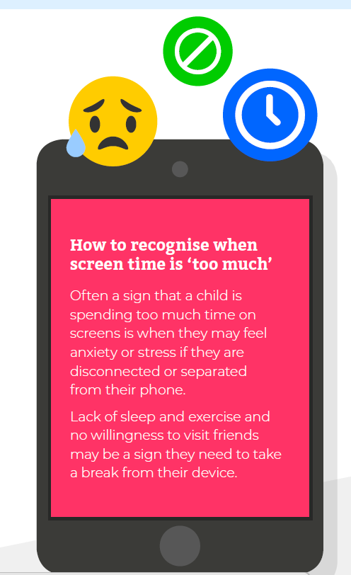
Notes:
Screen time too much –
Showing signs of anxiety / stress if separated from their phone.
Lack of sleep and exercise – not wanting to spend time with friends.

Slide 12
Screen Time Challenges: younger children
Screen time challenges
Young children might stumble across inappropriate content that may have a negative impact on their digital wellbeing.
Passive screen time could have a physical effect on their development (i.e. eyes, brain), sleep cycle and behaviour.
Younger children may not understand the concept of what the internet is and how it works so could find it hard to differentiate between what it real and what is fake.

Slide 13
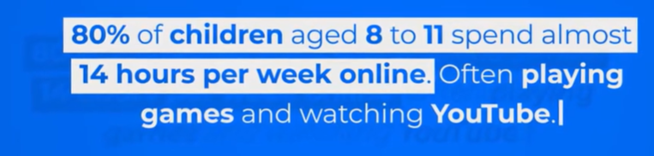
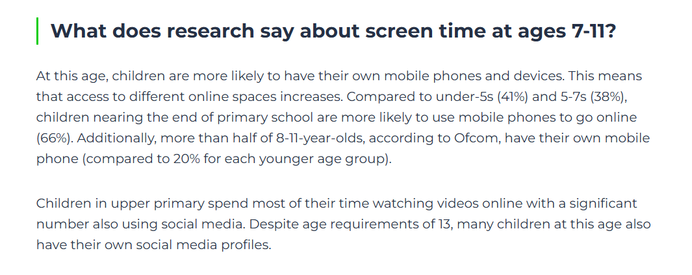
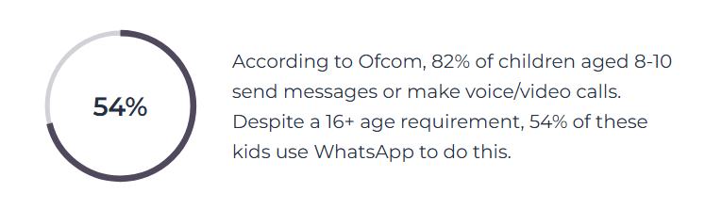
Screen Time Key Stage Two: 7 – 11 year olds
Notes:
These figures are from a few years’ ago so it may be higher.

Slide 14

Spending too much time online
41% of children believe they spend too much time online
Of these children, most reported it causing them some distress, upset or harm
Not all screen time is negative, but if your child’s wellbeing is negatively impacted, they need your support.
Most games and apps have screen time controls to manage this, but you should also help them find other activities to make their time online positive.
Guide to
balancing screen time
Notes:
The last issue we’ll look at today is spending too much time online.
Internet Matters asked 9-17-year-olds to identify issues they’ve experienced online. Of the 25 options, 41% said they spent too much time online – and this was the most highly reported issue of all listed.
As much as parents often think their children spend too much time online, this research shows that children recognise this as well. They just might not yet have the ability to regulate themselves to have a more balanced digital experience, which is why it’s important to set parental controls and screen time limits in their apps and games.
It’s also important to help them use their devices for a range of purposes such as learning and creating rather than just consuming content.
You can scan the QR code for Internet Matters’ guide to balancing screen time if you need more support.

Slide 15
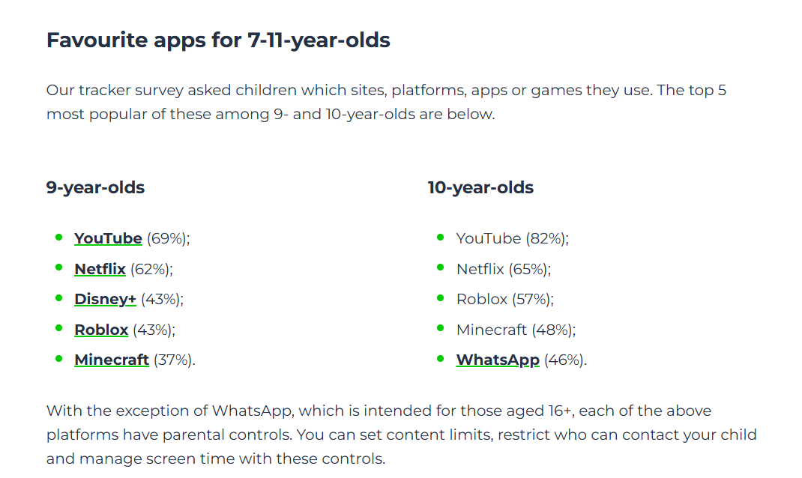
https://www.internetmatters.org/resources/screen-time-tips-to-support-7-11-year-olds/

Slide 16

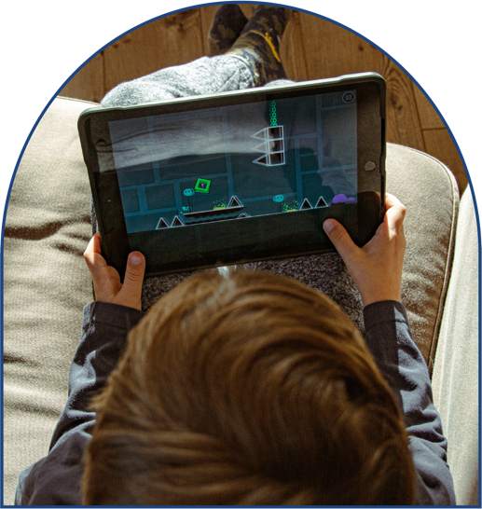




PEGI Ratings
The age ratings for green PEGI 3 and PEGI 7 games are advisory.
The age ratings for the orange PEGI 12 and PEGI 16, as well as the red PEGI 18, are legally enforceable. This means that shops cannot sell or hire games with an orange or red rating to people who are not the right age.
Online and downloaded games are not technically included but many major providers voluntarily add the limits to their games.
PEGI ratings offer a traffic light system of age ratings for computer games and are a simple way for you to ensure that your child is playing games that are suitable for their age. The purpose of these age ratings is not to show how difficult a game is but to indicate that the games are appropriate for players of a certain age.
Suitable for all age groups. These games should not include any sounds or pictures which will frighten young children. There should be no bad language. Mild forms of violence can only be used in a comical or childlike setting.
Games may contain scenes or sounds that could frighten young children. They can also contain mild forms of violence but this must not look realistic and must not be too detailed.
Games may show violence in a slightly more graphic way towards fantasy characters. Violence towards human-like characters is still unrealistic. There may be gambling and suggestive activities or language included. Bad language must be mild.
Games can feature more realistic violence. Games may include tobacco, alcohol or illegal drugs and stronger bad language.
This is an adult classification. These games can show all of the content from the PEGI 16 rating but also contain realistic and extreme violence, as well as other events that are only suitable for adults.
Notes:
Check PEGI rating before your child plays a game.

Slide 17



Online bullying (cyberbullying)
Online bullying is more difficult to escape than ‘traditional’ bullying
It can happen between friends or strangers
It can happen in video games, on social media, in messaging apps, etc.
About 1 in 10 children say they have experienced online bullying. This increases for children with SEN needs or similar vulnerabilities.
Set parental controls, talk about healthy behaviour and show your child how to block and report content.
Cyberbullying conversation guide
Notes:
A common issue that a lot of parents worry about is cyberbullying (or bullying that happens online). The biggest thing to remember about it is that it’s so much more difficult to escape than ‘traditional’ bullying. And, actually, a lot of offline bullying then continues online.
Cyberbullying can happen between friends or strangers and can happen on social media, in video games, through messaging apps, in comment sections, and basically anywhere where people interact with others.
About 1 in 10 children say they have experienced online bullying, and this number increases with children who have SEN needs or similar vulnerabilities.
Talking about cyberbullying, including what it looks like and how to take action against it, is important. If you scan the QR code, you can access Internet Matters’ conversation guide.
You can also set parental controls to limit contact, customise disallowed words and show your child how to report or block bullies.

Slide 18
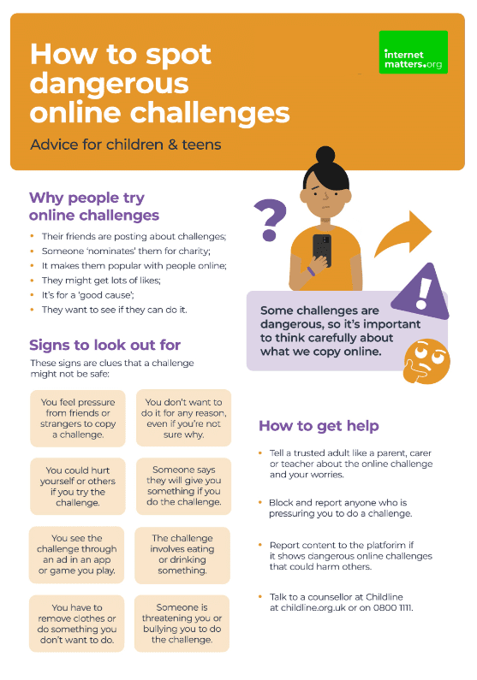
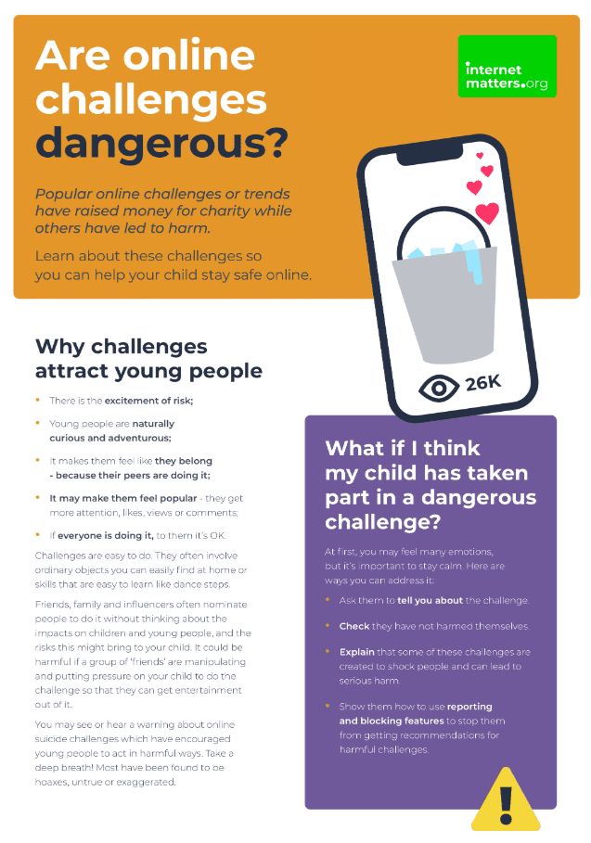

Dangerous online challenges
Viral online trends attract many children and teens
Most are harmless, but some can be dangerous
1 in 5 children say they’ve come across content which promotes dangerous stunts or challenges
It’s important to talk with your child so they understand the dangers and can avoid potential harm.
Remind your child of the importance of thinking before acting. Encourage them to get the facts and understand the risks before participating.
Notes:
You might have seen some online challenges and trends recently, or you might remember trends like planking and flash mob dances that were popular years ago.
These types of challenges attract many children but while most of them are harmless, some can be dangerous.
In Internet Matters’ survey, around 1 in 5 children aged 9-17 said they had come across content that promoted dangerous stunts or challenges. It’s important to remember that this is self-reported, and some children might see this content without realising it’s dangerous.
You’ll see a lot of these trends on social media, so it’s really important that you talk to your child about dangerous challenges. You can find more guidance about how to safely talk about this issue at InternetMatters.org or by scanning the QR code on screen.

Slide 19

Inappropriate content
27% of children see pornography by age 11
Around 1 in 10 children report seeing pornographic or violent content online. This increases with age.
Children with vulnerabilities are more likely to come across these things – especially violent content.
Parental controls can help limit access to certain websites, content and more. It’s also important for your child to report any inappropriate content they accidentally come across.
Notes:
The Children’s Commissioner for England ran a survey which found that over a quarter of children had seen porn by age 11; 10% had seen it by age 9. And the average age children first see pornography is 13. This could be through curiosity or stumbling across the content by accident through ads on other websites. Their friends might also share this content with them.
An Internet Matters survey of children aged 9-17 found that 1 in 10 reported seeing pornography or violent content online. As children grow and if a child has SEND needs – including autism, sensory impairments, communication needs, ADHD and even dyslexia or physical disabilities – they are more likely to come across this content.
Unfortunately, if children see a lot of this content, they can become desensitised, which means it’s harder for them to recognise when something is harmful. So, setting parental controls on broadband and mobile, talking to them about why some content is not appropriate and showing them how to use reporting tools is really important. Especially if inappropriate content makes its way through a filter that should have stopped it; this helps the platform strengthen these filters and protect users who do not want to see such content.

Slide 20

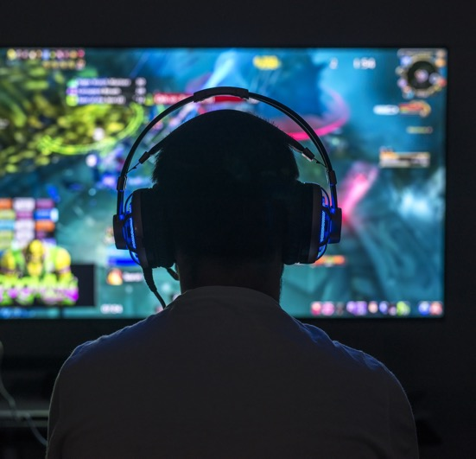

Online Content
Shielding your child from inappropriate online content is a high priority.
One way to do this is to set up filters or parental controls on devices.
You can also encourage your child to use child-friendly search engines, such as Swiggle or DuckDuckGo and discuss the importance of reporting anything that makes them uncomfortable. Younger children should stop what they are doing, close or switch off their device and then tell a trusted adult what has happened. Older children should be encouraged to report what has happened via the app or website they are on, save evidence such as screenshots and block the person or people responsible.
Even with the best filters in place, children are still likely to come across inappropriate material occasionally. Talking openly with your child about this and setting simple rules for what to do is an important way to build your child’s digital resilience.

Slide 21
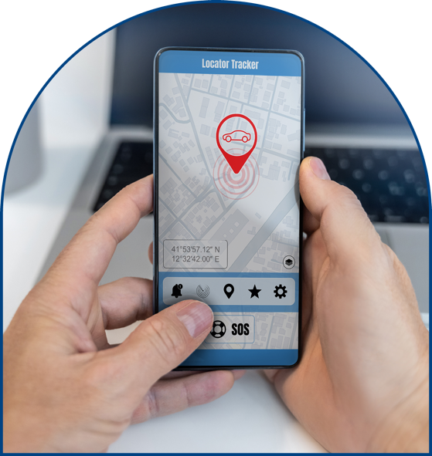
Location Sharing and Tracking
There are many apps and devices that allow us to track the location of others giving parents the peace of mind by knowing where their children are.
However, it is important that we are aware of the potential risks when tracking and sharing our locations.
Some apps and devices allow others to track a person’s location and/or store a user’s location. It is important to test tracking devices and ensure safety settings are followed when setting up an app or device.
Teach your child the importance of not sharing location details online or with people they don’t know.

Slide 22
NSPCC guidelines – Under 5’s
Advice for parents of under 5s
Supervise use - We recommend this age group only have supervised access to technology. This means that they should only be using technology when fully supported by a parent or carer.
Use family devices, accounts and services – Use child friendly devices and services like children’s tablets and child versions of popular video sites.
Check content first – Check the content on apps and games each time before use and turn off features like ‘autoplay’ so you can be in control of what is shown next.
Set up your parental controls – make use of safety settings across your home Wi-Fi, devices and accounts. You can find out more by visiting our parental controls page.
Start safety conversations - it’s important to start talking about safety online as soon as your child is using technology. Visit our Techosaurus page for age-appropriate resources.
Establish healthy habits - Make technology use purposeful from a young age by making sure it’s playing a positive role in your family. You can do this by watching and enjoying age-appropriate online videos together.
https://www.nspcc.org.uk/keeping-children-safe/online-safety/access-to-technology-for-different-ages/#under5s

Slide 23
NSPCC Guidelines – Primary Age
Advice for parents of children under 10 years old
Enable access to devices with limited features - Device usage at this age is best kept to devices with limited capability. This could include tablets without data and non-smart phones that only allow calls and texts.
Keep tech use visible in the home - Try to keep tech use in shared family spaces or used with bedroom doors open. This will allow you to support your child and be more aware of what they are doing online.
Follow age ratings – Apps, sites and games come with age ratings which are important to follow. You can find out the age rating on the website for the platform or by visiting Common Sense Media’s reviews.
Use safety settings – Explore the in-app and device safety settings with your child and check them regularly to make sure they are still in place.
Revisit parental controls – as children grow up and need the internet more for schoolwork you may want to adjust your parental controls. Keep checking these regularly to make sure they are in place.
Have regular safety conversations – at this age online safety conversations should be happening regularly. Visit our advice on talking to your child about online safety.
Build healthy habits - acknowledge the positives it brings as part of your safety conversations and agree rules and boundaries together as a family.

Slide 24
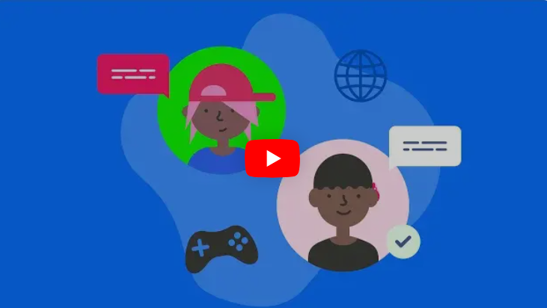
Summary – Short Video Clip
Summary

Slide 25
Useful Websites
https://www.internetmatters.org/
https://www.nspcc.org.uk/keeping-children-safe/online-safety/access-to-technology-for-different-ages/
https://www.nspcc.org.uk/keeping-children-safe/online-safety/talking-child-online-safety/
https://www.vodafone.co.uk/newscentre/smart-living/digital-parenting/digital-parenting-pro/nspcc-tips/
https://www.childline.org.uk/info-advice/bullying-abuse-safety/online-mobile-safety/staying-safe-online/?in_type=under12service
https://www.bbc.co.uk/bitesize/articles/zfmhfdm#z3hfb7h
https://www.childnet.com/parents-and-carers/
https://www.barnardos.org.uk/get-support/support-for-parents-and-carers/child-abuse-and-harm/keeping-children-safe-online/how-to-talk-children-safe-online

Slide 26






More support available at InternetMatters.org
Or on social media:
        /InternetMatters
        @IM_Org
        @InternetMattersOrg
        @InternetMatters
Notes:
If you want more information about anything we spoke about today or just want to have a look around at the online safety resources available, visit internetmatters.org or follow them on social media.
[Add any additional information or your goodbye message if relevant]

