Slide 1
Bearwood Primary School Upper Key Stage Two (UKS2) Presentation to Parents 2023/2024

Slide 2
UKS2 Staff Team
UKS2 Lead - Funmi Alder
Year 5 Red Squirrel Class Teacher – Merryn Reed
Year 5 & 6 Hedgehog Class Teacher – Jane Jackson
Year 6 Pine Marten Class Teacher – Brett Charlton
LSAs – Josie Mackenzie, Laila Fenton and Lauren Weaver

Slide 3
Our Vision…
"We aspire to be an outstanding, values based school at the heart of our diverse community.
Striving for excellence, our focus is to enable our children to be resilient and independent learners whilst also considerate of others.
Through an all-encompassing curriculum, our children will achieve their highest potential, and have a firm foundation on which to build successful and productive lives in an ever-changing world.“
Aspire ~ Succeed ~ Excel

Slide 4
High Expectations
We expect all children to attain at age-related expectations or above, unless they have genuine special learning needs.
We endeavour to ensure all children make accelerated progress from their starting points.
In addition to developing children’s academic ability, we strive to develop good character and judgement.
We teach through a mastery approach – mixed ability teaching.
Collaborative learning
Voice-21 Oracy Project
Talk and write like subject experts – widening vocabulary range

Slide 5
Attendance
Every day in school really does count. If your child misses a day, they will miss out on lots of learning, and will need to catch-up when they return.
There is a strong correlation between attendance rates and attainment.

Slide 6
Reading
In UKS2 the focus is on developing comprehension skills
Shared Reading – carefully selected texts
Accelerated Reader
English lessons
Reading across the curriculum

Slide 7
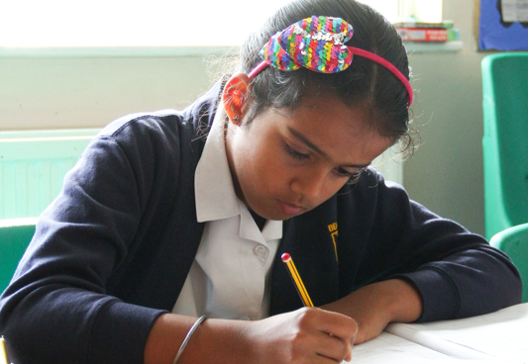
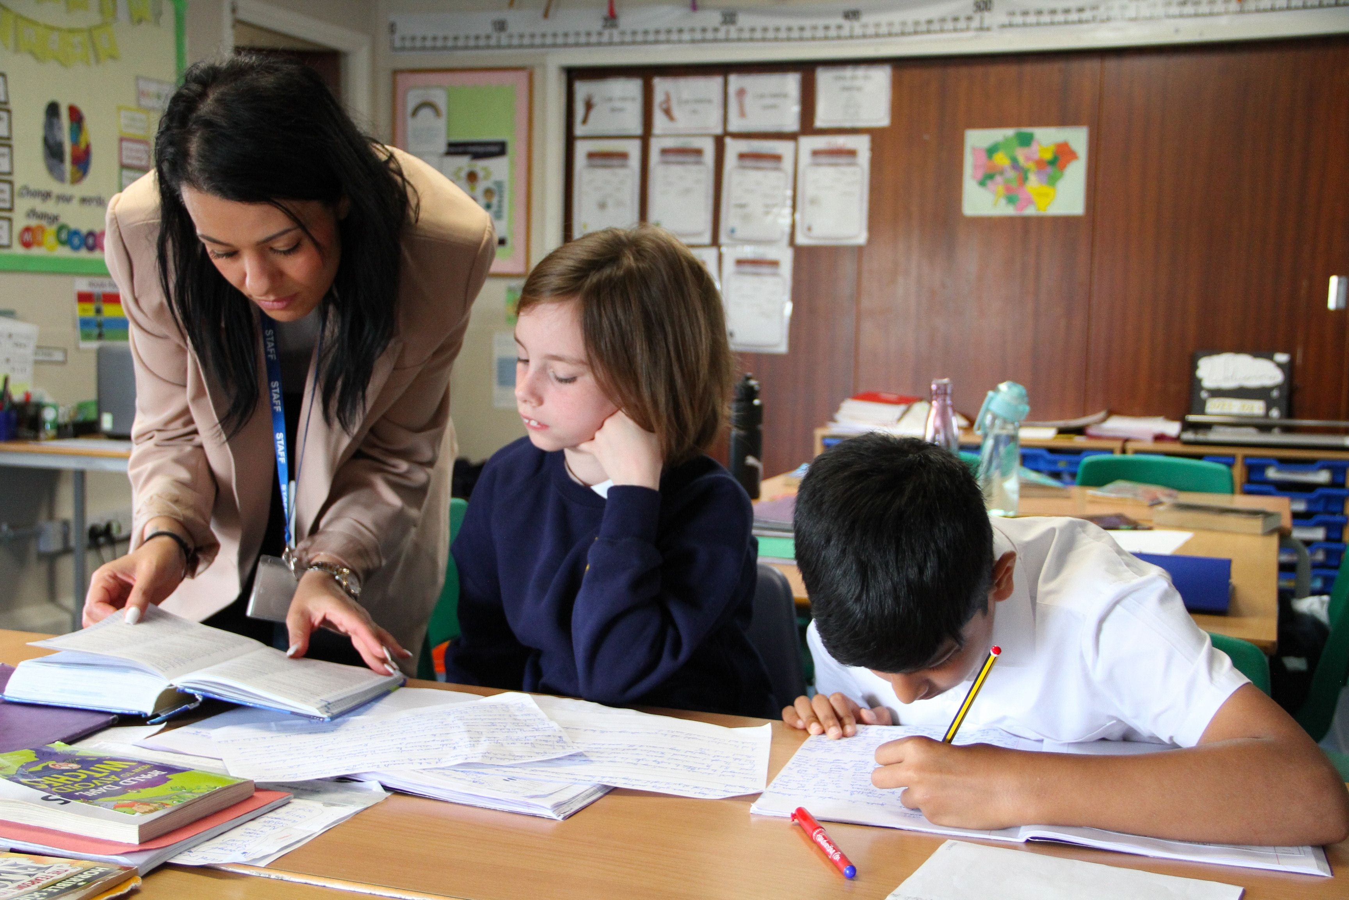
Writing
Developing writing stamina
Structure of a piece
Writing for effect: word choice and sentence structure
Use of punctuation and grammar
Spellings and spelling rules
Handwriting – cursive letter formation
English lessons and across the curriculum

Slide 8
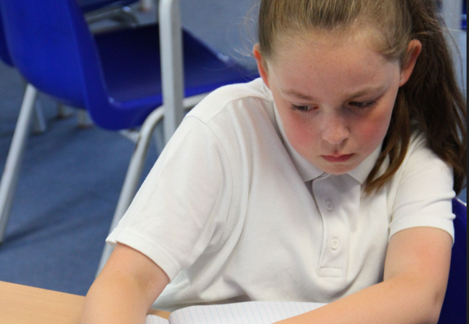
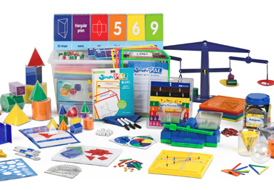
Maths
Mastery approach – White Rose Maths
Concrete > Pictorial > Abstract
Fluency
Mental maths recall
Problem solving and reasoning​

Slide 9
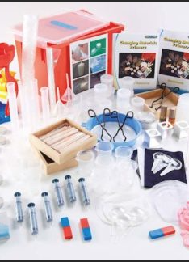
Science
Forces
Earth and space
Properties and changes of materials
Living things and their habitats
Investigation
Animals – including humans
Most science lessons involve carrying out experiments in collaborative groups.

Slide 10
Computing
Online safety
Databases
Spreadsheets
Coding
Concept maps
Game creator
3D modelling

Slide 11
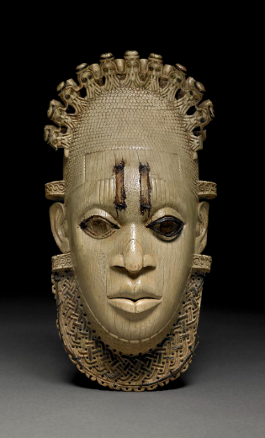
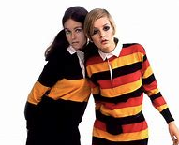
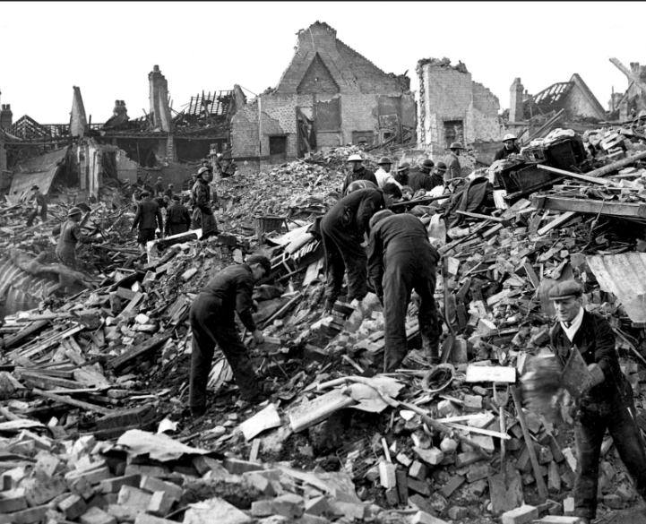
History
Benin – An African Kingdom
Britain at War – World War Two
Change in Post-War Britain
Children will develop research skills; extract information from texts and historical sources; questioning; draw links between different places and eras; presenting and writing like a historian.

Slide 12
Geography
Our World – physical geography
Canada and the UK
Volcanoes and earthquakes
Children will develop investigative skills; extracting information from texts; effectively using geographical materials; questioning; presenting; and writing like a geographer.

Slide 13
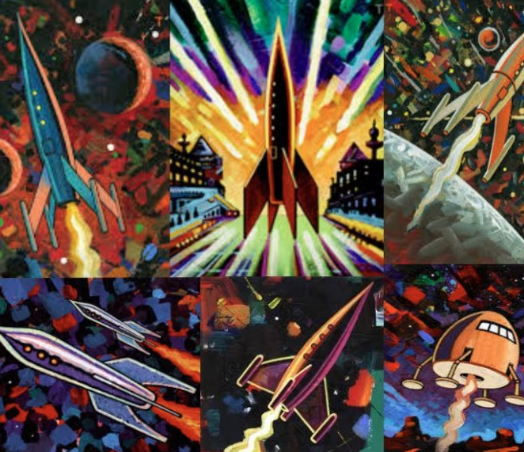
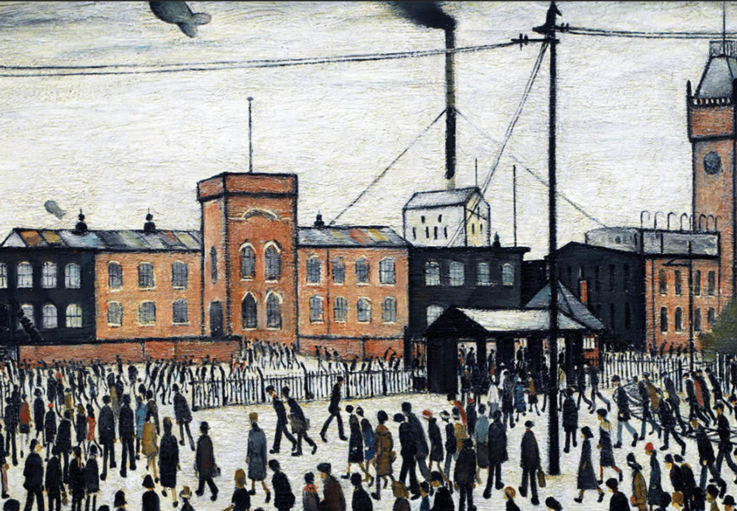
Art
Abstract art – Peter Thorpe
Line drawings – Lowry
Collage – Matisse
Children will further develop their mastery of art and design techniques.

Slide 14
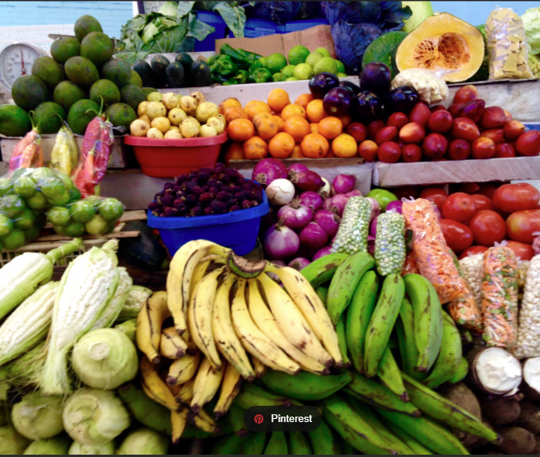
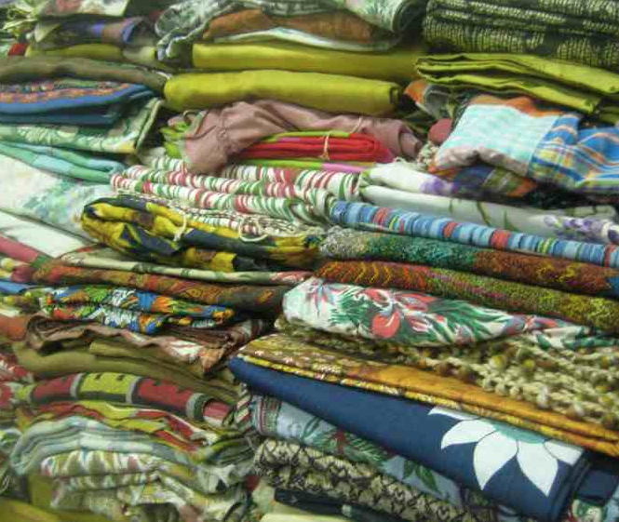
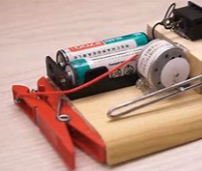
Design Technology
Textiles – creating an advent calendar
Electrical systems – making an alarm
Food – Caribbean vegetable soup
For each project, children will develop their ability to design, make and evaluate.

Slide 15
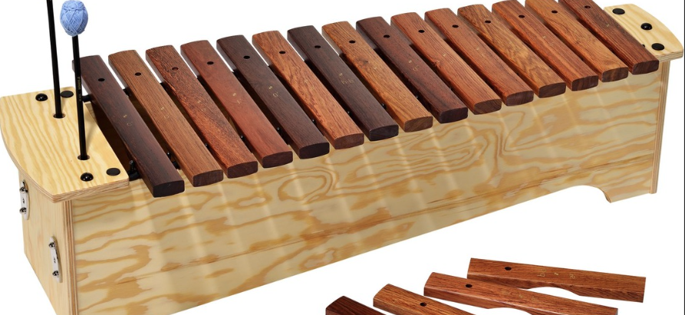
Music
Getting started with music technology
Exploring key and time signatures
Identifying important musical elements
Introducing chords
Learn to play the ukulele
Year Six production
Outdoor Music Festival performance

Slide 16
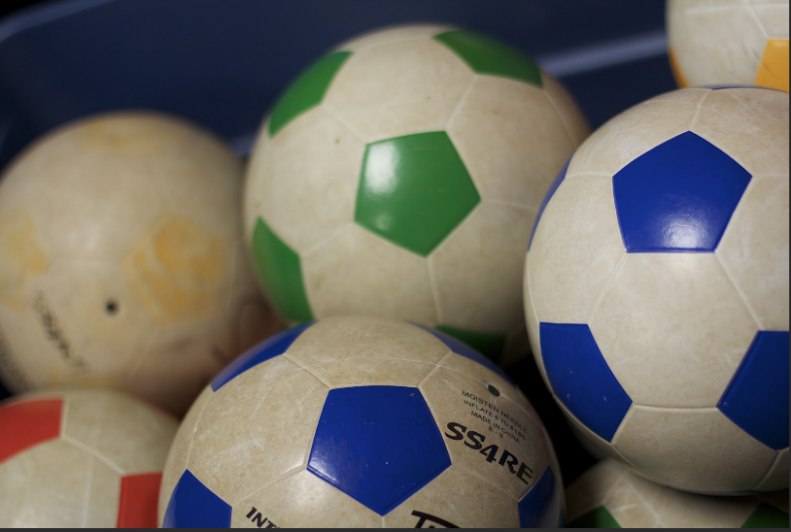
PE (Physical Education)
Games skills
Gymnastics
Dance
Athletics
Swimming
If your child is in Year Five and you have received an email notifying you that your child is on the list to attend swimming lessons, please let us know if your child can already swim 25 metres.
Class | PE Days
Red Squirrel | Tuesdays and Thursdays
Hedgehog | Mondays and Thursdays
Pine Marten | Tuesdays and Thursdays

Slide 17
RE (Religious Education)
Throughout primary education, most lessons are focused on Christianity. Each primary school year also focuses on another major world religion. This year, the additional religion UKS2 will be focusing on is Sikhism.
What is the best way for a Christian to show commitment to God?
Is the Christmas Story true?
How significant is it for Christians to believe God intended Jesus to die?
How far would a Sikh go for his/her religion?
Are Sikh stories important today?
What is the best way for a Sikh to show commitment to God?

Slide 18
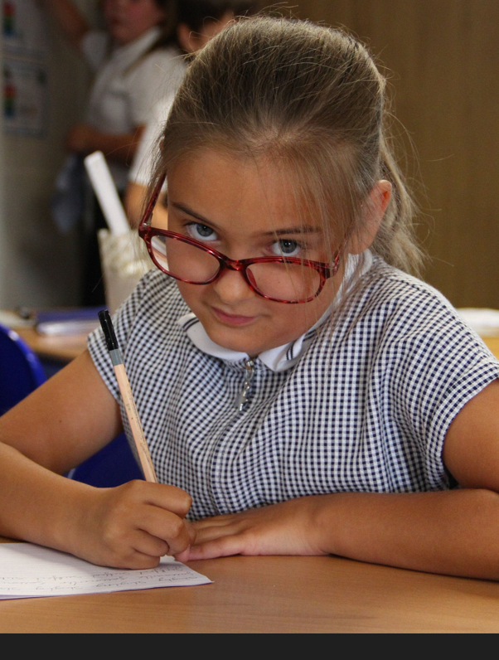
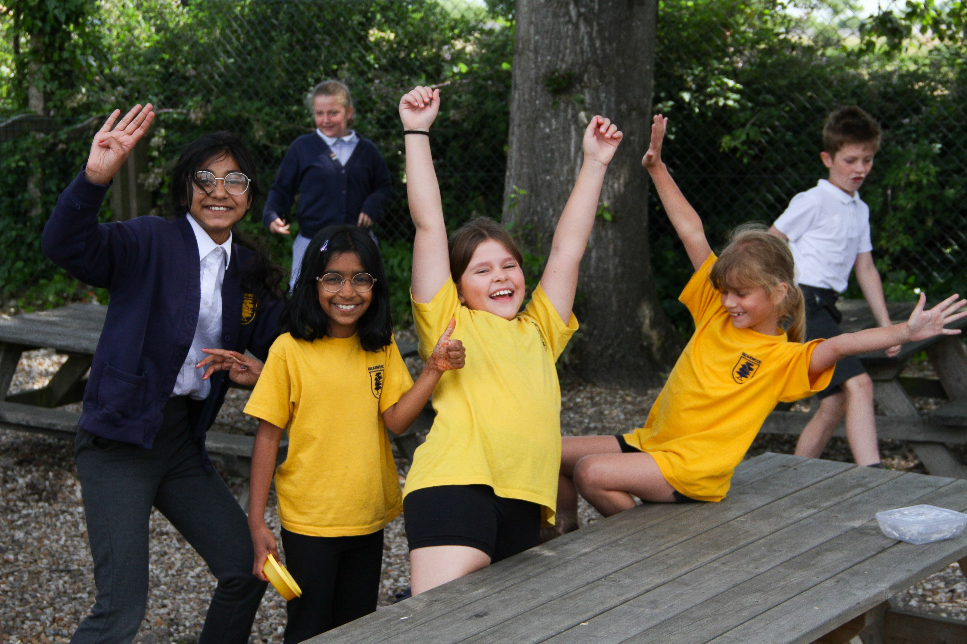
PSHE
Respect and bullying
Mental wellbeing
Staying safe
Substances
Keeping active
Careers
Relationships and Sex Education (RSE):
Year Five – Growing and changing
Year Six – Puberty and reproduction
Our RSE Policy is on the school website. Before we teach the RSE units, we will invite parents to come to a meeting where we will share what we will cover and the resources we will use with the children.

Slide 19
Latin
Latin is being introduced this year.
Teachers enjoyed a really engaging and inspiring professional development session on Latin.
Latin supports the development of spelling, grammar and vocabulary.
Research shows children who are less able experience the greatest gains in Latin.

Slide 20
Homework
Children should:
Read every day for 20 minutes. They should record the books they are reading in their home/school reading book.
Complete the set Spelling Shed activities 3 times a week. These include spelling and grammar exercises.
Complete set tasks on either Mathletics or Times Tables Rock Stars 3 times a week.
Your child will have their logon details for the learning platforms.
Each half-term, we will also email to you a range of additional homework tasks your child can complete. We will send home an exercise book for the homework to be completed in.

Slide 21
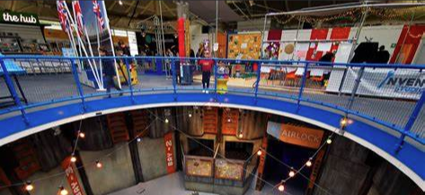
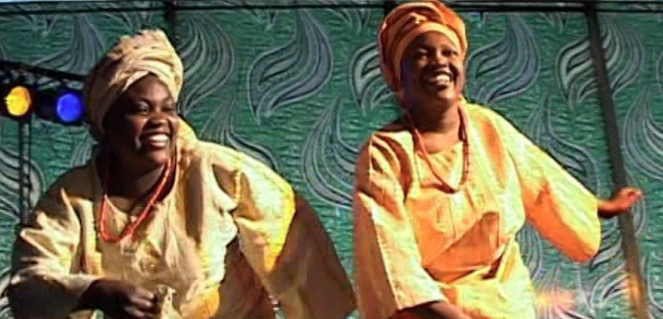
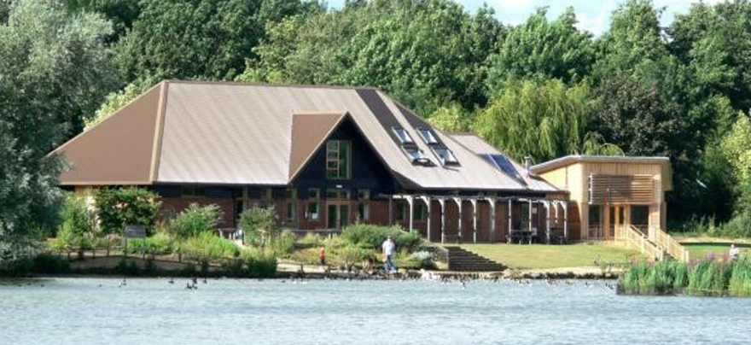
Enrichment
Osun Arts Foundation workshop
Winchester Science Centre and Planetarium
For WWII – either a museum trip or workshop
The Nature Discovery Centre
Big Foot Arts – Windrush visitor
Year Six – residential to Osmington Bay

Slide 22
Additional Information
Remember to send your child into school with a water bottle each day.
Children in KS2 can bring in fruit or a piece of vegetable for a morning breaktime snack.
Children should not bring in lip balms, hand gels or hand creams etc unless they have been approved via the office.
Jewellery and valuable belongings should not be worn or brought to school. If your child has pierced ears, they can wear one stud earring in each ear. Earrings must be removed or have micropore tape over them for PE lessons. Only analogue watches can be worn.
Make-up of any kind is not permitted.
If your child is not wearing the correct school uniform, they will receive a reminder slip.
If you want your child to go home alone, please complete the required form.
UKS2 children travelling to or from school alone may bring in a mobile phone. The phone will be collected as soon as they arrive into their classroom, and will be handed back at home time.

Slide 23
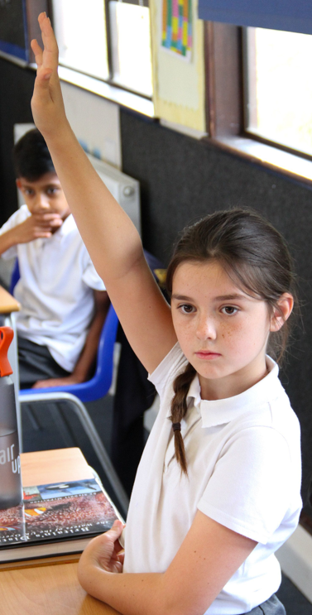
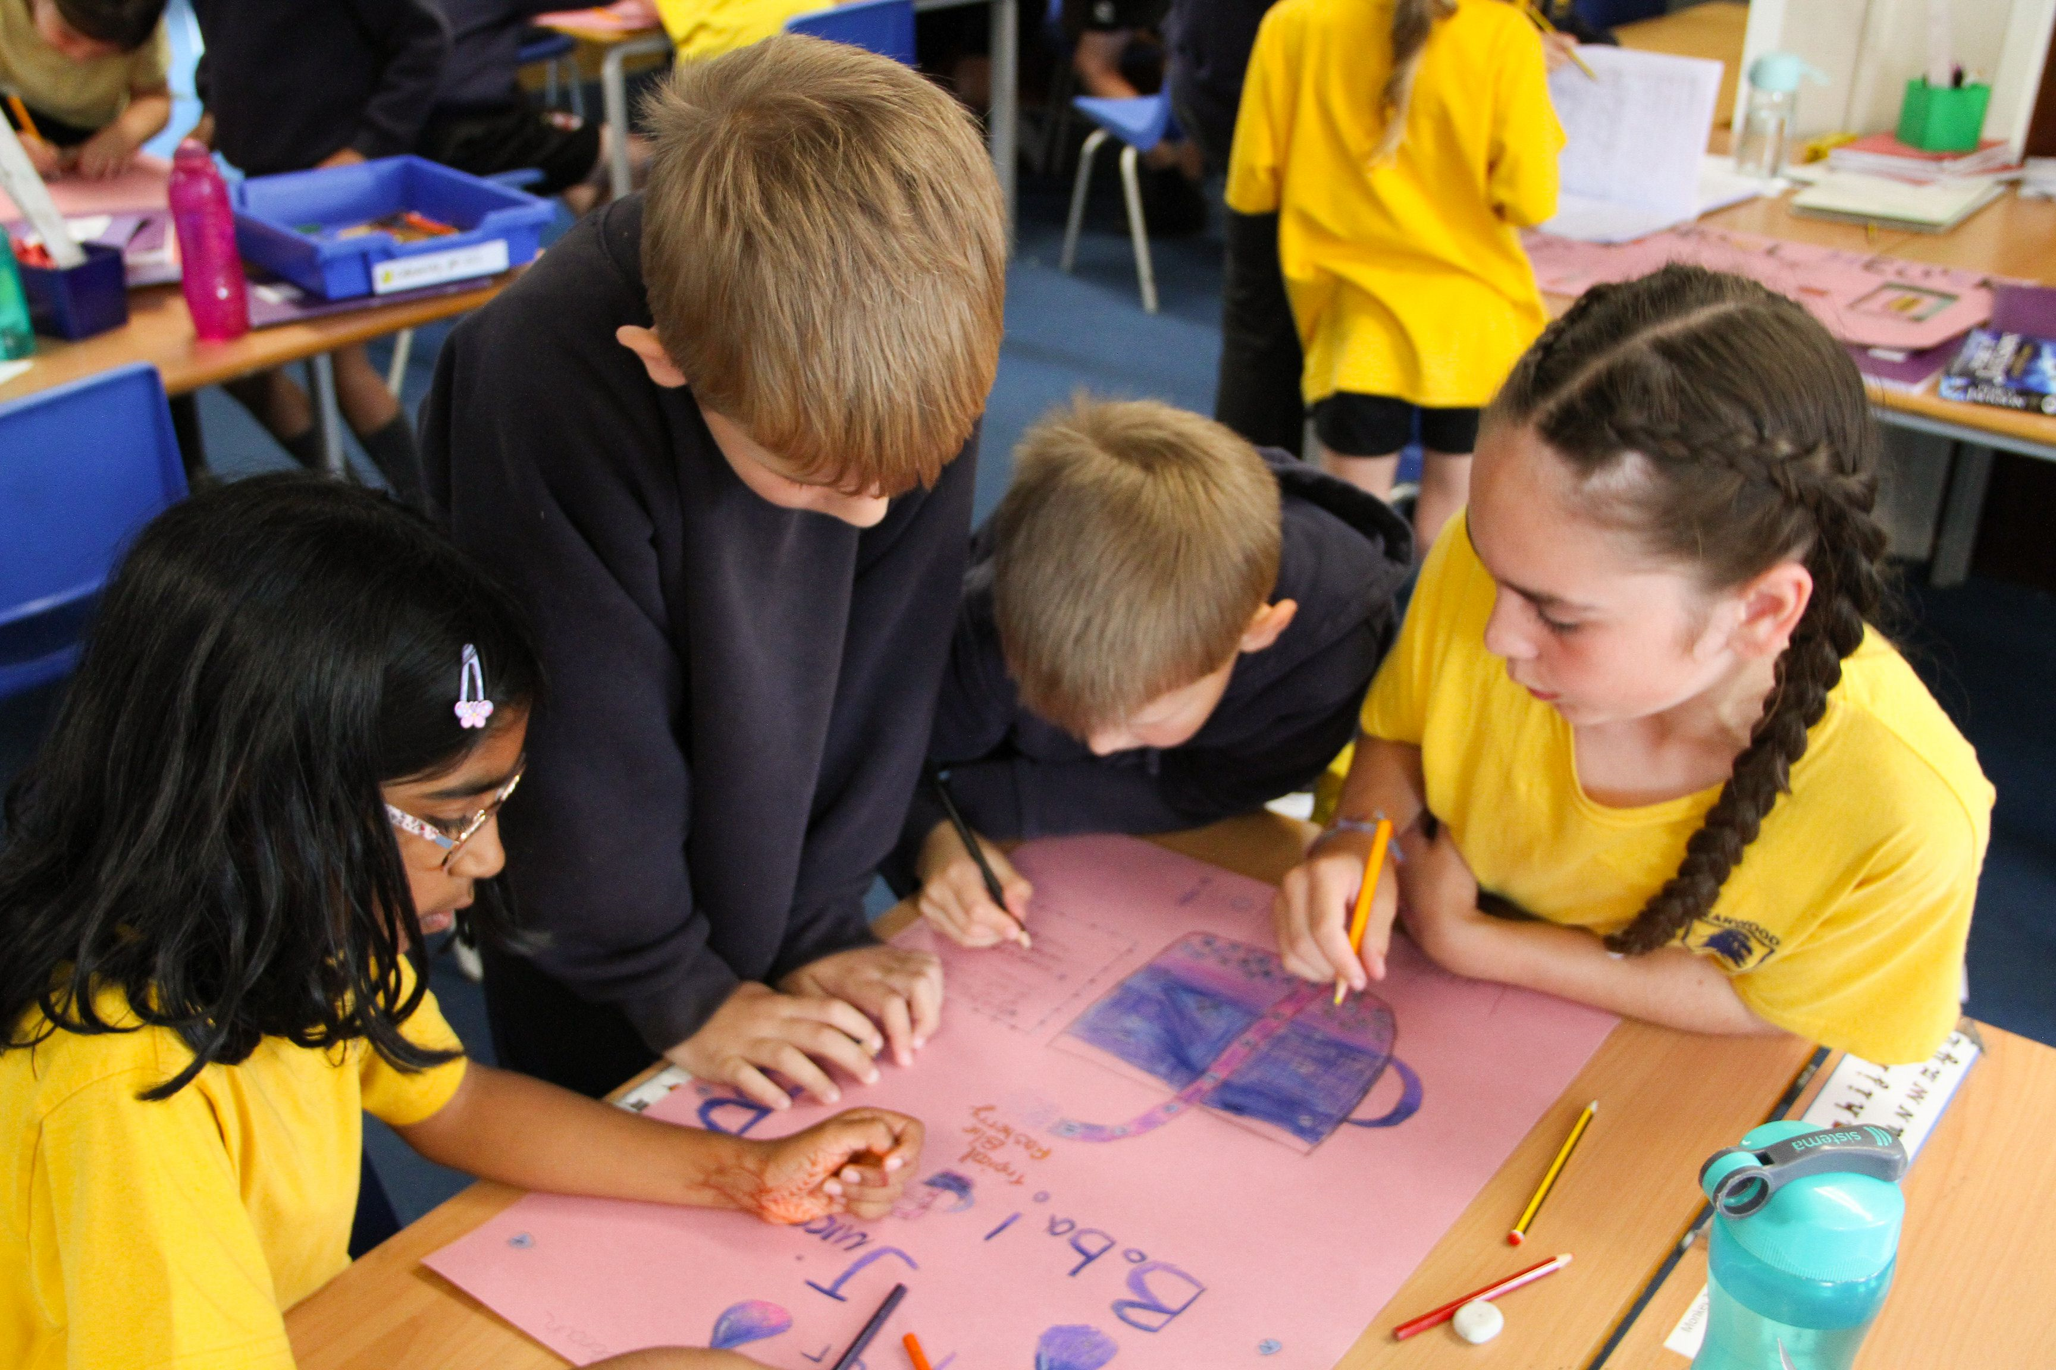
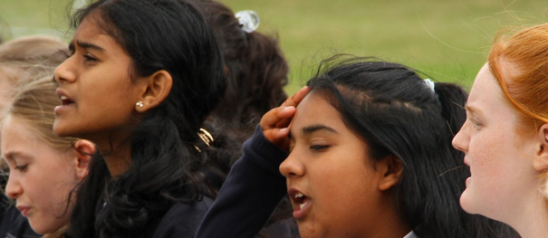
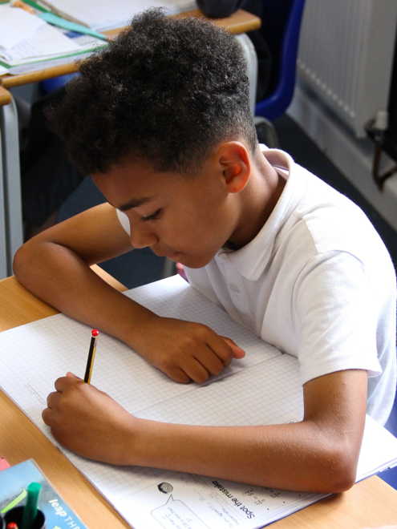
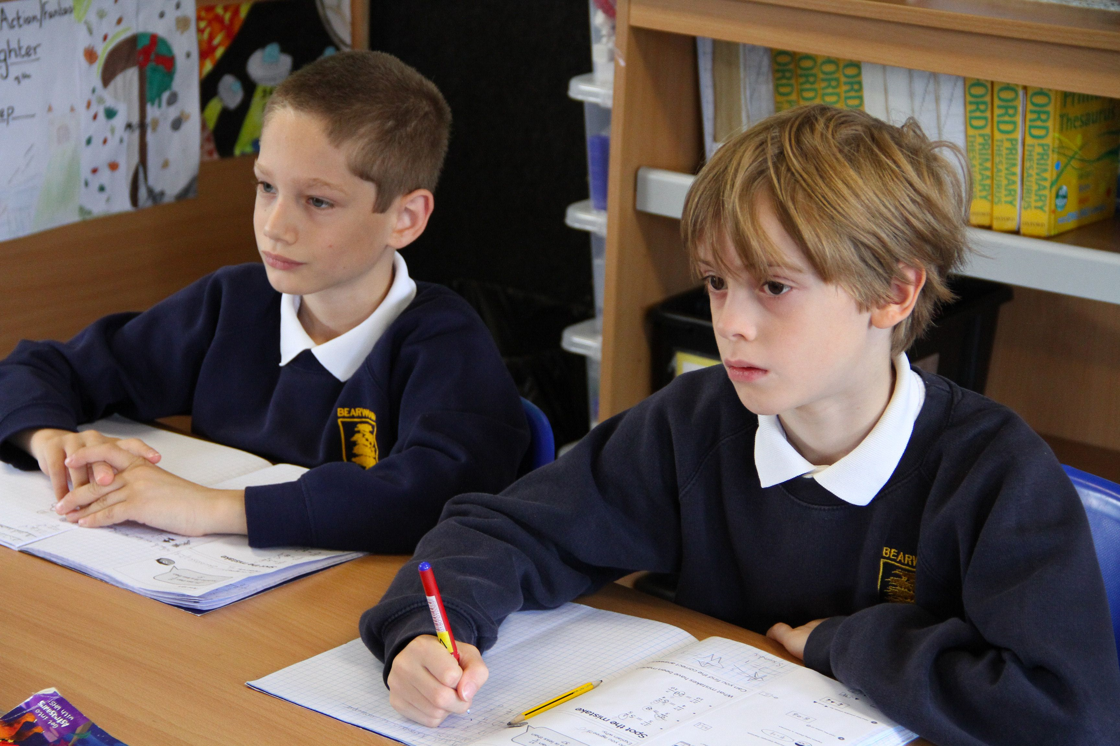
We aspire to be…
OUTSTANDING
We will strive to ensure every child is at age-related+
All of the UKS2 team are looking forward to a productive and fun filled year with your children. ☺

