Slide 1
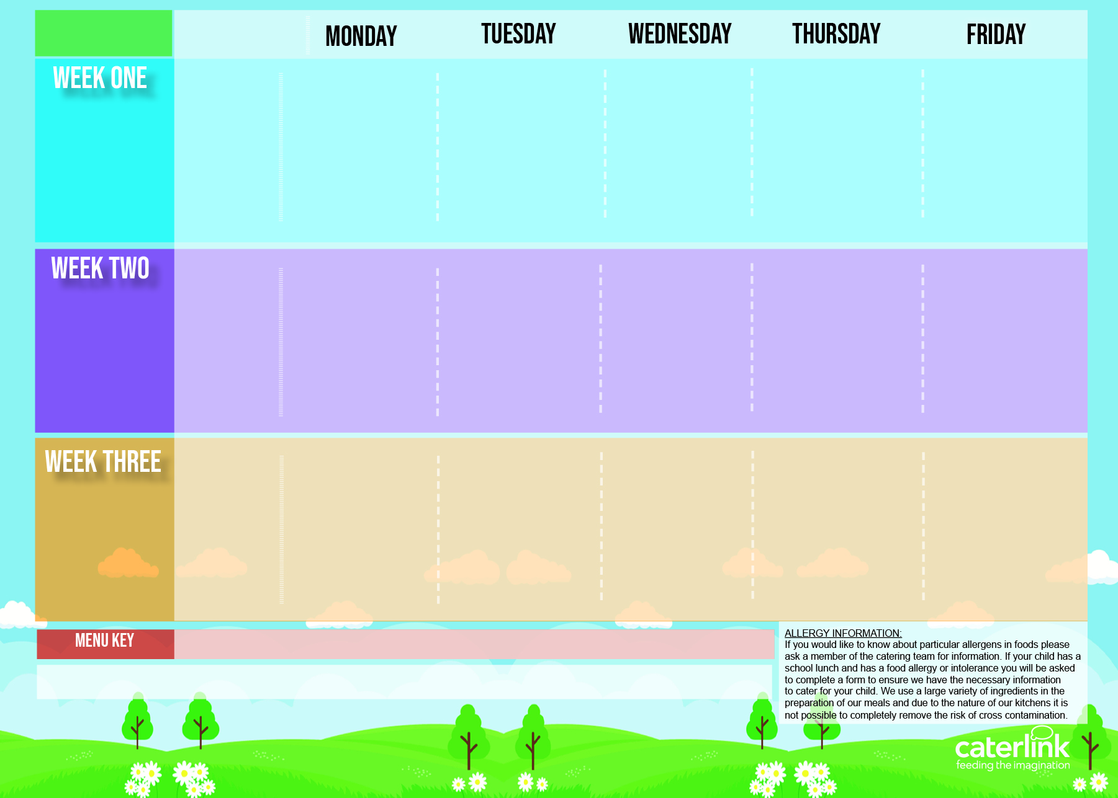
Central Autumn Winter Menu 2024 2025
NEW Tomato & Vegetable Pasta | Cottage Pie with Gravy | Peri Peri or BBQ Chicken or Quorn with Diced Seasoned Potatoes & Sweetcorn Salsa | Meatballs in Tomato Sauce with Rice | Fishfingers with Chips & Tomato Sauce
Mexican Fajitas with Rice | NEW Creamy Chickpea and Coconut Curry with Rice |  | NEW Cheese and Broccoli Pasta with Garlic Bread | Mexican Bean Roll with Chips & Tomato Sauce
Vegetables of the Day | Vegetables of the Day | Vegetables of the Day | Vegetables of the Day | Vegetables of the Day
Blackberry and Apple Crumble with Custard | Melting Moment Biscuit | Fruit Platter | Carrot and Courgette Cake | Chocolate Orange Cookie
04.11.2024
25.11.2024
16.12.2024
20.01.2025
10.02.2025
10.03.2025
31.03.2025
Classic Cheese and Tomato Pizza Or Rainbow Pizza With Potato Wedges | NEW Chicken Pasta Bake with Garlic Bread | Sausage and Mash with Gravy | Chicken Tikka Masala with Rice | Fishfingers with Chips & Tomato Sauce
 | Chinese Vegetable Curry with Rice | Vegan Sausage and Mash with Gravy | NEW Mild Mexican Chilli with Rice | Cheese and Tomato Quiche with Chips & Tomato Sauce
Vegetables of the Day | Vegetables of the Day | Vegetables of the Day | Vegetables of the Day | Vegetables of the Day
Marble Sponge Cake with Custard | Jelly with Mandarins | Fruit Medley | Peach Cake | Oaty Cookie
11.11.2024
02.12.2024
06.01.2025
27.01.2025
24.02.2025
17.03.2025
Macaroni Cheese | NEW Mild Caribbean Chicken with Rice and Peas NEW Caribbean Butterbean Stew with Rice and Peas | Roast Chicken with Stuffing, Roast Potatoes and Gravy | Spaghetti Bolognaise | Fishfingers with Chips & Tomato Sauce
Plant Balls in Tomato Sauce with Rice |  | Cottage Pie with Gravy | NEW Hot Pot Baked Bean Casserole with Rice | Cheese and Pepper Omelette with Chips & Tomato Sauce
Vegetables of the Day | Vegetables of the Day | Vegetables of the Day | Vegetables of the Day | Vegetables of the Day
Chocolate and Beetroot Brownie | Sticky Toffee Apple Crumble with Custard | Fruit Salad | NEW Savoury Cheese Scone | Vanilla Shortbread
18.11.2024
09.12.2024
13.01.2025
03.02.2025
03.03.2025
24.03.2025
Added Plant Power
Wholemeal
Vegan
Available Daily: Fresh Bread – Salad Selection – Fresh Fruit and Yoghurt

