Slide 1
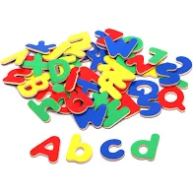
Bearwood Primary School Early Years Foundation Stage Phonics Workshop October 2024

Slide 2
Why do we teach phonics?
We use phonics as the building blocks for teaching reading and writing.
It helps children hear, identify and use different sounds that distinguish one word from another in the English language.

Slide 3
Phonics Schemes
At Bearwood, we follow Lesley Clarke’s Letters & Sounds Programme. The intention is to equip children with the phonic knowledge they need to become fluent readers by the age of 7.

Slide 4
Terminology
Phoneme - the smallest unit of sound in speech
Grapheme – one or more letters representing a phoneme
Segmenting – identifying the individual phonemes in a word
Blending – identifying the word made by a string of phonemes
Digraph – two letters which make one phoneme
Trigraph - three letters which make one phoneme
CVC word - Consonant Vowel Consonant eg: cat
Tricky words (common exception words) – words that cannot be sounded eg: the, go, come
High frequency words – words that appear often but can be sounded eg: and, his,
GPC –Grapheme Phoneme Correspondence- writing

Slide 5
Phase 1 Delivered in our Nursery
Environmental Sounds
Instrumental Sounds
Body Percussion
Rhythm and rhyme
Alliteration
Voice sounds
Oral blending and segmenting.

Slide 6
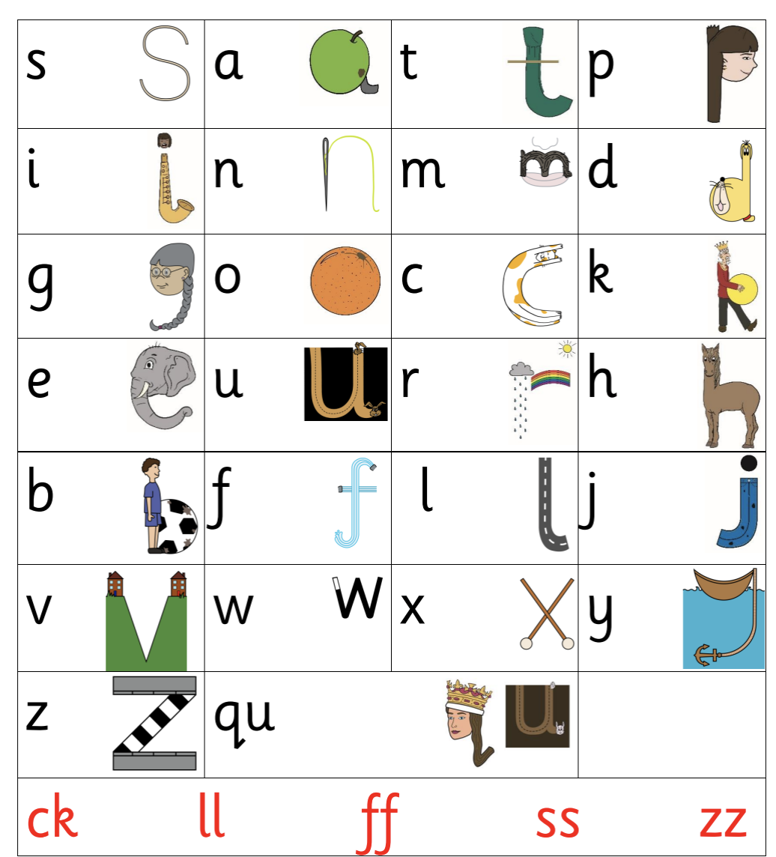
Phase 2 Autumn Term in Reception
Introduces grapheme /phoneme (letter/sound) correspondence GPC. Children learn a small selection of common consonants and vowels each week and begin to put them together to read and spell CVC words and simple sentences using only the GPC and tricky words they have learned.
Set 1: s, a, t, p
Set 2: i, n, m, d
Set 3: g, o, c, k
Set 4: ck, e, u, r
Set 5: h, b, f, ff, l, ll, ss
Tricky words: I, no, to, go, the, into,

Slide 7
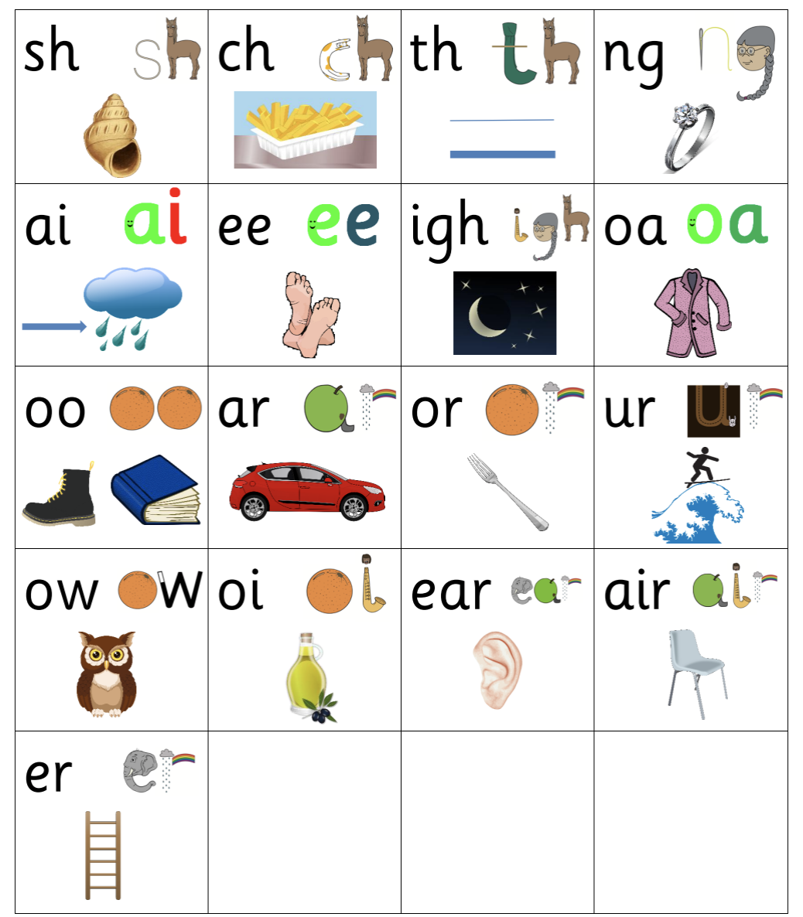
Phase 3 Autumn and Spring Term in Reception
Begins to teach digraphs and trigraphs to help children understand the English reading code. Continue to read and spell words and sentences using the GPC and tricky words they have learned so far.
Set 6: j, v, w, x
Set 7: y, z, zz, qu
Consonant digraphs: ch, sh, th, ng
Vowel digraphs: ai, ee, igh, oa, oo, ar, or, ur, ow, oi, ear, air, ure, er
Tricky words: he, she, me, we, be, was, you, they, all, are her, my,

Slide 8
Phase 4 Summer Term in Reception
This phase consolidates all the children have learnt in the previous phases, including words containing adjacent consonants eg. stamp, and polysyllabic words eg. shampoo, and continue to apply all their phonic knowledge to read and spell to write.
Tricky words: said, have, like, so, do, some, come, were, there, little, one, when, out, what,

Slide 9
Phase 5 year 1
Children will be taught new digraphs and alternatives to those they have already learned. E.g. ay is alternative digraph to ai.
Vowel digraphs:, ay, ou, ie, ea, oy, ir, ue, aw, ew, oe, au,
Consonant digraphs: wh, ph, kn, gn,
Split digraphs: a_e, e_e, i_e, o_e, u_e
Tricky words: oh, their, people, Mr, Mrs, looked, called, asked, could

Slide 10
Phase 6
The focus is on learning spelling rules for suffixes to develop their skills and automaticity, creating an increasing capacity for reading complex words and reading for meaning.
-s -es -ing -ed
-er -est -y -en
-ful -ly -ment -ness
Homophones: there, their, they’re, here, hear, where, wear

Slide 11
Pure sounds and letter names
In phonics it is important that we teach children the pure sound that the letter is making. As adults we often add a 'schwa' onto the end of the letter
Mmmmm rather than muh
https://www.youtube.com/watch?v=UCI2mu7URBc
We teach letter names and capital letters later on in phonics but these are not concentrated on too heavily. Reading with letter names is impossible, reading with exaggerated phonics sounds (adding the uh) is also very tricky. This is why we use pure sounds to help children understand the reading code quicker.

Slide 12
Blending
Building words from phonemes to read.
c a t
cat

Slide 13
Blending
Qu ee n
queen

Slide 14
Segmenting
Breaking down words for spelling.
cat
c a t

Slide 15
Segmenting
Queen
qu ee n

Slide 16
What does a phonics lesson look like?

Slide 17
Reading with your child In a moment your child will be joining us in the hall to read with you. This slide will remain here for your support.
What to do if your child gets stuck and doesn't seem to know the sound?
Give them some time... then tell it to them and carry on with their blending.
Warm up the text
Sounds and tricky words for book (if page is present)
Child begins reading- adult gives sufficient time for independent sounding
Adult models blending
Adds additional information for comprehension
Re read sentence together
Stop when child is losing interest or finding it tricky
Answer comprehension questions if book is finished

Slide 18
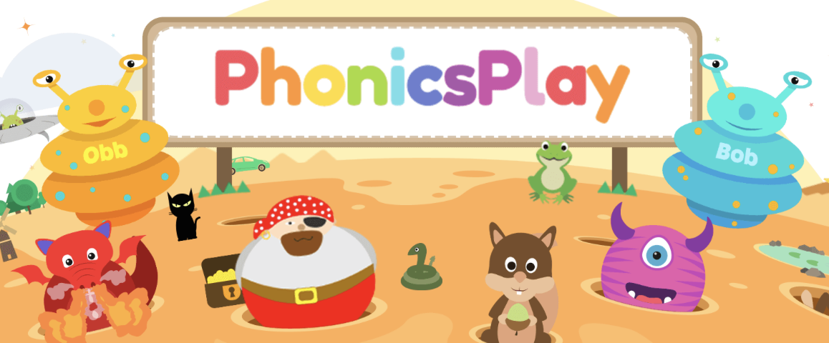
Resources and more information
Sound card for each phase.
The fully decodable reading books that the children read with you at home. This is how they practise and apply their phonics knowledge. Research and Government guidance states that children should re-read their books to develop fluency.
www.phonicsplay.co.uk
www.lesleyclarkesyntheticphonics.co.uk

Slide 19
Any questions?

