Slide 1

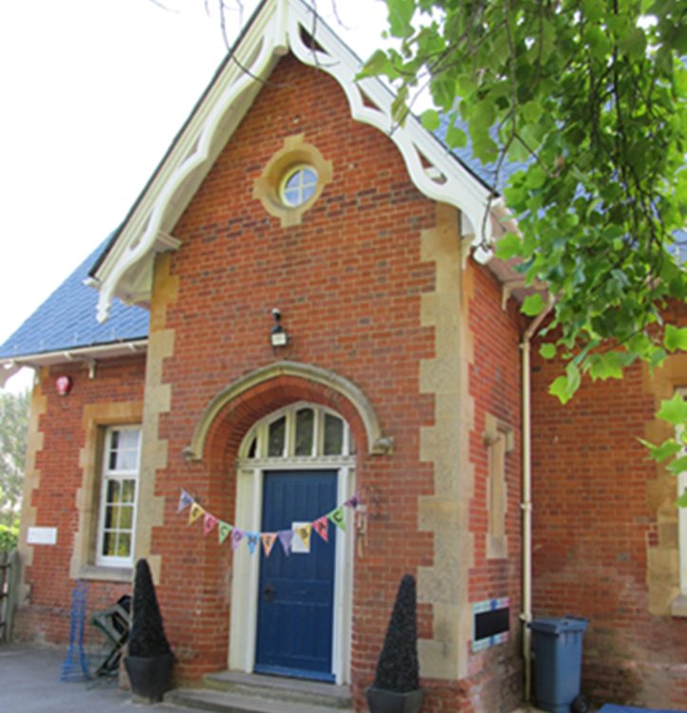
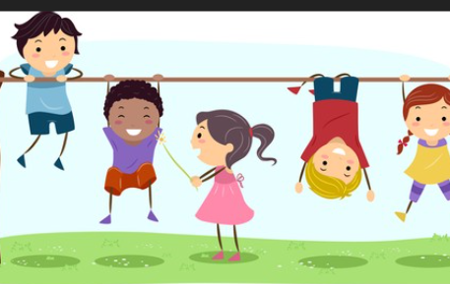
Bearwood Primary School Early Years Foundation Stage Welcome to Nursery and Reception September 16th 2025

Slide 2
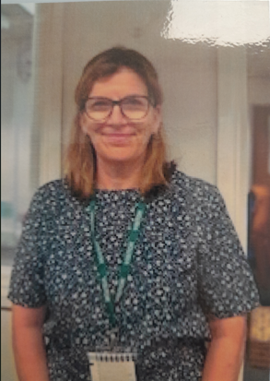
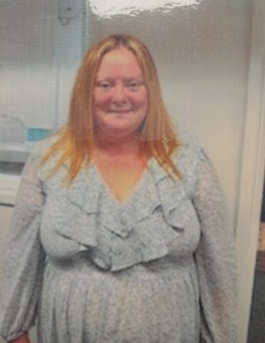
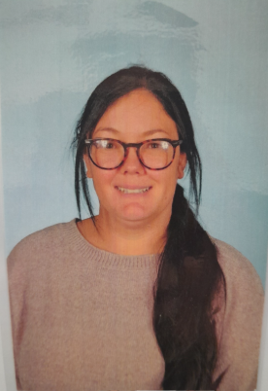
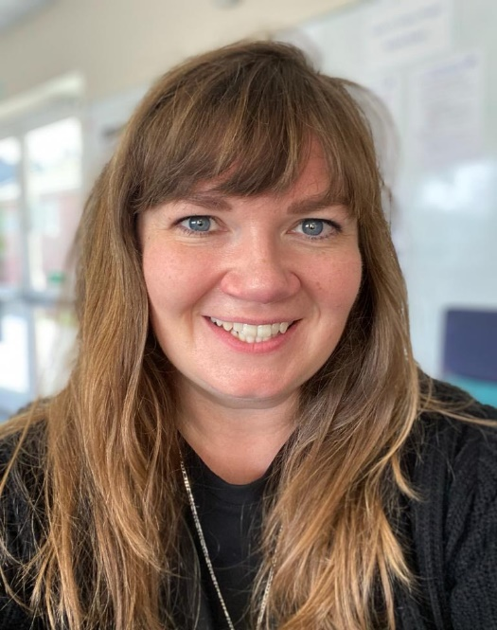
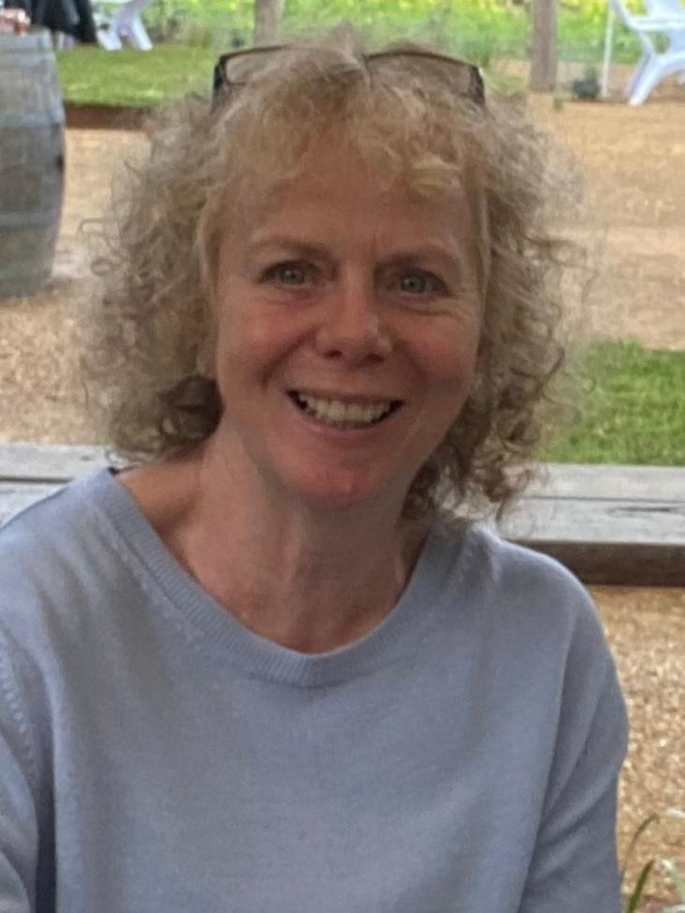
Foundation Stage TEAM
Mrs Stacey
Nursery teacher
Ms Mckehon
Reception teacher
Mrs Brooker
LSA
Mrs Barker
LSA
Mrs White
Nursery Nurse

Slide 3
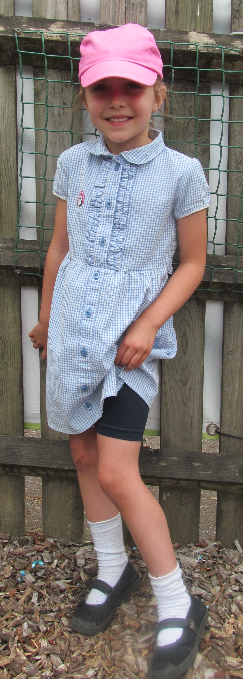
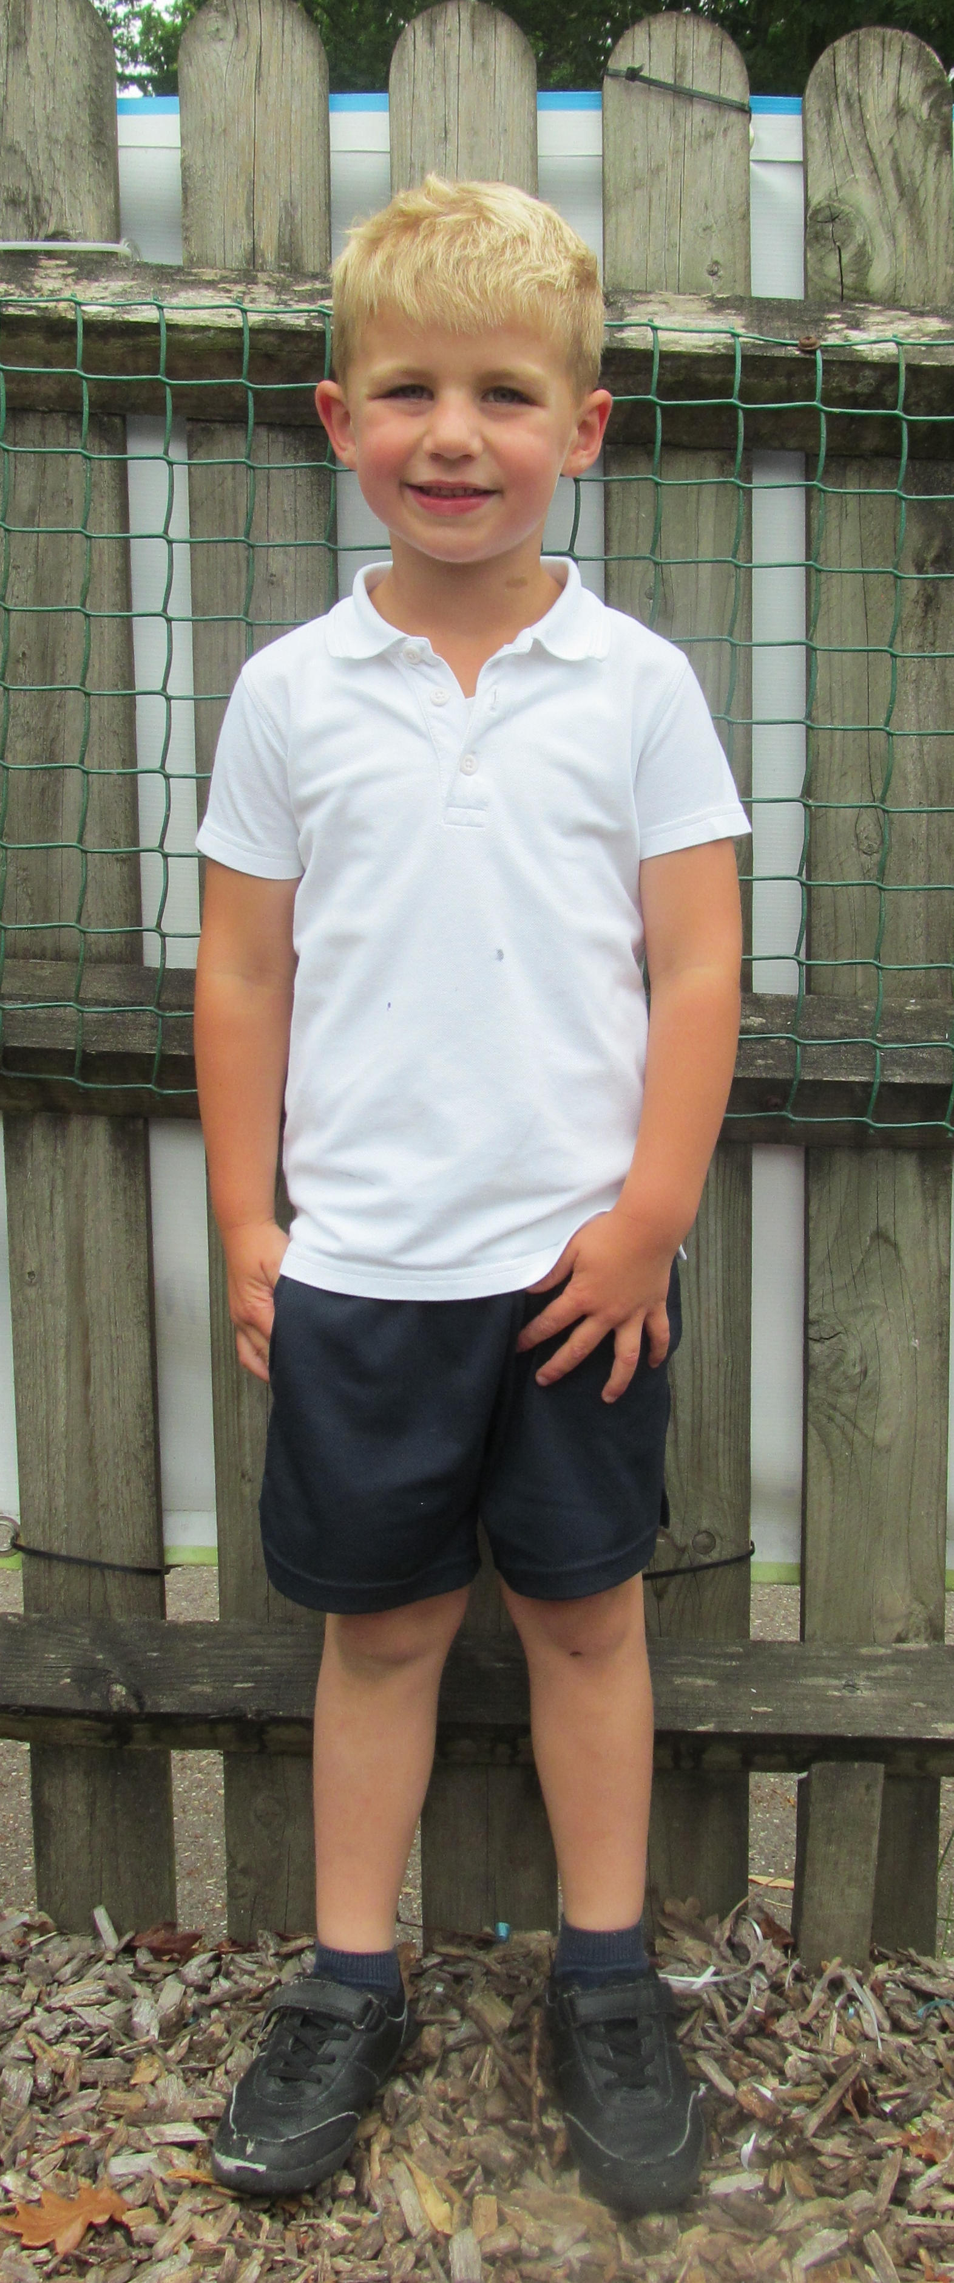
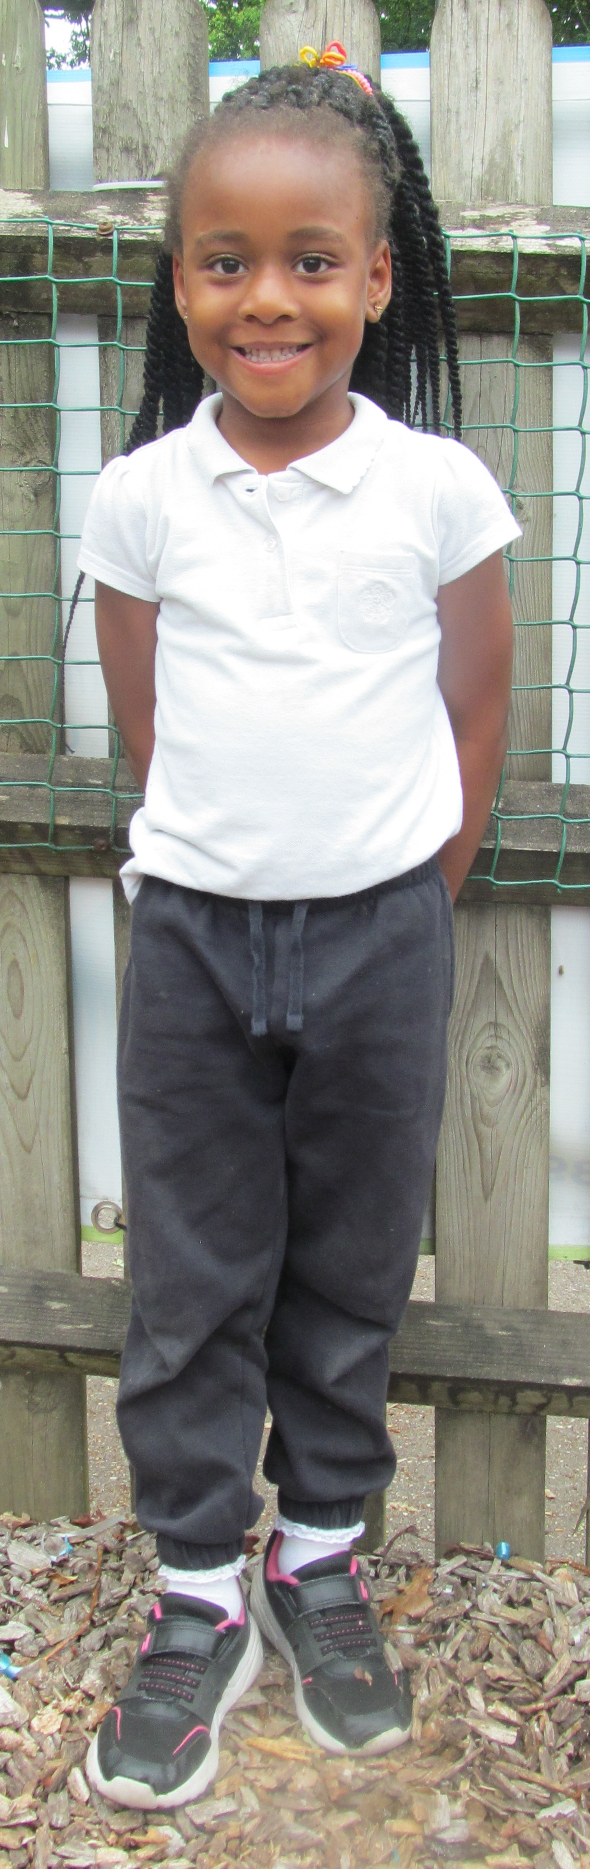
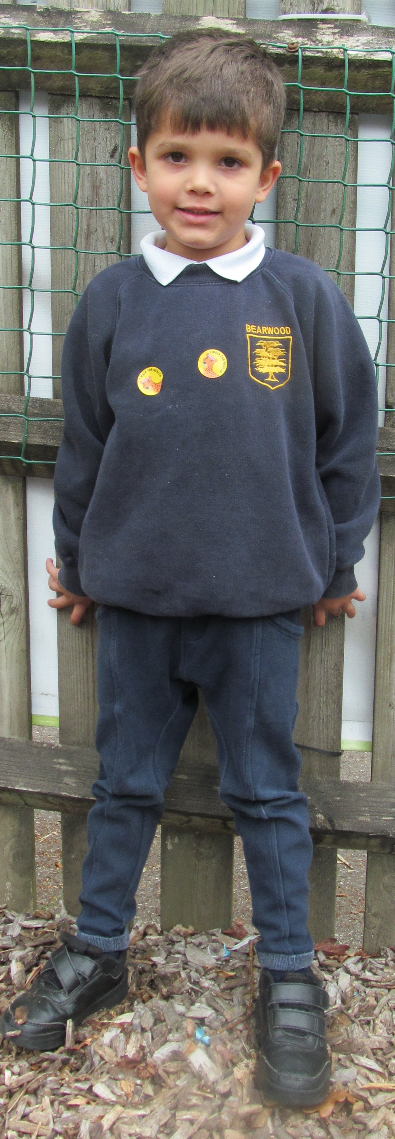
Uniform
Please label EVERYTHING!
Our EYFS uniform is slightly different to the rest of the school because our curriculum is much more active and based outside in all weathers.
Navy jumper or cardigan with school logo
White polo shirt
Black or navy shorts or jogging bottoms
Black trainers
Girls may choose to wear a blue gingham summer dress with cycle shorts in summer
No jewellery please.
Please label EVERYTHING!

Slide 4


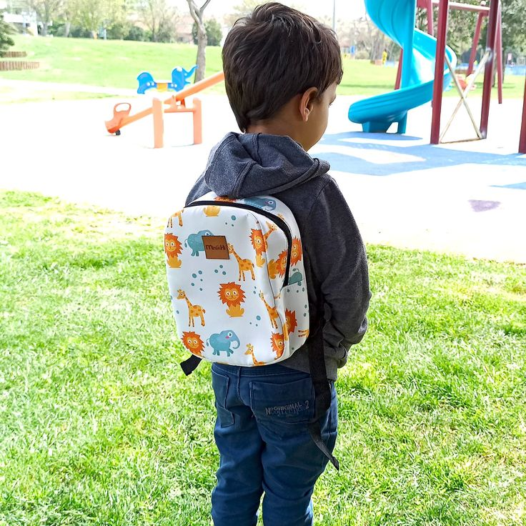

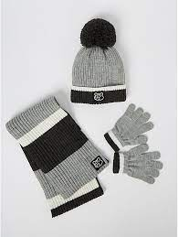


What does my child need to bring?
Please label EVERYTHING!
A water bottle filled with water (no squash or flavoured drinks please!)
A book bag (navy blue only)
A small backpack or tote bag with a full set of spare clothes.
A named coat
Weather appropriate extras (sun hat, woolly hat, gloves etc.)
Wellies and puddle suit to stay in school .
Spare clothes, these can stay in school.
Please label EVERYTHING!

Slide 5

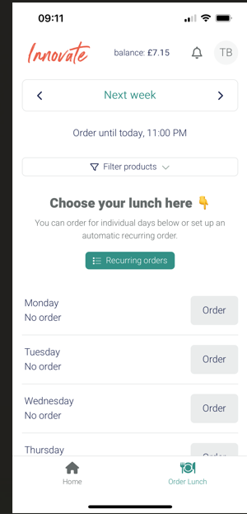
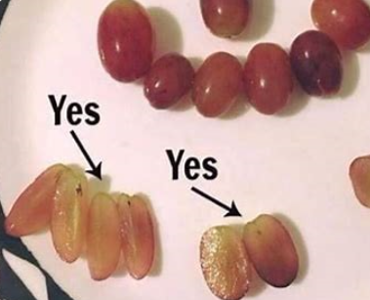
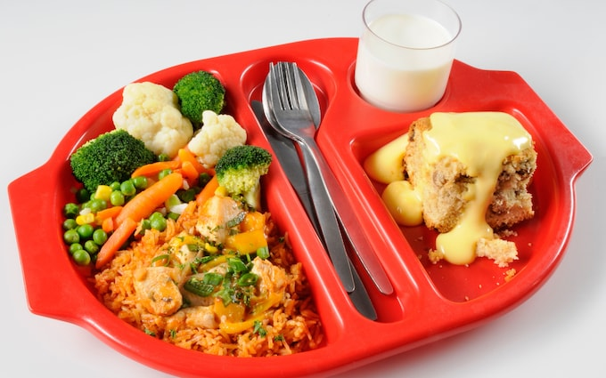

Lunch time
PACKED LUNCHES
We are a healthy school, please help promote this by sending your child with a healthy packed lunch. Children are not allowed sweets, chocolate, fizzy drinks, however they can bring a juice, smoothie or diluted juice to have with their lunch.
Please cut up (long ways) grapes, small tomatoes, olives and blueberries to reduce any risk from choking.
We are a nut aware school. Please ensure there are no nuts or nut products such as peanut butter and chocolate hazelnut spread in your child's lunch box. There are children in the school allergies
SCHOOL DINNERS
Meals are ordered via an app called Impact Food Group and all meals for the coming week must be ordered by 11pm on the Sunday before. Please see a member of staff if you need any support ordering.

Slide 6


Attendance and timings
Research has shown that there is a strong link between attendance and achievement, therefore we work in partnership with parents/carers to ensure that every child has the opportunity to meet their full potential.
School starts at 8.45am
The EYFS garden gate opens at 8.35am and closes promptly at 8.50am
If your child attends morning Nursery at pick up time the gate will open at 11.40am and will close at 11.50am.
Please try and keep to these times, however if you are late, please drop off/collect via the school office.
The gate will open at the end of the day at 3.15pm, we know that it can take a little time to dismiss the children, and we appreciate both your understanding and patience at this time.
Please let staff know if someone other than yourself will be collecting your child. If they are unknown to staff, you will need to supply a password to office prior to collection.
If your child is ill, please School Office on 0118 978 4628. If your child has sickness and/or diarrhoea they should be kept at home for 48 hours after the last bout.

Slide 7

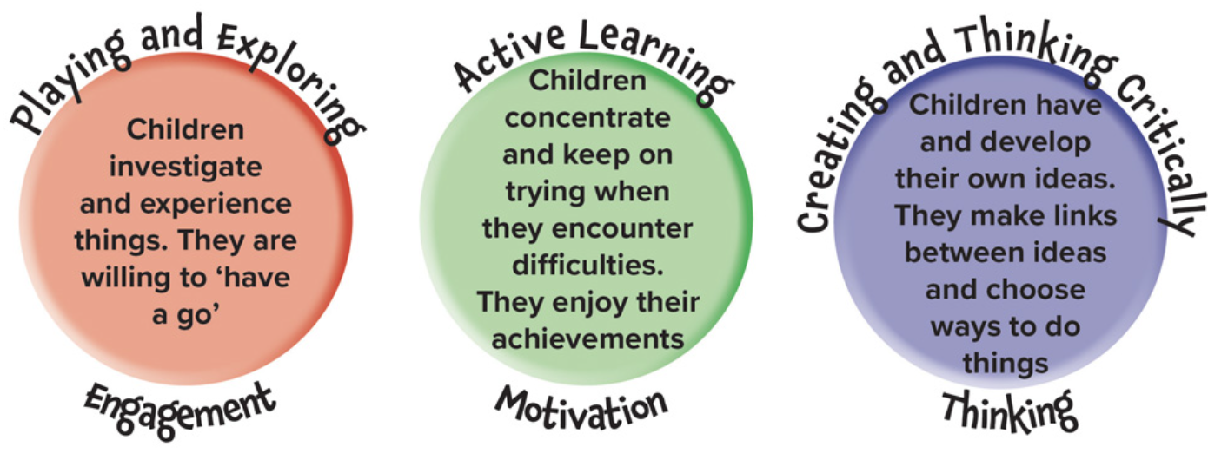
Foundation stage curriculum The Early Years Foundation Stage (EYFS) is the framework that underpins the education and care of young children in England, from birth all the way up to the age of five
SPECIFIC AREAS OF LEARNING
LITERACY
Comprehension​
Word Reading​
Writing​
MATHEMATICS
Number​
Number Patterns​
UNDERSTANDING THE WORLD
Past and Present​
People, Culture and Communities​
The Natural World​
EXPRESSIVE ARTS AND DESIGN
Creating with Materials​
Being Imaginative and expressive
PRIME AREAS
COMMUNICATION AND LANGUAGE
Speaking
Listening, Attention and Understanding
PHYSICAL DEVELOPMENT
Gross Motor Skills
Fine Motor Skills
PERSONAL, SOCIAL, EMOTIONAL DEVELOPMENT
Self-Regulation
Managing Self
Building Relationships
Characteristics of effective learning

Slide 8




Teaching and learning in EYFS
The Drawing Club is an engaging approach in Early Years Foundation Stage (EYFS) that fosters creativity, literacy, and fine motor skills through imaginative drawing activities.
The EYFS classrooms are set up so the children can independently access continuous provision during Discovery Time.
We will celebrate key events and festivals.
Children have extended periods of uninterrupted play during the school day.
The children have daily phonics, maths and topic time.
Reception children have Drawing club and Nursery have Story Dough.
Story Dough! This offers children delightful moments of time together to immerse in language, fine motor, song, rhyme, chat, imagination and mark making – its adventure can be unlimited and opens doors to a host of joy.
Daily story and rhyme time
High quality key texts which relate to children's interests and develop a love of books

Slide 9


Phonics
At Bearwood we use the Lesley Clarke synthetic phonics scheme to teach our phonics.
In Nursery, children will participate in Phase 1 phonics activities such as listening games, rhymes, songs and robot talk.
In Reception children will begin daily formal phonics lessons/
Each child will have a slightly different pace in their learning and we focus on helping each child to understand the sounds and skills that phonics teaches.
There will be a phonics workshop for Reception parents to help you to understand what phonics is, and how we teach it to the children at 9.00AM Tuesday 7th October.
Wordless books will be given to the Reception children over the course of the week.
Once children have begun learning the first few sounds we will begin sending home some reading books. These will be matched to the child’s ability but should be able to be read fluently. We want to encourage a love of reading in your child. There will be a Teaching Reading Workshop at 9.00am on Tuesday 21st October.

Slide 10
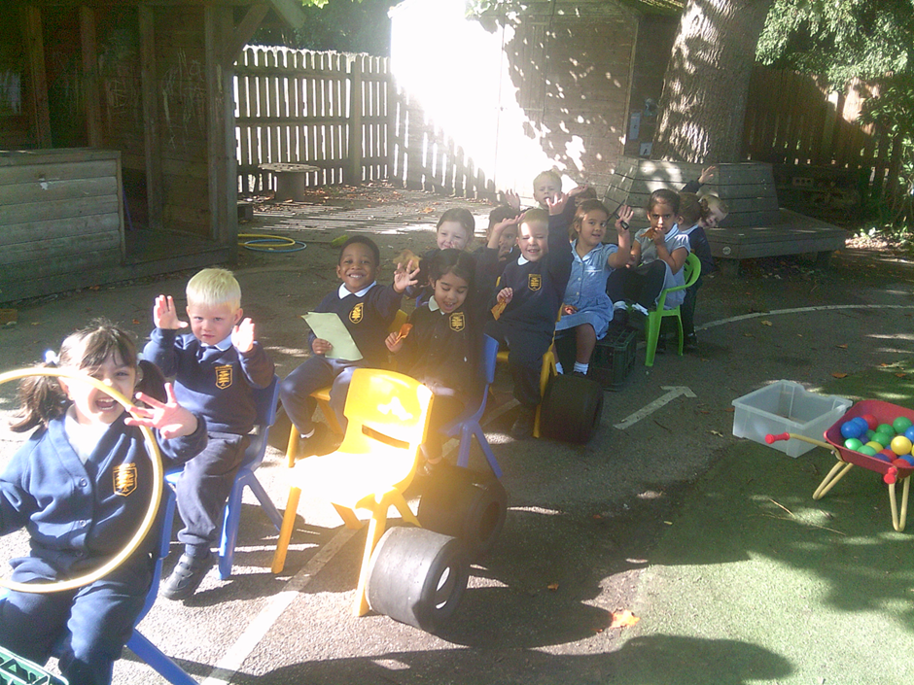

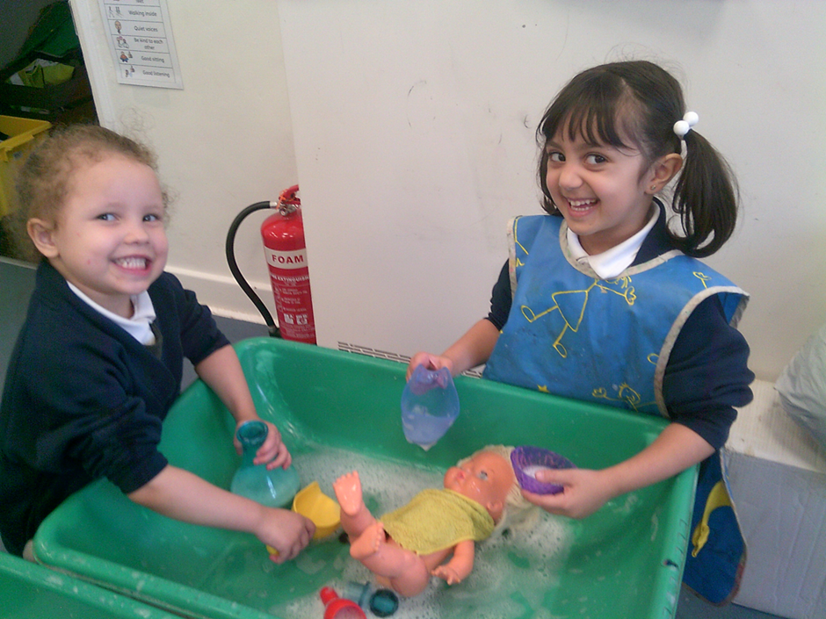
Statutory Assessments in Reception
Reception Baseline Assessment (RBA) – at the beginning of the year.
Early Years Foundation Stage Profile (EYFSP) – at the end of the year – GLD. More information will be shared about this later in the school year
See saw
Online sharing platform.
We will use this to upload photographs and videos of what
the children are doing in school
We will also send reminder messages such as 'non-uniform
day' and 'remember its library day tomorrow'
Please upload the app and scan your individual QR Code.

Slide 11

Communication
Communication is so key to us understanding your child. Every morning and afternoon, a teacher will be present on the EYFS door to take any messages and answer any questions. If you need to speak to us in more detail, you can arrange a meeting through the office or send an email.
All letters and communication will be sent via the school office.
We will also hold parent workshops, stay and play and special activities to involve parents in our school life, please keep an eye out for these.
The school website https://www.bearwood-pri.wokingham.sch.uk/ has a wealth of information, please do have a look.

Slide 12

Thank you for your time.
Please let us know if you have any questions.

