Slide 1




Welcome to Middle Phase!

Slide 2

Middle Phase Staff
Year 1 Teacher – Ms. Brannigan
LSA – Ms. Hitchins
Year 2 Teacher/Phase Lead – Miss Davis
LSA – Mrs Davis
Year 3 Teacher – Miss Reed
LSA – Mrs Rowland

Slide 3
Transition
Most parents and carers understand the importance of preparing their children for starting school, but the move from Reception to Year 1 can be a big change too.
Some children move on without a backward glance, but others can find some aspects a challenge.
We put support in place to help our children with this transition, and there are things you can do to prepare your child for this next stage in their school life.

Slide 4
Year 1
- Learning in reception is play-based. Children have lots of freedom to choose their own activities and can move on to something else when they choose. In year 1, learning becomes more formal, subject-based and adult-directed.
- Expectations increase in Year 1. Children need to be able to follow instructions, focus for longer periods and become more independent.

Slide 5
How to support transition into Year 1
Talk positively about the move into Year 1.
Read, read, read! Reading with and to your child is one of the most powerful things you can do to support their learning and progress.
Encourage them to write, but make it fun! For example, a shopping list, diary entry or a postcard to a family member.
Practise counting in 2s, 5s and 10s (songs are great to help with this) and talk about ‘more than’ and ‘less than’.
Practise handwriting and letter formation. If your child has a weak grip, strengthen their fingers using activities such as playdough, bead threading, construction with bricks, as well as strengthening their shoulders.

Slide 6
Phonics Screening Check
In 2025, 93% of our Year One children passed the Phonics Screening Check. This is above the National and Wokingham Average. Those who did not pass, will retake it in Year 2.
We following Lesley Clarke’s Synthetic Phonics programme. Year 1 have a 20 minutes phonics lesson every day, to help with learning new sounds, segmenting words and blending sounds together.
https://www.lesleyclarkesyntheticphonics.co.uk/index.php/parents
Notes:
The PSC takes place in June and children are expected to decode both real and alien words and then blend the sounds together correctly.

Slide 7

Reading
Year 1 Read to an adult
Focused reading activities
Year 2 and 3 Read to an adult/Accelerated Reader
Shared Reading
English lesson
Reading across the curriculum
Class story at the end of the day
Reading Record
Record reading at home
Teachers will check and stamp when they hear a child read.

Slide 8
Accelerated Reader
When children have completed their book, they will complete a quiz on Accelerated Reader in school. Children can record their reading in their Reading Record and teachers will check these frequently.
Accelerated Reader helps teachers manage and monitor children’s independent reading practice. Your child picks a book at their own level and reads it at their own pace. When finished, your child takes a short quiz on the computer. Passing the quiz is an indication that your child understood what was read.
Notes:
Accelerated Reader gives both children and teachers feedback on the quiz results, which the teacher then uses to help your child set targets and direct ongoing reading practice.

Slide 9
How to support reading at home
Walk through the book-
First discuss the pictures and the important words. Always remember to keep reading aloud to your children even when they can read independently.
Encourage your child to read to you- Follow the words with your finger and sound out the words (c-a-t: cat) See if they can pronounce each sound and then blend them together.
Praise your child for trying hard at reading-
Let them know it is okay to make mistakes.

Slide 10
Writing – KS1
Story maps – retelling the story using pictures
Orally rehearse sentences before writing
Modelling writing
Spellings and spelling rules
Finger spaces, capital letters in the correct places
Year 1 encourage phonetically plausible attempts
e.g. happee. Year 2 are expected to apply spelling rules, they have learnt throughout the year to their writing to improve their spelling.
Handwriting – Year 1 – printed letters
Year 2 – pre- cursive letter formation

Slide 11
Writing – Year 3 (KS2)
Lesson 1: Introduce/read text.
Lesson 2: Analyse text – Identify structure, genre features, language and grammar. Gather ideas for own writing.
Lesson 3: Planning – Create a whole class plan, these are useful to set expectation when the plan later in lesson.
Lesson 4&5: Shared Draft – Practise orally developing sentences, shared and independent composition
Lesson 6 – Read second model text, identify effective features
Lesson 7 – Planning independent write – discuss and share ideas.
Lesson 8&9 – Independent draft/write – Write using their plan, edit and proof read as the go.
Notes:
In all classes, when a child produces a piece of independent writing, we identify the next step in their writing development and feed that back to the child.
We give the child strategies or scaffolding resources to support the child to meet the next steps in a variety of forms of feedback.

Slide 12
Spelling
In Year 2 and 3, the children have Spelling lesson.
Each child has a spelling journal which they use to record the spelling rules we learn and practise in our daily spelling lessons.
Learning the spelling rules enables pupils to apply them when spelling a range of words.
Children will receive weekly set tasks on Spelling Shed to practise further.

Slide 13
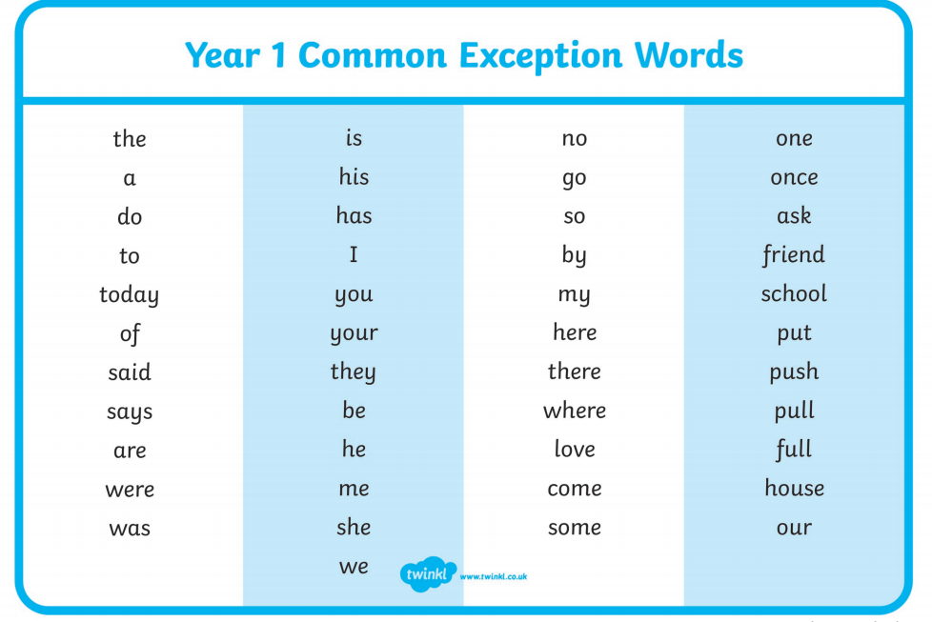

Slide 14
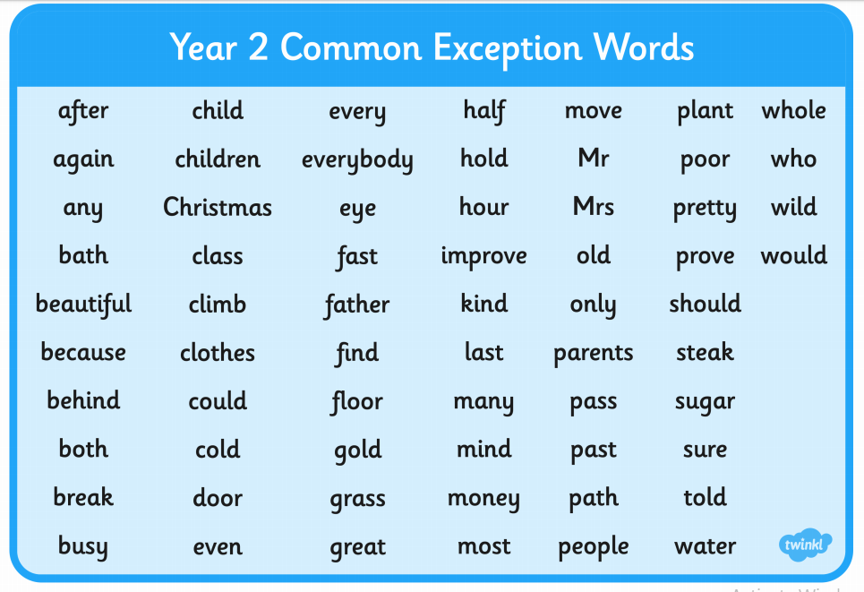

Slide 15
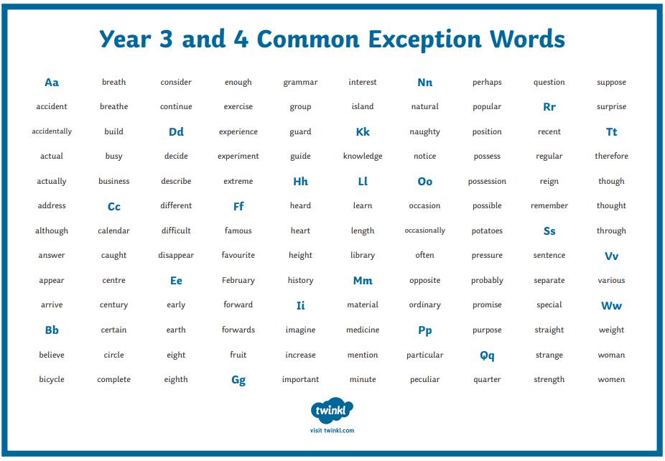

Slide 16
Maths
KS1 Maths
Maths Mastery
Number formation ​
Concrete/physical resources ​
Pictures to represent numbers​
Problem solving and reasoning​
Maths in the environment e.g. shapes around us, laying the table, coin recognition​, times of day
2, 5 and 10 times tables (Year 2)
KS2 Maths
A huge focus in LKS2 is times tables. By the end of Year 3, children are expected to know the facts for the 2, 3, 4, 5, 8 and 10 times tables, with corresponding division facts.
They will be regularly practising times tables and will use Times Tables Rock Stars to help us. Practising daily at home will significantly support children’s progress in learning the times tables so that they confidently recall them without relying on counting up in multiples.

Slide 17
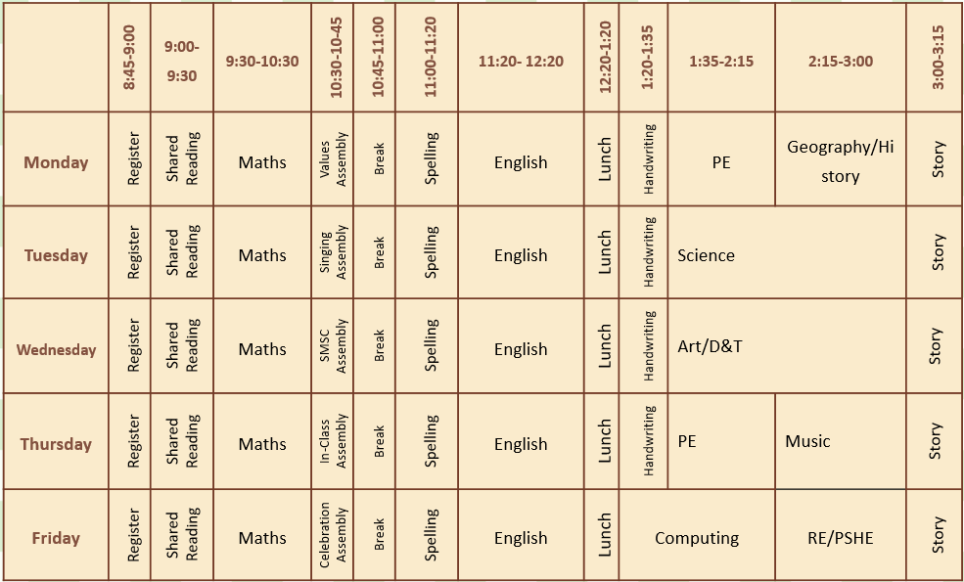
KS1 Timetable

Slide 18
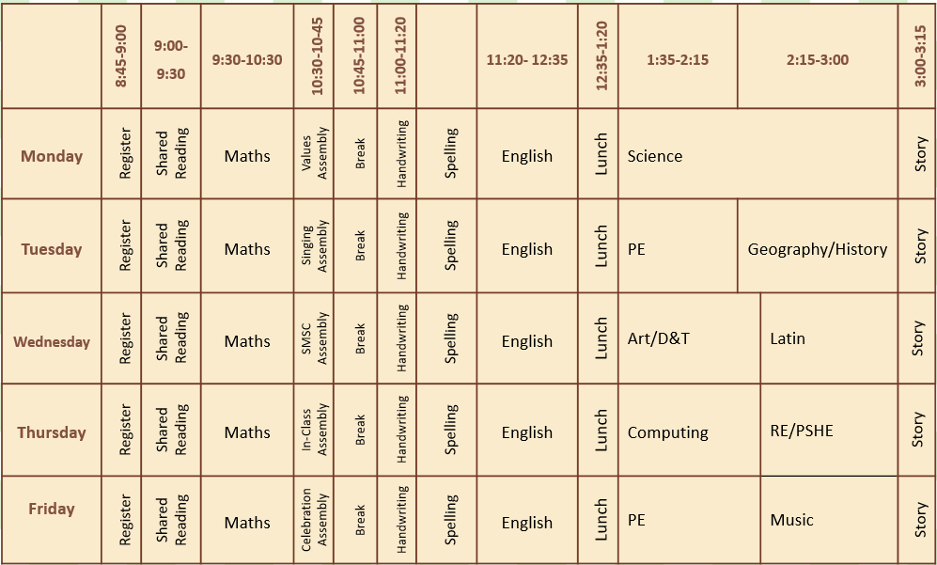
KS2 Timetable

Slide 19
PE Kit
Children will continue to come to school in their PE kit.
Beaver and Fox PE days are Monday and Thursday
Red Squirrel PE days are Tuesday and Friday.
For PE children should wear:
Plain navy shorts - no cycling shorts
Gold printed School PE T-shirt with navy school logo
All black trainers – no high tops or brightly coloured logos
Plain navy track suit or jogging bottoms
All long hair to be tied up at all times
Please make sure all clothing (including school uniform) is clearly named.

Slide 20
Year 3
Although Year 3 are in middle phase, they are still following the KS2 National Curriculum.
The main purpose of being part of this phase is to help with a smoother transition.

Slide 21
Transitioning
1. Continue to talk positively about school and focus on your child’s good experiences.
2. Build a good, communicative relationship with the new teacher.
4. If there is homework to be completed, make sure your child has chance to wind down before starting it.
5. If you are concerned, speak to the teacher.

Slide 22
All of the Middle Phase teachers are excited for a productive and fun filled year!

