Slide 1
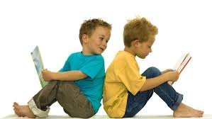
Bearwood Primary School
Early Years Foundation Stage
Early Reading Workshop
October 2022

Slide 2
Our Vision…
"We aspire to be an outstanding, values based school at the heart of our diverse community.
Striving for excellence, our focus is to enable our children to be resilient and independent learners whilst also considerate of others.
Through an all-encompassing curriculum, our children will achieve their highest potential, and have a firm foundation on which to build successful and productive lives in an ever-changing world."

Slide 3
July 2022
End of KS2 Results for Reading…
EXP + 91%
GDS 50%
Our progress was the 6th highest in Wokingham.
All well above the National averages.

Slide 4
Aims of this workshop
Develop an understanding of early reading and how it is linked to phonics
Introduce how we teach early reading
Give you strategies to use at home to support your child in learning to read

Slide 5
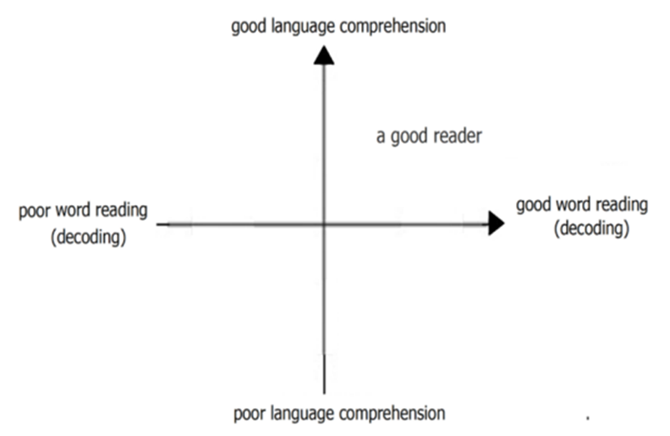
What is Reading?
Making meaning of print is more than just matching sounds to a letter or letters.
Can you read this?
‘Laciate ogni speranza voi che entrate’.
You may read with practise by matching sounds, but, the sounds do not make sense, so no real reading is taking place.
Competent readers draw upon a whole host of clues when making meaning out of print.
Notes:
This graph has been taken from the Reading framework published in July 2021.
It is really important when thinking about reading to consider the whole approach to reading.
The report says:
When children start learning to read, the number of words they can decode accurately is too limited to broaden their vocabulary. Their understanding of language should therefore be developed through their listening and speaking, while they are taught to decode through phonics. However, when they can read most words ‘at a glance’ and can decode unfamiliar words easily, they are free to think about the meaning of what they read. They can then begin to develop their understanding of language through their reading.

Slide 6
Pre Reading Requisites
Must have a knowledge of language – communication and conversation
Rhyme and Alliteration – noticing when sounds are repeated
Listening – able to pay attention to and identify the sounds they hear
Vocabulary – introduce and explain the meaning of high quality words
Predictability – listening to lots of stories helps children understand the structure of sentences as well as stories
Must have a knowledge of how books work - handling books

Slide 7
Three Aspects of Reading
Phonics – Most Important! - Using phonic knowledge to sound and read – called decoding
Whole word – used to read Tricky Words that cannot be sounded out, eg: the
Prediction – using clues such as pictures, grammar and story structure
Beginner readers will be practising one or more of these aspects until all three are used

Slide 8
Phonics in Reception
At Bearwood we follow the Essential Letters and Sounds Phonics Programme.
A 20 minutes daily whole class lesson in school.
Sound and Tricky Word Cards – practise what has been learned so far in school and at home daily when reading.
Short sounds ‘p’ not ‘puh’ ‘h’ not ‘huh’ etc, see how to say the sounds here: https://www.youtube.com/watch?v=UCI2mu7URBc
We teach Phase 2 and the single GPCs of Phase 3 in the Autumn Term.
We held a Phonics Workshop last week, the presentation for which was emailed to parents. Please speak to us if you have any further questions about phonics.
The reading book your child brings home is a fully decodable book. This means they have been taught all the phonics in the book.

Slide 9
Learning to Read at School
1:1 reading twice a week
Children read books linked to their phonics learning. They will re-read their fully decodable book to develop fluency, and move on to the next book after they have been taught all the phonics required to read it
Literacy lessons – sharing high quality stories and developing vocabulary, understanding of story structures, as well as comprehension
Reading is taught through the whole curriculum, eg: sharing information texts about topics, signs and symbols in maths, pictures and labels throughout the setting
Independent reading in inviting reading areas with familiar stories, information books and fully decodable books
Children have targets to develop their reading skill – shared at parents’ evening

Slide 10
1:1 Reading Session
Warm-up – Sound and Tricky Word card
Book talk – cover, pictures, story so far, predictions,
Read. Children use their phonic knowledge to say the sounds, then blend them to read the word, and then repeat the sentence. Encourage independence, resilience, refer to sound card if needed, and recognising Tricky Words.
Questioning and discussion to develop comprehension
Reminder of target and what to practice at home

Slide 11
Practising Reading at Home
Check the reading record for notes.
Practise sounds and tricky words on the card. Practise the ones your child has learned so far in school – they should know what these are.
Listen to your child read. They should hold the book and point to each sound/ word as they read. Encourage them to say the sounds clearly, and repeat them until they can blend them to say the word. Encourage them to read each sentence once they have decoded or recognised all the words. Children will have been taught all the phonics in their reading book.
Re- read the book to develop fluency. Children will have a reading book for approximately 1 week, as they will only move on to the next book once they have been taught all the phonics required.
Sign the Reading Record, so that we know you have listened to them practise their reading.
Read other stories and books to and with your child, as often as you can.
Read

Slide 12
What you can do to help
Make sure your child has their book bag with their Reading Record, sound/tricky word card and reading book with them in school each day
Know their reading target
Practise the sounds and tricky words they have learned with them
Listen to them practise their reading at home every day in a quiet time and place
Encourage them to stretch and repeat the sounds if they cannot blend to read the word
Make sure they read the word and the sentence after they have decoded it
Encourage them in re-reading their book to develop fluency
If they have memorised the book, ensure that they are pointing to each word as they say it
Discourage guessing! They may recognise a word once they have come across it multiple times or if they are skilled silent decoders – but random guessing is not an effective strategy
Speak to the class teacher if you have any concerns or questions

Slide 13
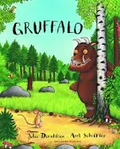


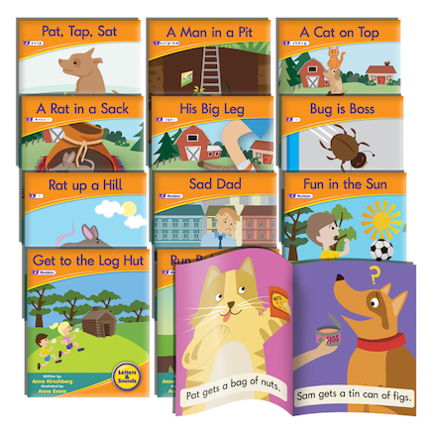
Reading Resources
Picture Books
Information Books
Fully decodable books linked to phonics
eBooks on Oxford Owl assigned for weeks
when we do revision/ holidays. (see login
details in reading record) https://www.oxfordowl.co.uk/
Sound Cards
Tricky Word Cards
Colour banded reading books
Any text: magazines, comics, recipes,
Words anywhere…

Slide 14




Reading the Environment
Not all reading is in books
We are surrounded by print that communicates a message
Alert your child to uses of print in the environment
Point out signs and labels

Slide 15

Learning to read is a marathon, not a sprint. Our children deserve to develop a love of reading – make it a happy event.
Reading is the key to knowledge and success. Any Questions?

