Slide 1
Year 4 Multiplication Tables Check
Monday 3rd June - Friday 14th June 2024

Slide 2
What is the Multiplication Tables Check?
The multiplication tables check (MTC) is statutory for all Year 4 pupils registered at state-funded maintained schools, special schools or academies, including free schools, in England.
The purpose of the MTC is to determine whether pupils can recall their times tables fluently, which is essential for future success in mathematics. It will help schools to identify pupils who have not yet mastered their times tables, so that additional support can be provided.
Notes:
The National Curriculum states that pupils should be taught to recall multiplication and division facts for multiplication tables up to 12 × 12

Slide 3
When will the Multiplication Check be administered?
Schools must administer the MTC to all eligible Year 4 pupils between Monday 3rd June and Friday 14th June. If a child is absent during the 2-week window, schools can use the following week to administer the test to them.

Slide 4
How will the MTC data be used?
School level results and individual pupil results will be made available to schools. This will allow schools to provide additional support where required.
There is no expected standard threshold for the MTC, but higher scores indicate greater proficiency in fluently recalling multiplication tables.
The DfE will not publish school-level results for the MTC. There will be a statistical publication at national and local authority level.

Slide 5
How will the MTC be administered?
Children will be tested using an on-screen check (on a computer or a tablet),where they will have to answer multiplication questions against the clock.
Wall displays that could provide children with answers will be removed while the MTC is taking place.
Children will have 6 seconds to answer each question in a series of 25 questions.
This allows pupils the time required to demonstrate their recall of multiplication tables, whilst limiting pupils’ ability to work out answers to questions.
Each question will be worth one mark and will be presented in this format: _____ x _____ = ______
The test will last no longer than 5 minutes.
It will be automatically scored, and results will be available to schools once the assessment window closes at the end of the assessment period.

Slide 6
How will the MTC be administered?
Questions will be selected from the 121 number facts that make up the multiplication tables from 2 to 12, with a particular focus on 6, 7, 8, 9 and 12 as they are considered the most challenging.
Each question will only appear once in any 25 question series, and children won’t be asked reversals of questions as part of the check (so if they have already answered 3 x 4 they won’t be asked 4 x 3).
Once the child has inputted their answer, there will be a 3 second pause before the next question appears.
Children will be given the opportunity to answer a couple of practice questions in the format before the check begins.

Slide 7
How to access the MTC
Pupils will access the official check and try it out check using a PIN and school password, generated on the day of administration.
Notes:
PINs for a try it out check: schools can generate try it out PINs from Monday 17 April until the end of the check period on Friday 23 June. The practice check is the same throughout this time.

Slide 8
Access arrangements for pupils with specific needs
Colour contrast
Font size
Pause ‘next’ button between questions: If the 3-seconds pause between question is not long enough for a specific pupil, or the pace of the check may disadvantage the pupil, a ‘Next’ button can be enabled. Instead of 3-seconds pause, the pupil can select ‘Next’ when they are ready to start a new question. This access arrangement does not extend the time given to answer each question.
Remove on-screen number pad: This may be useful to support pupils who are distracted by it, or do not plan to use it. Only the question-and answer box will show on the screen. The pupil will need a keyboard to enter their response.
Input assistance: An input assistant is someone who enters answers dictated by the pupil. An input assistant can be used when a pupil is unable to enter their own answers.
Audio version
Pupils cannot have additional time to complete the MTC questions. The purpose of the check is to determine whether pupils can recall their times tables fluently. Additional time would remove the fluent recall element of the check.
Notes:
For pupils who require additional arrangements so they can take part in the MTC.

Slide 9
What is the pass mark for the check?
At present the DfE have not issued an official pass mark.
As a school we are aiming for a pass mark between 23 and 25.

Slide 10
How are we preparing pupils for the MTC?
Daily speed tests which track the progress the children are making
Weekly ‘Soundcheck’ test on Times Tables Rock Stars (TTRS)
Regular multiplication games and reciting of times tables
Using knowledge of key table facts
A weekly intervention group for children who require more practice

Slide 11
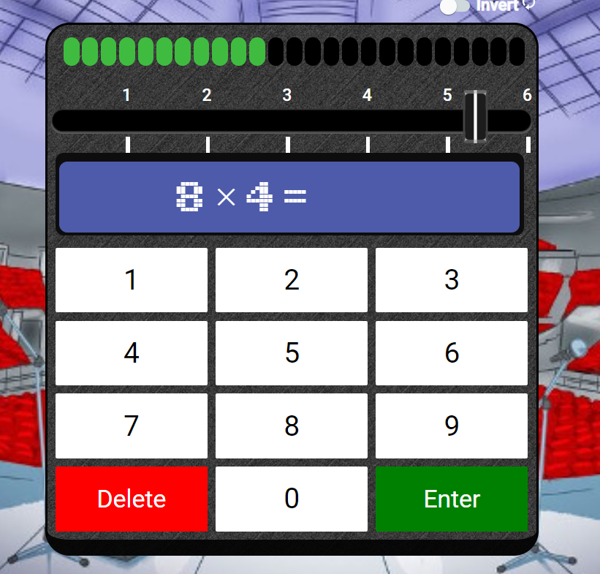
How can parents and carers support at home?
- Access ‘Soundcheck’ on TTRS at home as much as possible
- Allow children to access the tournaments on TTRS that are set up weekly
- Test children on their quick recall of times tables in random order
- Play times tables songs available on You Tube
Notes:
Soundcheck is a complete replica of the MTC. Log in details in children’s reading records. Ask your child’s class teacher if you require them again.

Slide 12
How can parents and carers support at home? Knowing your children’s gaps
Notes:
‘Heat map’ generated on TTRS and most of you have received your child’s.

Slide 13
Any questions?

