Slide 1

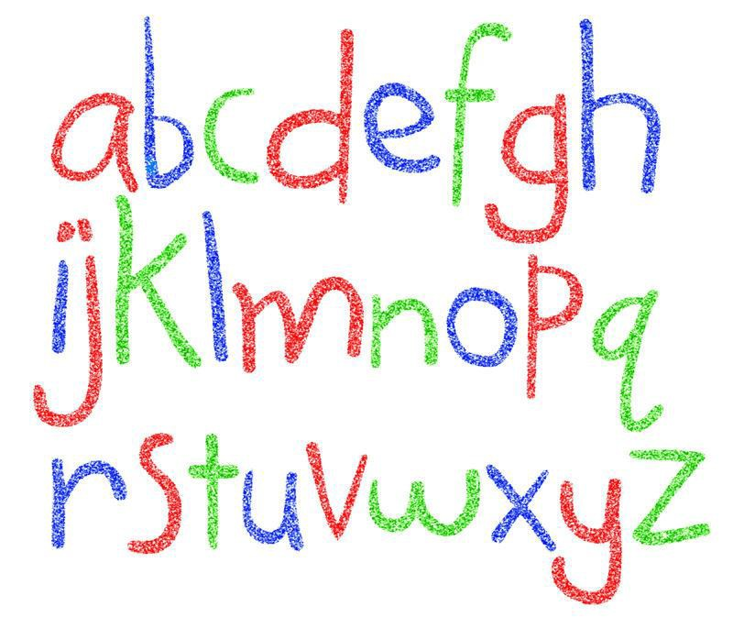
Year 1 Phonics Workshop

Slide 2
What is Phonics?
Phonics is a tool that aids reading and writing.
It links sounds to letters.
There are different phonemes (smallest unit of sounds) in words.
Digraphs (2 letters that make one sound).
Trigraphs (3 letters that make one sound).
Split digraphs.

Slide 3
Why do we teach ‘Phonics’?
The teaching of the letter sounds helps the children to
read and write.
The children use ‘blending’ (linking sounds together) and ‘decoding’ (sounding out) for reading.
They use ‘segmenting’ (chopping up) for writing.
It is important that we teach and use the ‘pure’ sounds.
https://www.youtube.com/watch?v=d80fufsrClw
Visit -
https://www.lesleyclarkesyntheticphonics.co.uk/parents/frequently-asked-questions/470-articulation-of-phonemes

Slide 4
Digraphs
Here are some examples of
‘Digraphs’
ee (sleep)
or (corn)
ar (farm)
ie (pie)
sh (sheep)
th (think)
er (farmer)
ai (rain)
ch (chip)
ou (sound)
oi (foil)

Slide 5
Trigraphs
Here are some examples
of ‘Trigraphs’
igh (light)
air (fair)
ear (hear)
For some digraphs and trigraphs there are alternative representations
For Example:
air (fair)
are (hare)
ee (see)
ea (sea)

Slide 6
Split Diagraphs
∗ These sounds used to be taught as the Magic ‘e’
They also contain two letters but they are split between a consonant.
a-e
e-e
i-e
o-e
u-e
(cake) (these) (like)
(bone)
(cube)

Slide 7
Can you remember…
What is a digraph?
What is a trigraph?
What is a split digraph?

Slide 8
Sound Buttons/Dashes
Sound buttons are little spots or circles that can be placed or written below sounds in words to help children with reading skills. Each sound button denotes an individual phoneme and helps the children to use their phonics blending and segmenting skills by identifying the individual phonemes or sounds within a word.
We use a dot if 1 letter makes one sound.
If a sound is made up of 2 or more letters we use a dash .
If there is a split digraph we use .

Slide 9
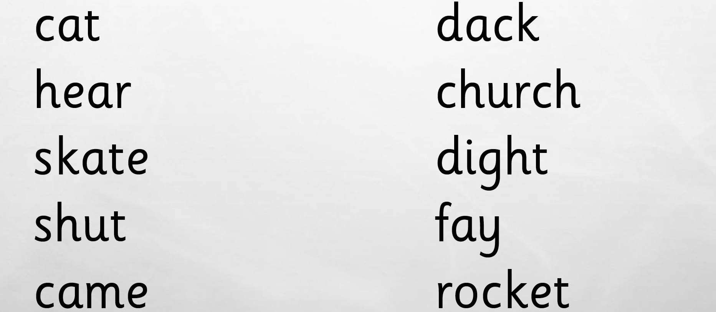
Can you add the sound buttons?

Slide 10
Can you add the sound buttons?

Slide 11
Compound Words
These are words that are made up of two smaller words.
For example
Lighthouse
Farmyard
Seaweed
handbag
∗It is important that the children are taught these as two separate words that they put together.

Slide 12
What is the Phonics Screening Check?
The check is set by the Government for every child in year one in the country.
It is designed to assess whether a child has reached an appropriate standard when using their phonics (decoding and blending) to read unfamiliar words.

Slide 13

When will it take place?
Every child in the country will complete the check during the same week in June.
Year 2 children who did not reach the expected standard in the check last year will also sit the check during this week.
Your child’s teacher will conduct the check.

Slide 14

What will the children be required to do?
The check consists of 40 words.
20 real words and 20 nonsense words.
The check will be carried out on a 1:1 basis.
There is no time limit for the check.

Slide 15


Nonsense Words
The nonsense words will have a picture of a monster character next to them so the children will know that it is not a real word.
This is to see how they are using and applying their phonic skills.
The children will need to remember all the sounds they have been taught to read these, including the split digraphs.

Slide 16
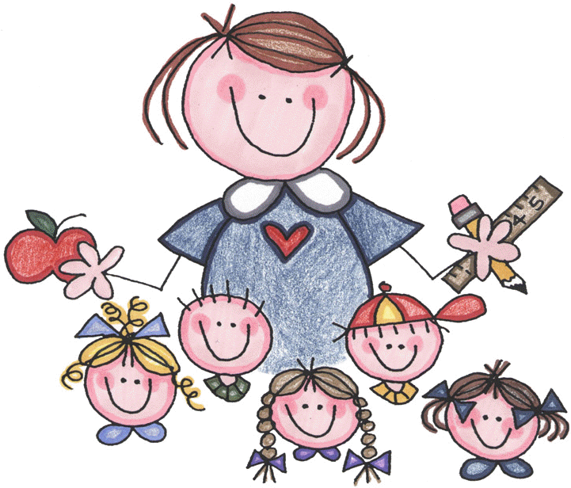
What are we doing at school?
Many things!
Daily phonics sessions
Small group work
Sending home sounds if needed
Practise papers
Regular screening/assessment

Slide 17

Reporting to Parents
∗ How will I know if my child has passed the screening check?
∗Results will be sent home at the end of the Summer Term with your child’s school report.

Slide 18
What if my child has not passed?
If you child has not reached the expected standard they will have the
opportunity to re-take the check in year 2.
Some children may not pass the check but that does not mean we are concerned about their reading.
You will be informed by your class teacher if they have a concern about your child’s phonic knowledge or ability.
We will continue to support all children at their required level.

Slide 19

How can you support your child at home?
Play lots of sound and
listening games.
Read with your child as much as possible
Point out the digraphs, trigraphs and split digraphs in words as you read them.
Encourage decoding (sounding out) and blending.
Encourage and praise them for using their sounds when reading new words.
Discuss the meaning of
new words.

Slide 20
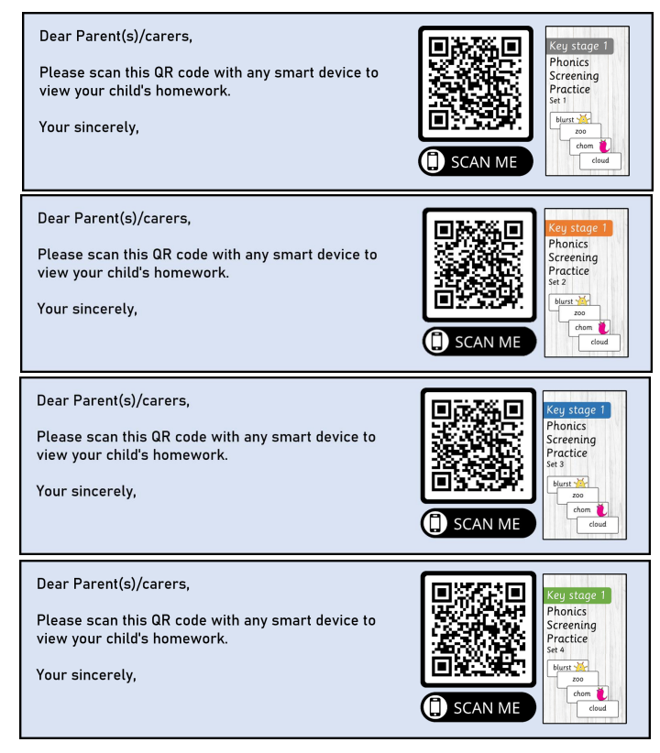

Slide 21

Useful websites
https://www.lesleyclarkesyntheticphonics.co.uk/parents
https://home.oxfordowl.co.uk/reading/phonics/​
https://www.phonicsplay.co.uk/parents​
https://www.youtube.com/channel/UC7sW4j8p7k9D_qRRMUsGqyw (Mr Thorne Does Phonics)
Phonics)​
Suggestions from parents -​
https://www.katiesclassroom.com/​
https://www.teachyourmonster.org/​

Slide 22

∗Any Questions?

