Slide 1
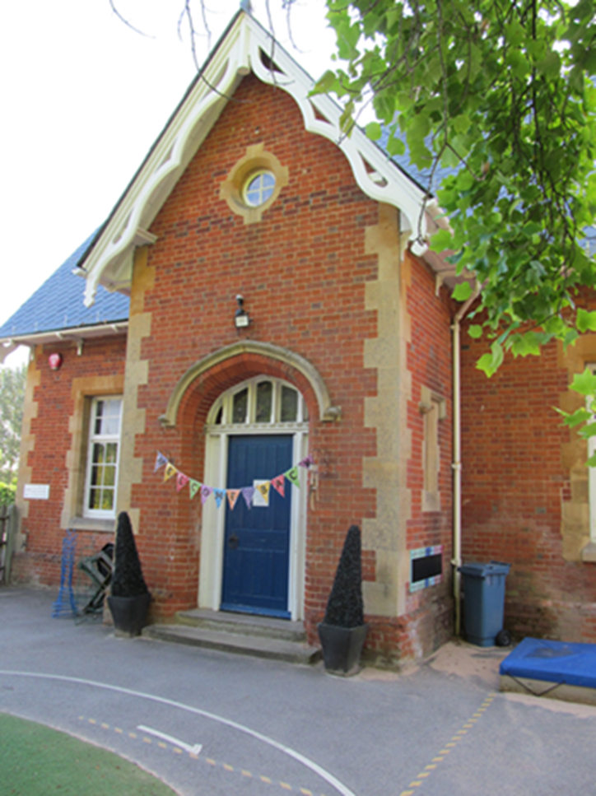
Bearwood Primary School Early Years Foundation Stage Welcome to Nursery and Reception September 2023

Slide 2
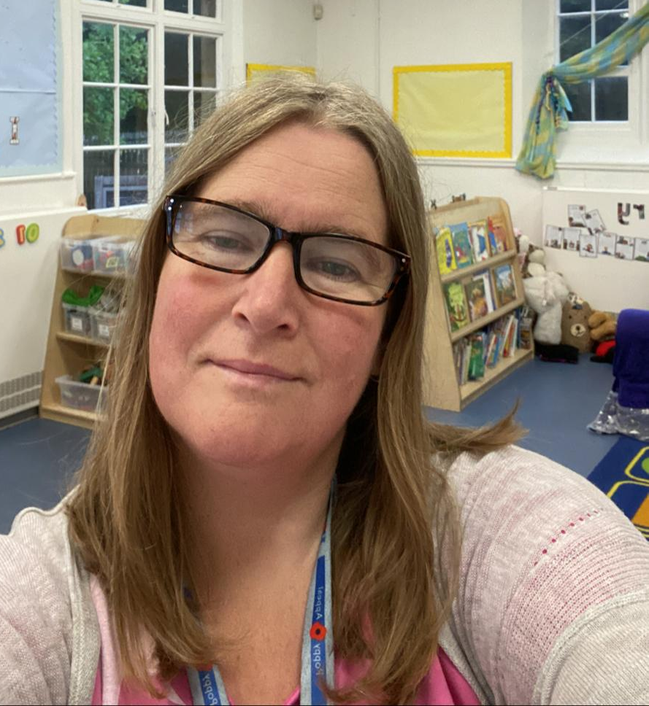
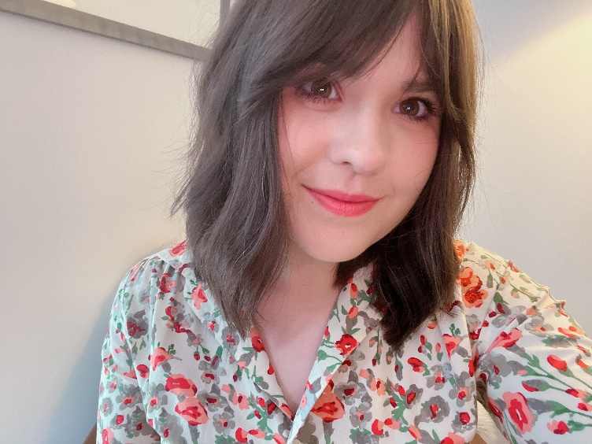
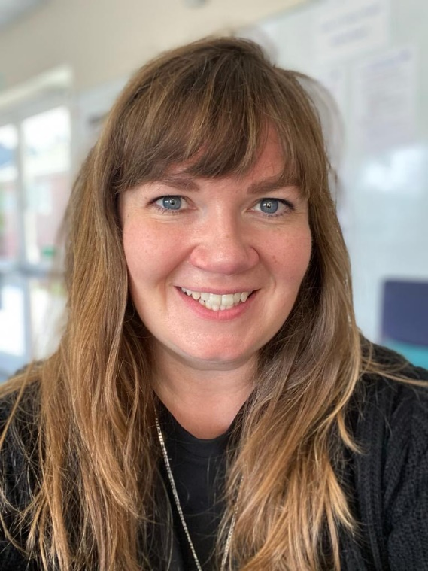
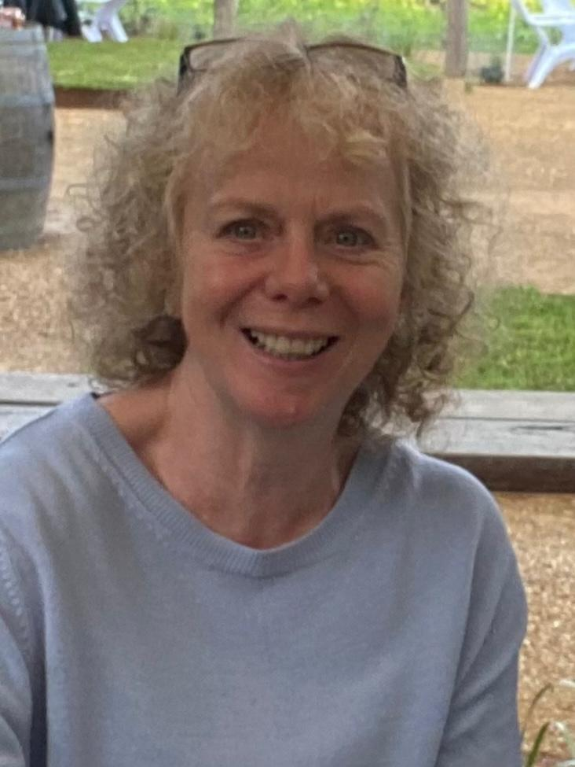
Foundation Stage Staff
Mrs Johnson-
Foundation Stage Lead
Reception teacher
Miss McNulty
Reception teacher
Ms Brannigan
Nursery teacher
Mrs Davis
LSA
Mrs White
Nursery Nurse
Mrs Barker
LSA
Mrs White
Nursery Nurse

Slide 3
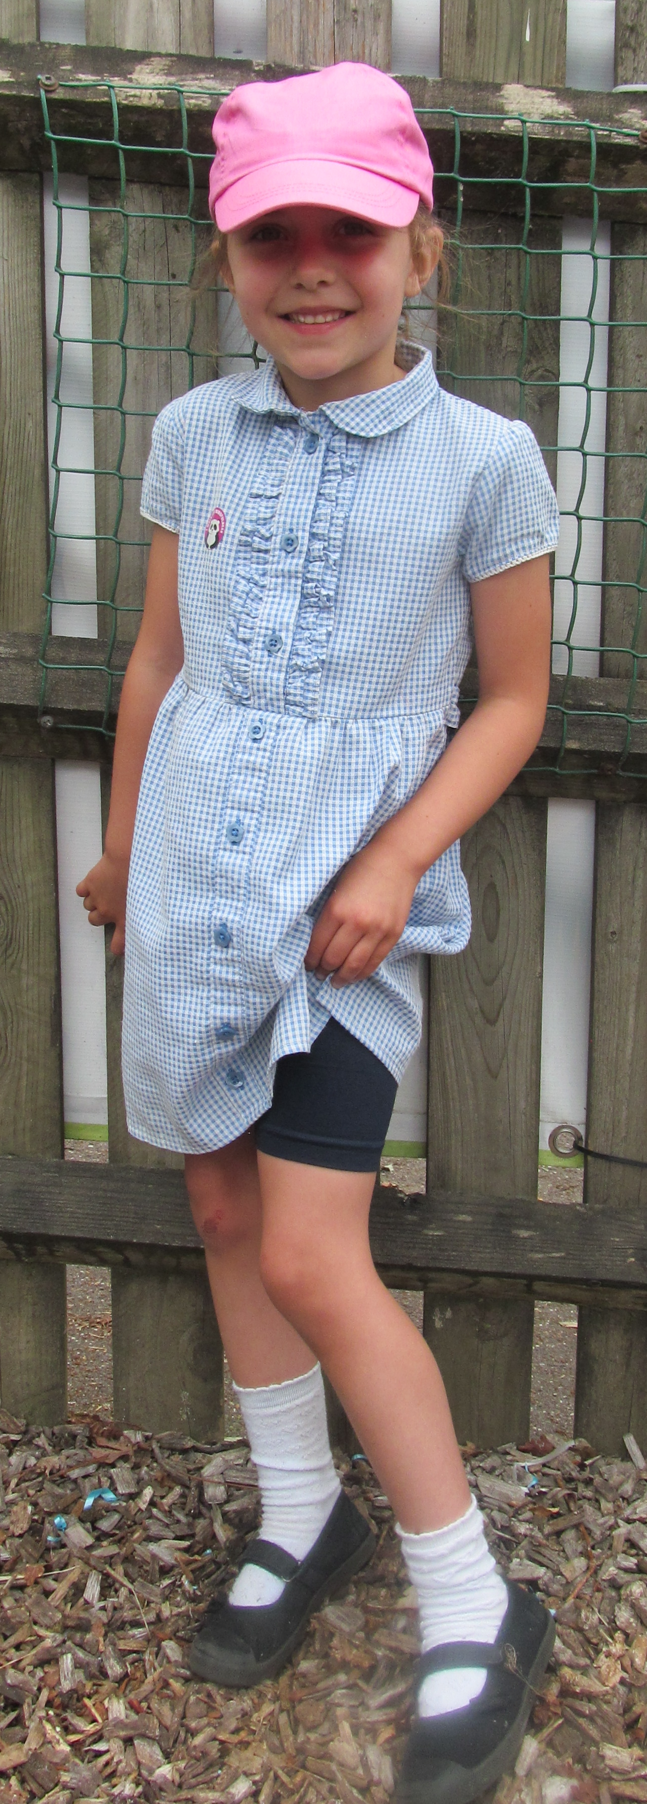
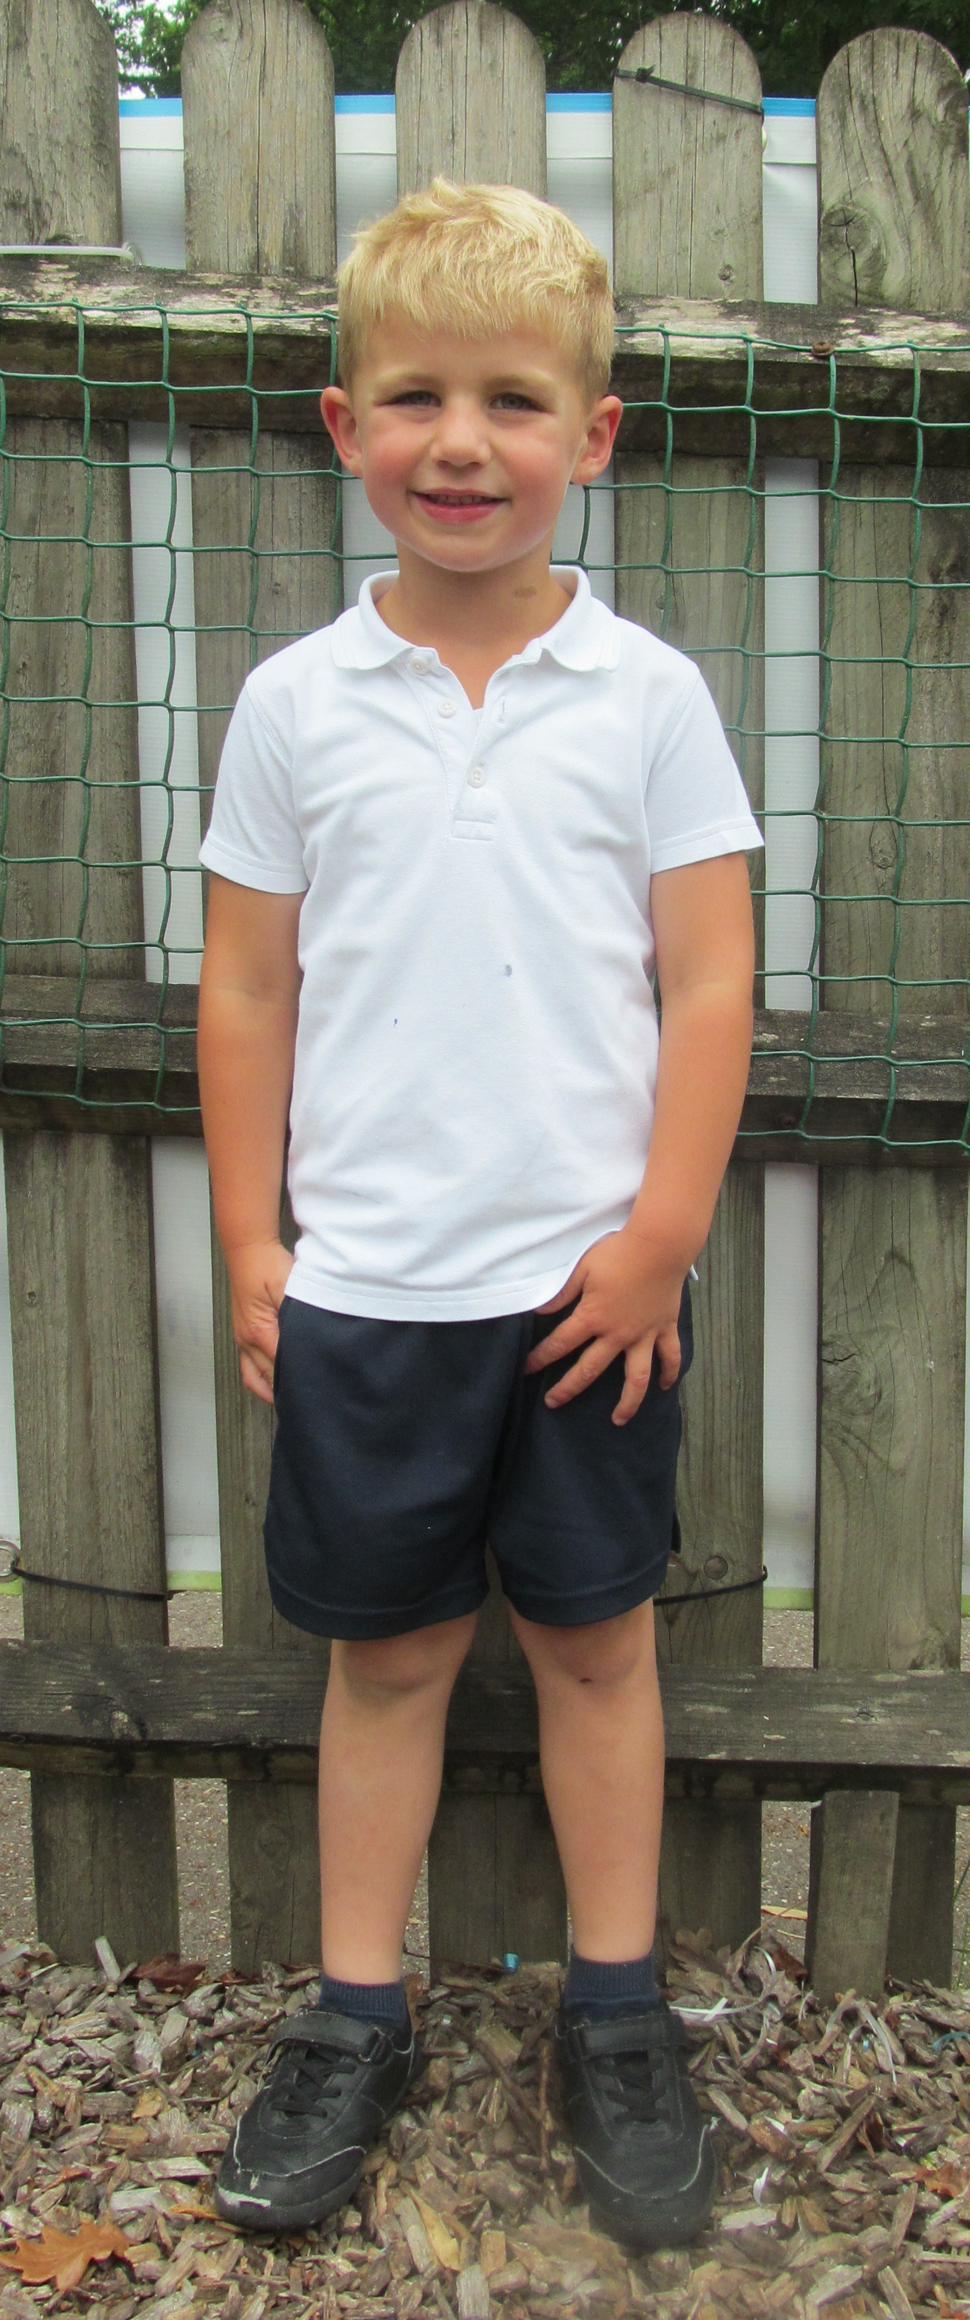
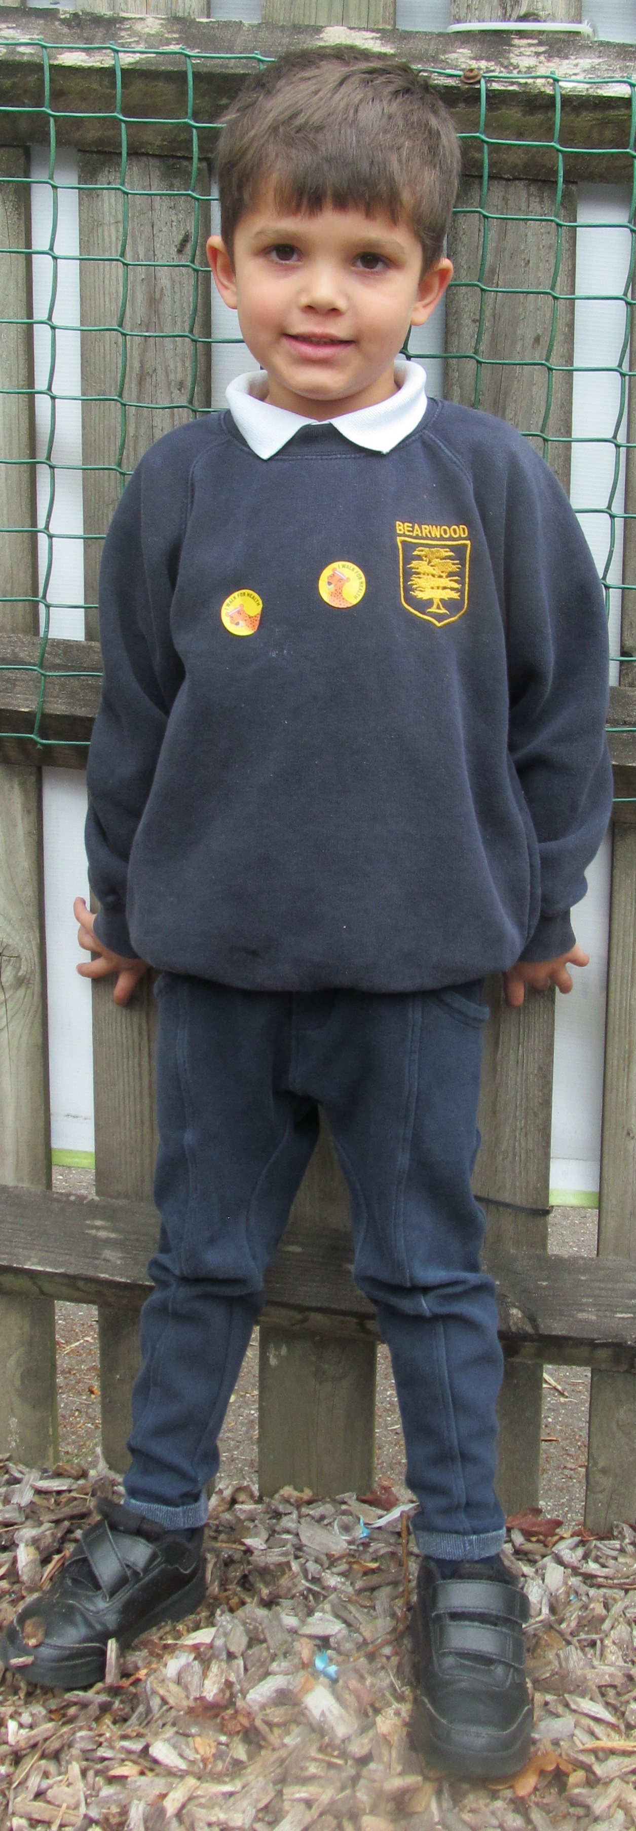
Uniform
Please label EVERYTHING!
Our EYFS uniform is slightly different to the rest of the school because our curriculum is much more active and based outside in all weathers.
Navy jumper or cardigan with school logo
White polo shirt
Black or navy shorts or jogging bottoms
Black trainers
Girls may choose to wear a blue gingham summer dress with cycle shorts in summer
Nursery are not currently in our school uniform, but we would love to make them feel part of our school. Our aim is for nursery children to have uniform by January. Until then, clothes should be practical and comfortable and uniform can begin being worn whenever you and your child are ready.

Slide 4
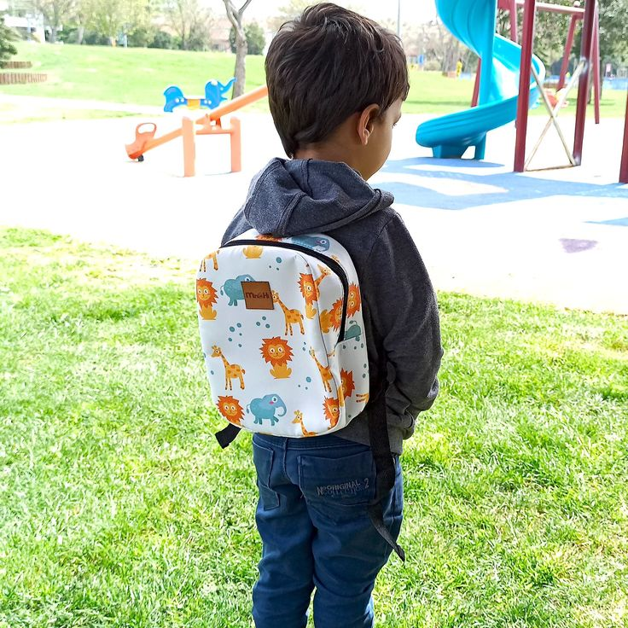
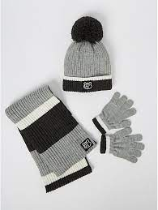
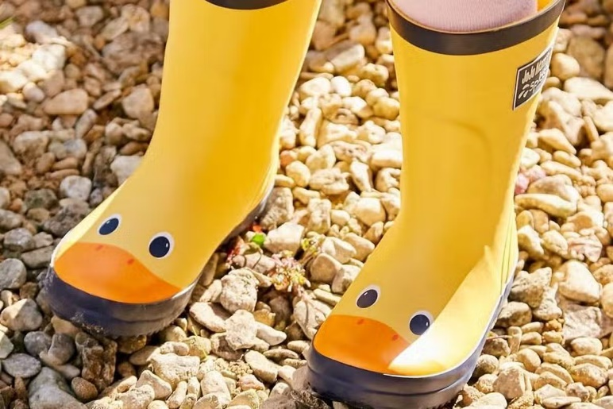
What else does my child need to bring?
A water bottle filled with water (no squash or flavoured drinks please!)
A book bag for Reception
A small backpack or tote bag for Nursery
A named coat
Weather appropriate extras (sun hat, woolly hat, gloves etc.)
Wellies in a carrier bag to live at school

Slide 5
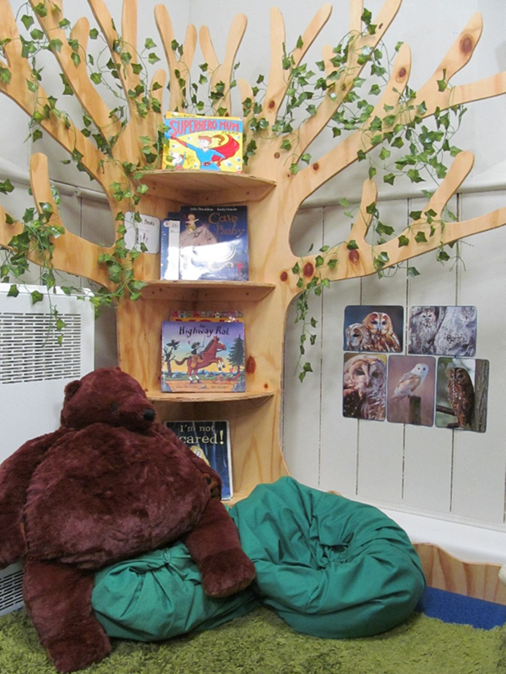
The Foundation Stage Curriculum
Characteristics of Effective Learning:
Playing and Exploring
Finding out and exploring
Playing with what they know
Being willing to ‘have a go’
Active Learning
Being Involved and concentrating
Keeping on trying
Enjoying achieving what they set out to do
Creating and Thinking Critically
Having their own ideas
Making links
Choosing ways to do things

Slide 6
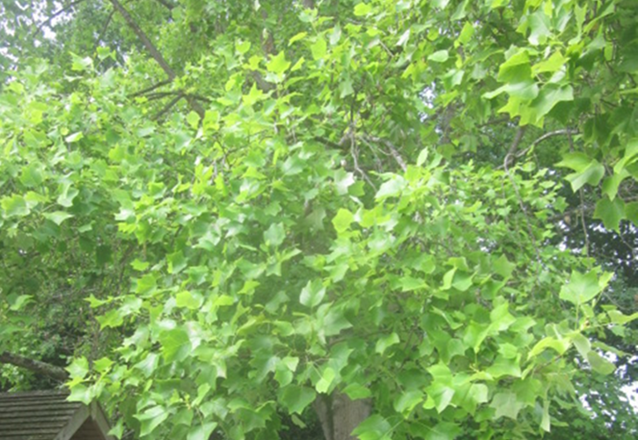
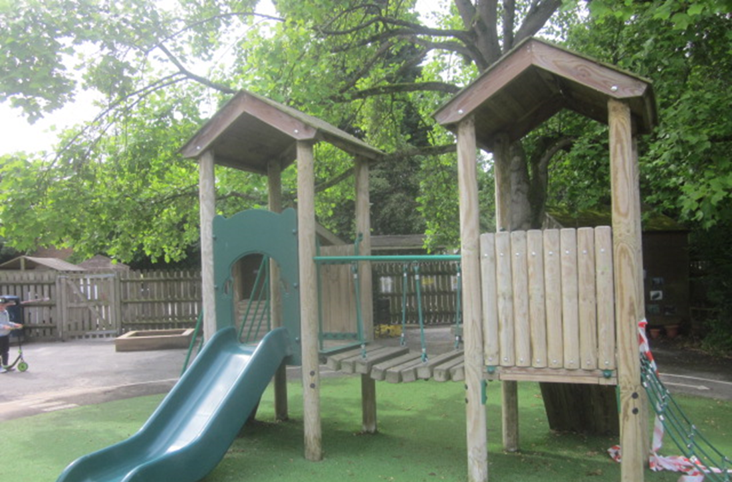
The Foundation Stage Curriculum
Prime areas of learning:
Communication & Language Development
Speaking
Listening, Attention and Understanding
Physical Development
Gross Motor Skills
Fine Motor Skills
Personal, Social & Emotional Development
Self-Regulation
Managing Self
Building Relationships

Slide 7
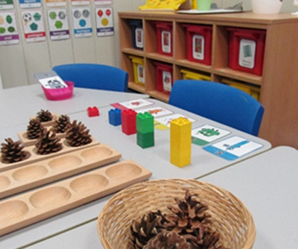
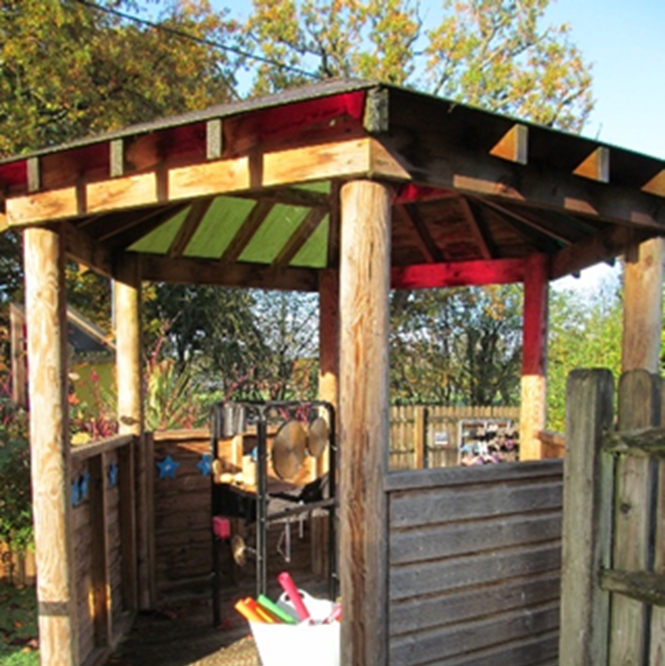
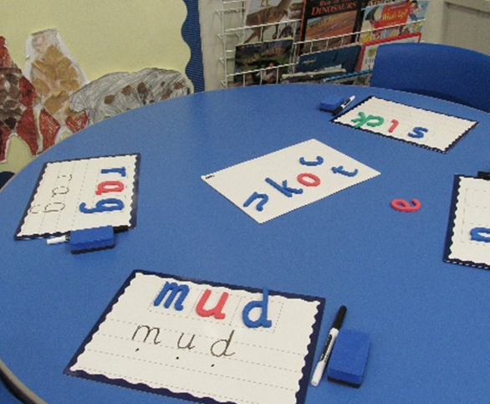
The Foundation Stage Curriculum
Specific areas of learning:
Literacy
Comprehension
Word Reading
Writing
Mathematics
Number
Number Patterns
Understanding the World
Past and Present
People, Culture and Communities
The Natural World
Expressive Arts & Design
Creating with Materials
Being Imaginative and Expressive

Slide 8
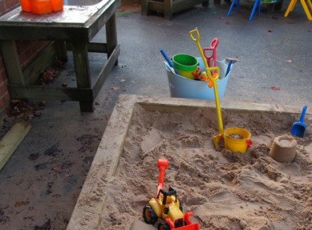
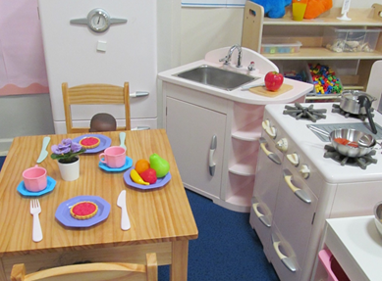
Statutory Assessments in Reception
Reception Baseline Assessment (RBA) – at the beginning of the year
Early Years Foundation Stage Profile (EYFSP) – at the end of the year
Reception Outcomes 2022…
79% of our Reception children attained a ‘Good Level of Development’ (GLD) in 2023 which, is above the national average

Slide 9
Phonics
At Bearwood we use the Lesley Clarke synthetic phonics scheme to teach our phonics.
In Nursery, children will participate in Phase 1 phonics activities such as listening games, rhymes, songs and robot talk.
In Reception children will begin formal phonics lessons mid September and will work through Phase 2 and 3.
Each child will have a slightly different pace in their learning, we focus on helping each child to understand the sounds and skills that phonics teaches.
Once children have begun learning the first few sounds of phase 2 we will begin sending home some reading books. These will be matched to the child’s ability but should be able to be read fluently. We want to encourage a love of reading in your child.
There will be a phonics workshop for Reception parents to help you to understand what phonics is, and how we teach it to the children. Please look out for this information.
Reading at home is an ESSENTIAL part of a child’s development and should happen as much as possible. In Nursery this should be an adult and child sharing a picture book together at a convenient time of day for you as a family. In Reception, this should continue to happen, alongside encouraging the children to look for sounds, find words or read their reading book.

Slide 10
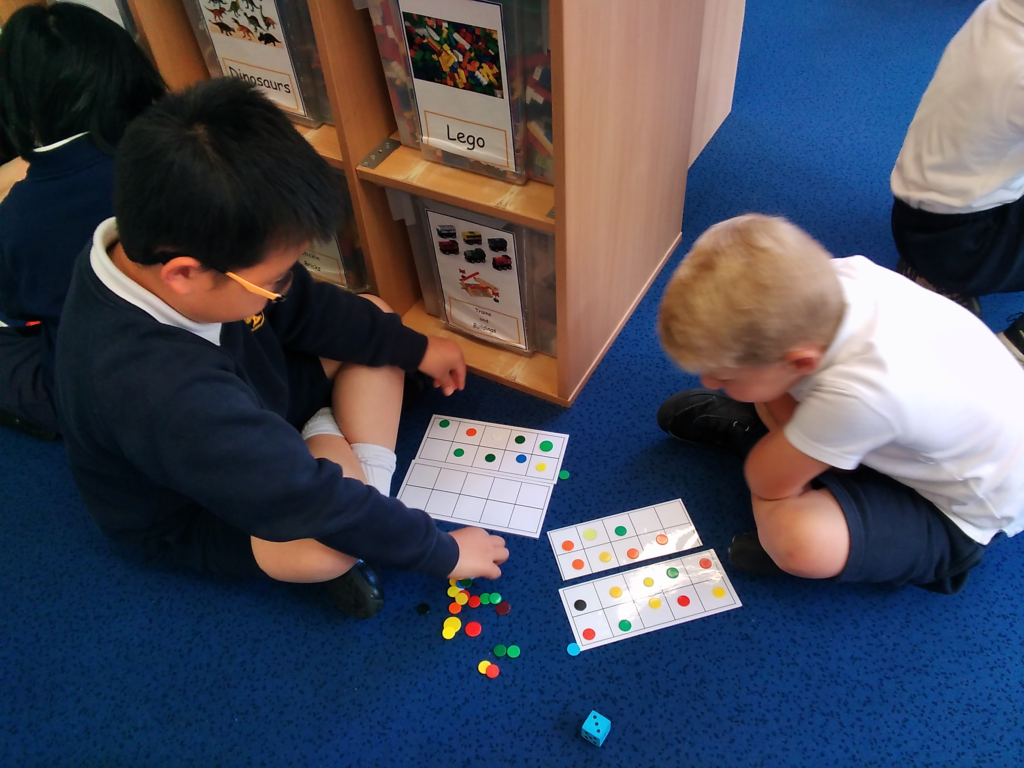
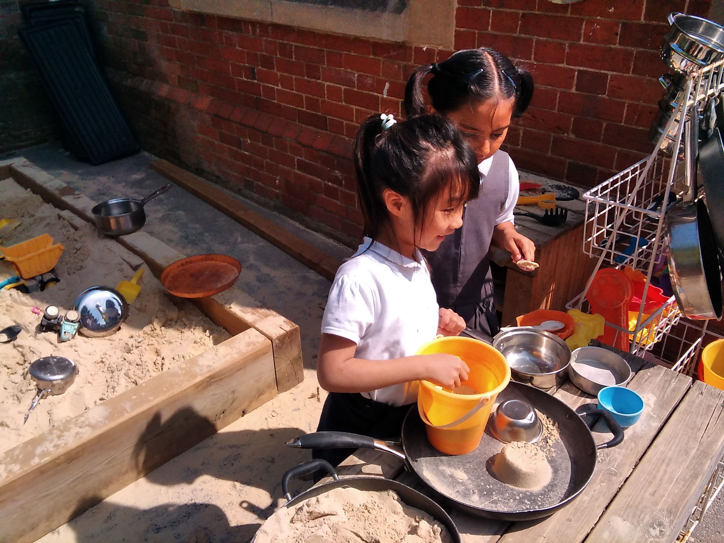
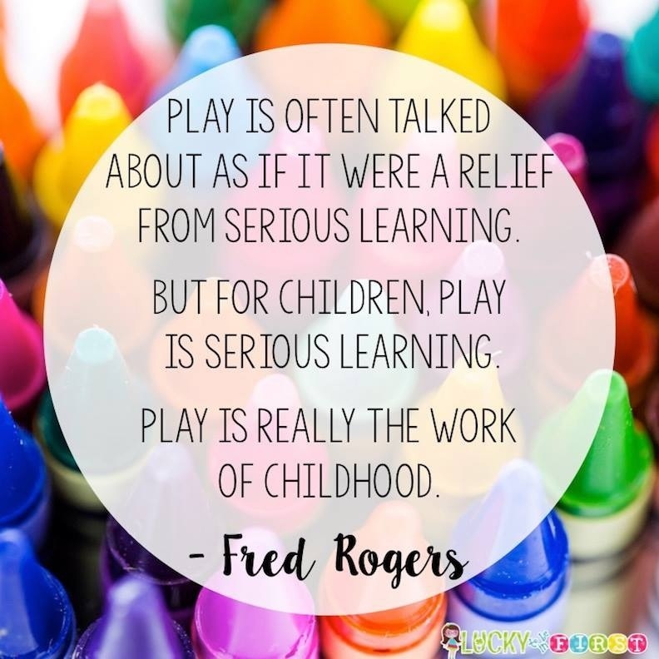
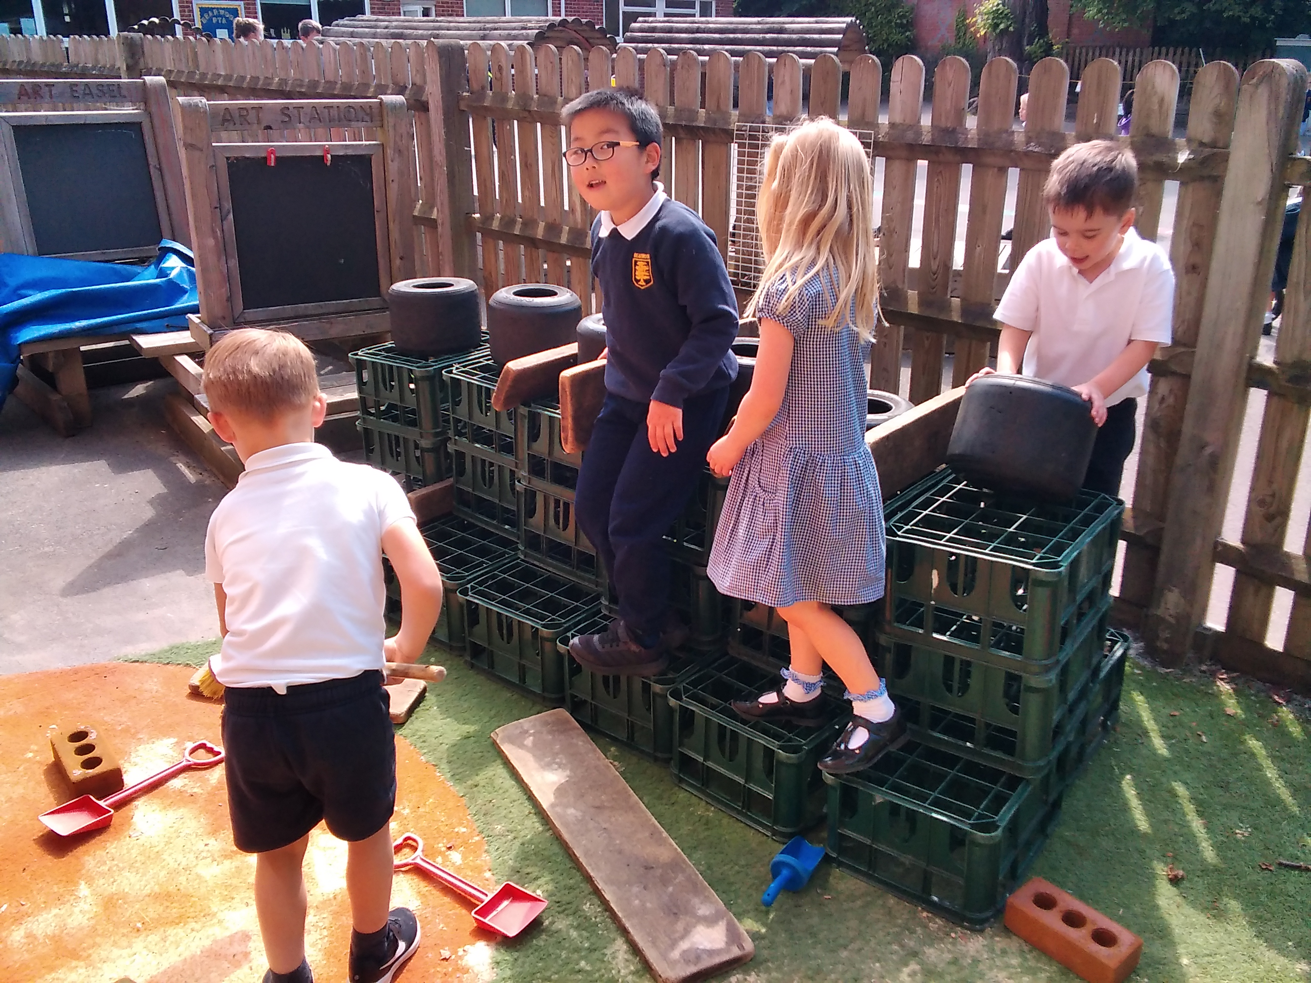
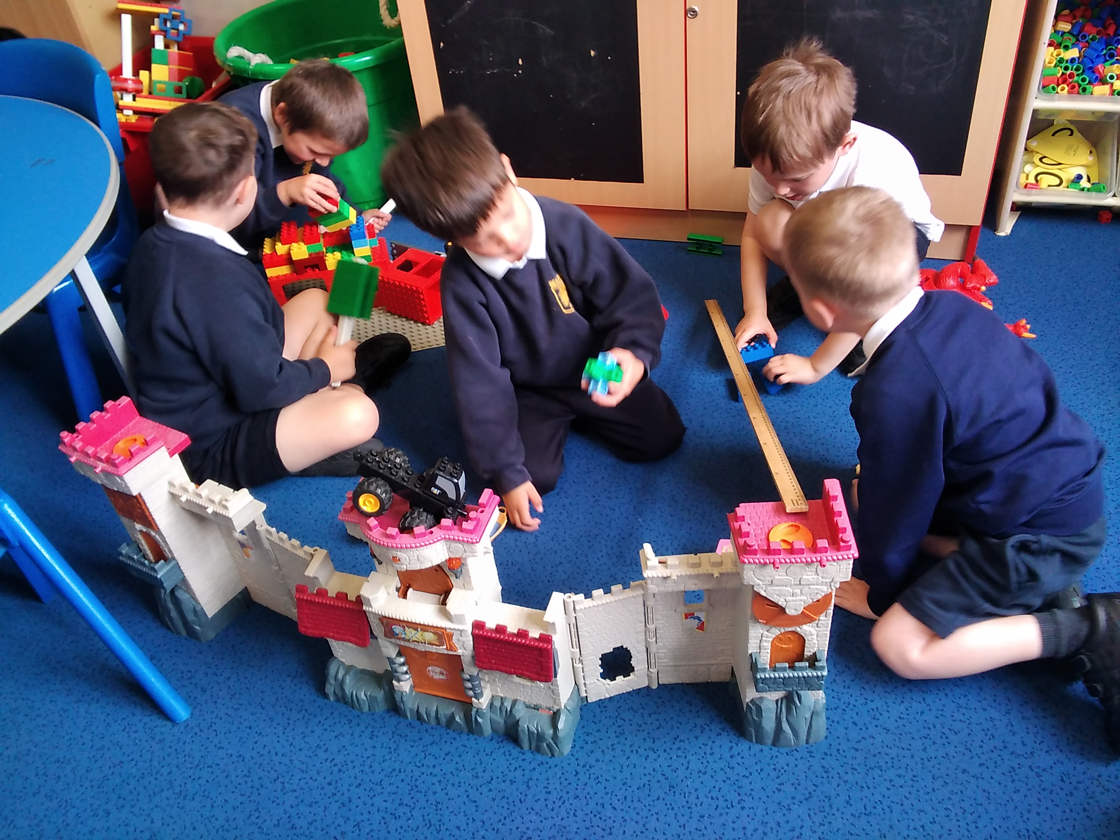
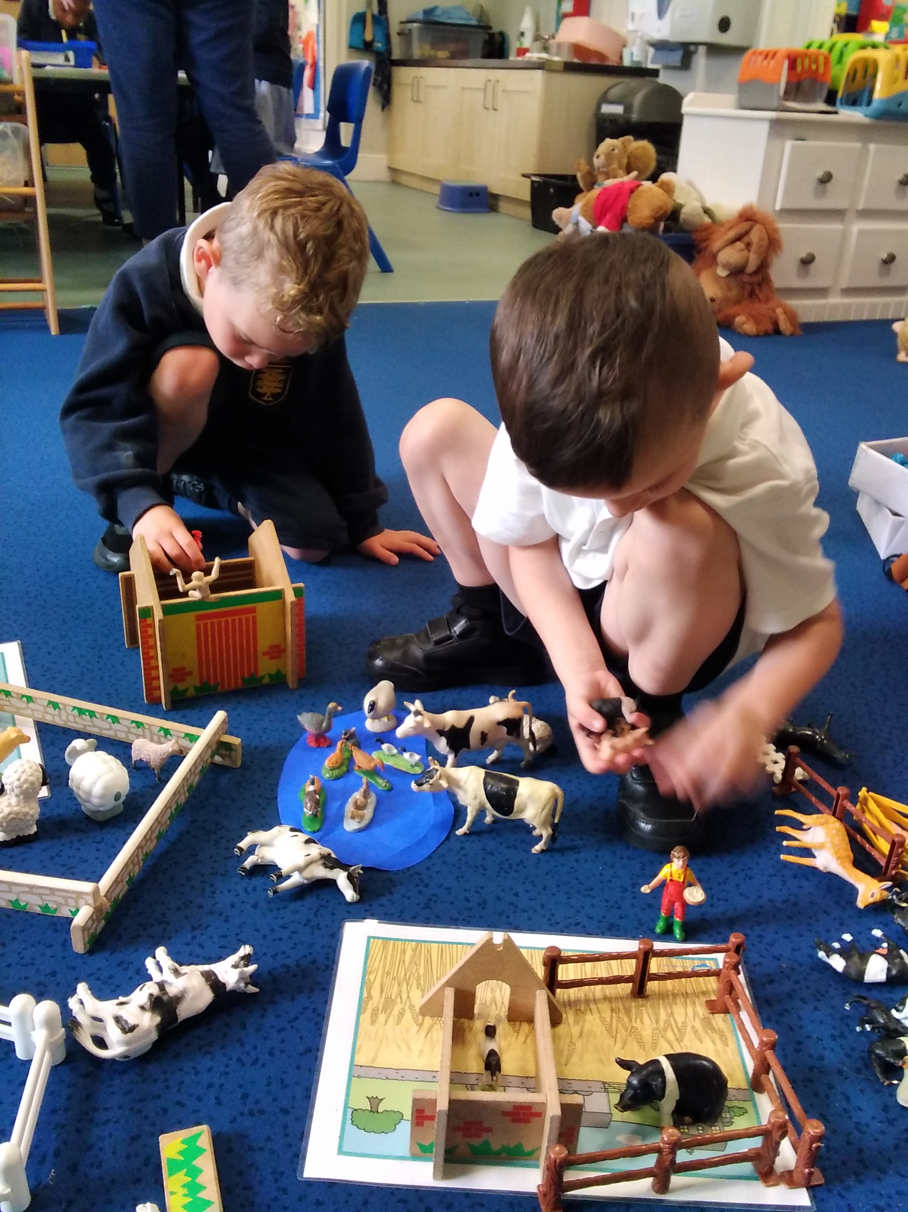
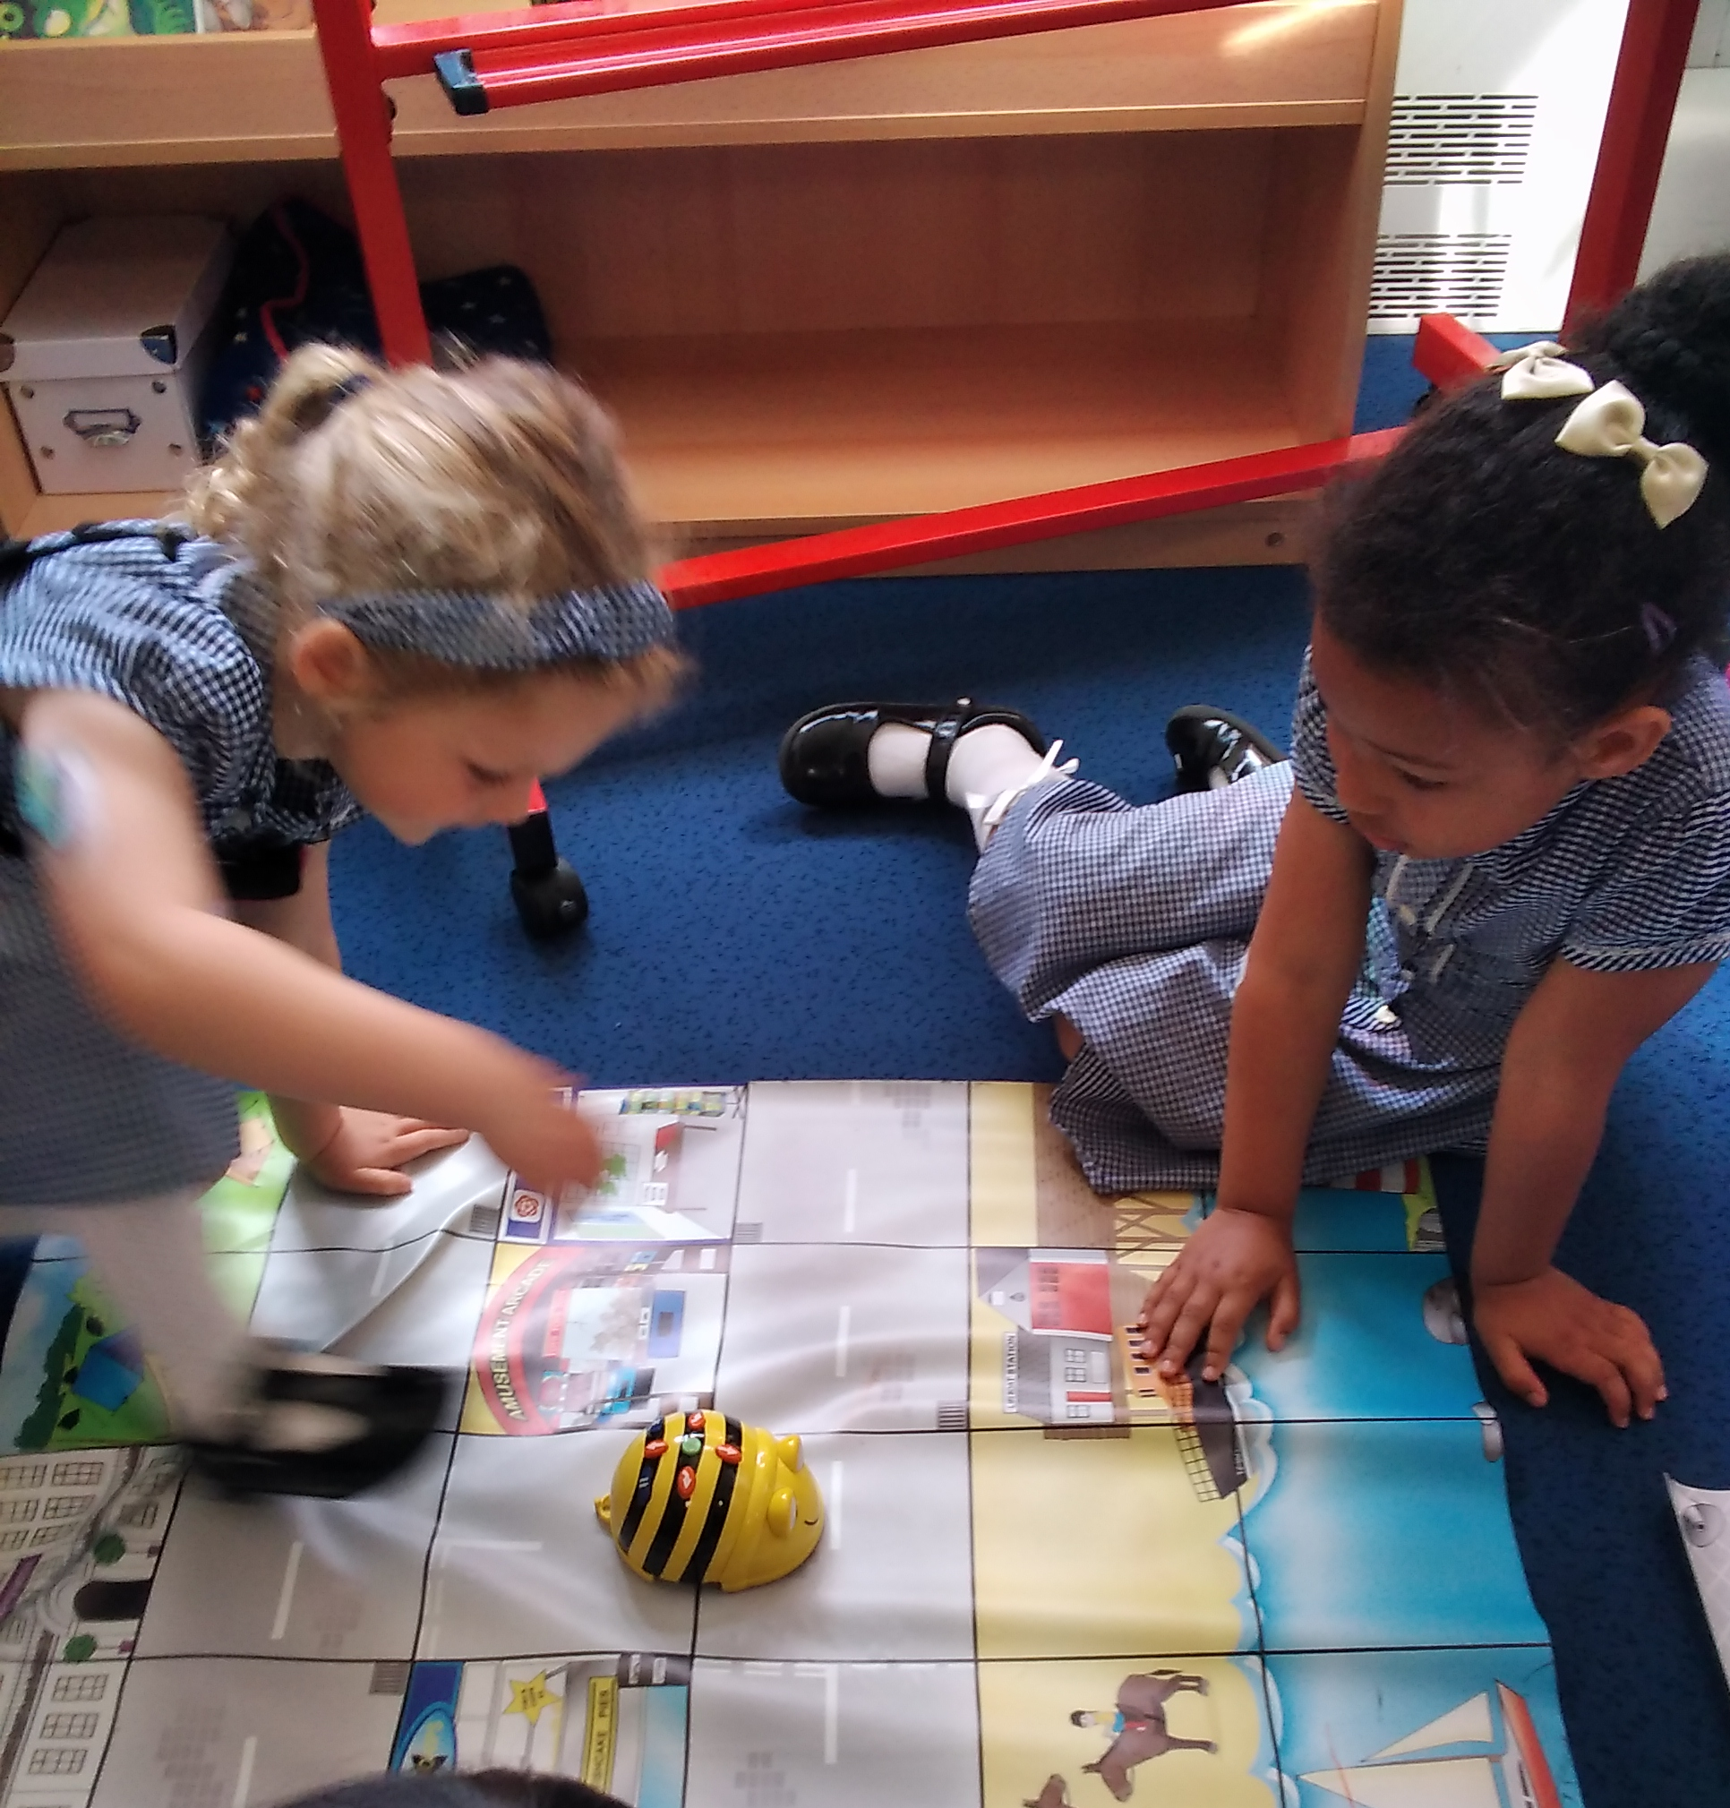
Learning through play

Slide 11
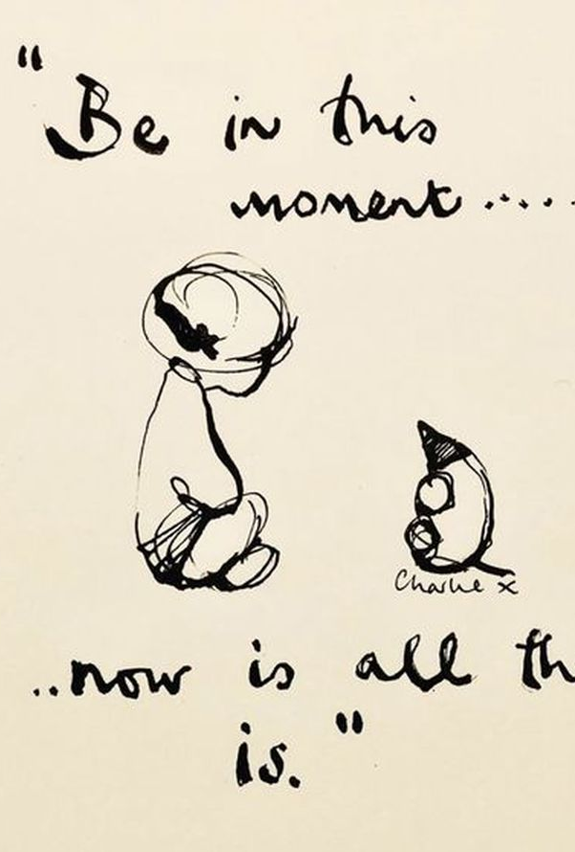
In the moment planning
At Bearwood EYFS, we are moving away from Topics.
Rather than dictate that children will learn Fairy tales for 2 weeks in October, and people who help us for 2 weeks in February, we allow the children to take control of their learning.
Each week, we observe and interact with the children during their play and make notes on what things interest them and what skills they may be keen to develop. We also note down those things that are necessary next steps such as pencil grip.
Teachers then plan a set of lessons dedicated to the interests and needs of your children specifically. This means that we may learn about dinosaurs, light and dark, superheroes…anything your children can dream of!
Learning should be fun, engaging and exciting in this way.

Slide 12
Communication
Communication is so key to us understanding your child. Every morning and afternoon, a teacher will be present on the EYFS door to take any messages and answer any questions. If you need to speak to us in more detail you can arrange a meeting through the office, or send an email.
All letters and communication will be sent via the school office.
We will also hold parent workshops, stay and play and special activities to involve parents in our school life, please keep an eye out for these.

Slide 13
What can I do at home?
The best thing you can do with your child is to talk to them, about anything and everything! Narrate your day, share stories of your activities, ask rhetorical questions or wonderings to get children thinking.
Encourage your children to be independent in their morning routine as much as possible. Can they do their shoes themselves, can they put their coat away.
Ensure nursery children are independent in toileting.
Read! Reading TO your child is just as important as them reading to you. The expression you use in your voice, the way you stop at punctuation...all of this makes for a much more confident reader in your child.
Play alongside your child. Play board games, Lego building, dinosaurs, craft... anything that interests them. Our lives are so busy with work, school, activities, seeing family...that sometimes we forget to stop and play with our children. Modelling this helps with their emotions and their ability to take turns.

Slide 14
Thank you for your time.
Please let me know if you have any questions.

