Slide 1
Safer Internet Day
Notes:
https://www.saferinternetday.org/news/article?id=7043422

Slide 2
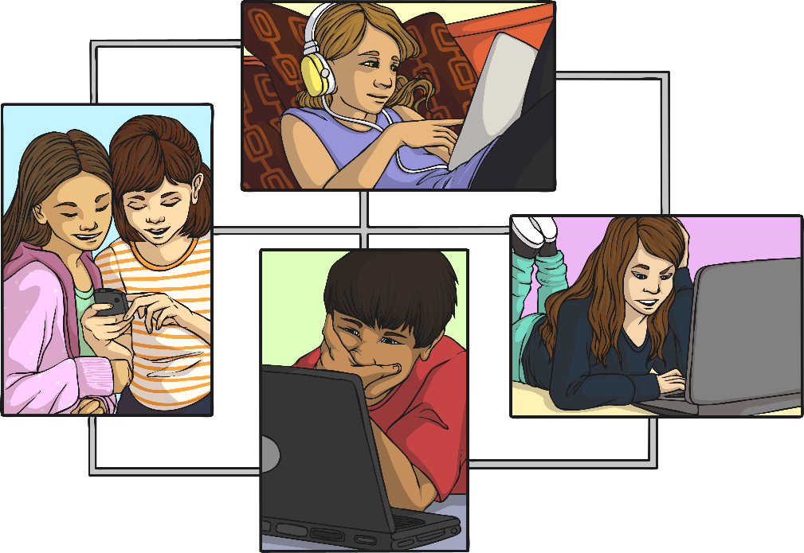
Safer Internet Day
Safer Internet Day is celebrated in over one hundred countries across the world this year it will be celebrated on the Tuesday 7th February 2023.
It is a day for everyone to talk about how to look after each other and stay safe in an online space.
The theme this year is, ‘Want to talk about it?’ Making space for conversations about life online.
In school we will be completing age appropriate activities.

Slide 3
This year we are hoping to answer the following questions:
What issues really matter to children and young people?
What changes do they want to see?
How can we all work together to advocate for them moving forward?
With your help, Safer Internet Day 2023 can be a springboard for conversations that shape how we talk about and respond to online issues, not just for one day, but throughout the whole year.

Slide 4
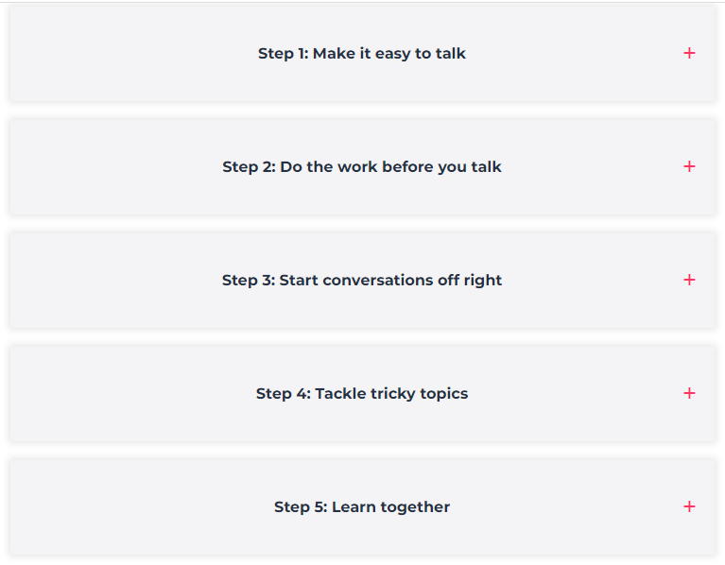
https://www.internetmatters.org/safer-internet-day/

Slide 5
Make it easy to talk
Create the right environment
Conversations about online safety don’t have to be awkward or feel like a lecture. Talking while you’re already spending time together — like during a meal, while driving in the car or as a part of a bedtime routine — is a great way to make discussions about online safety feel natural.
Listen to what your child has to say and give them time to form their words, even if you have concerns. Listen more than you speak, so they can see that you’re actively listening to them. Ask them open-ended questions to help encourage more meaningful responses.
A welcoming and open environment will help your child feel comfortable talking to you about their daily online lives.
Get more support here with expert advice from Dr Linda Papadopoulos, Martha Evans and Catherine Knibbs.

Slide 6
Do the work before you talk
Understand what to talk about and when
When having conversations, make sure you’re informed. Explore the apps and platforms they use and read up on common online safety issues they might face. Understanding common issues and interests by age can also help you direct the conversations you have towards things you might worry about.
Advice by age
0-5 guide
6-10 guide
11-13 guide
14+ guide
Learn more about supporting your child’s digital journey here.

Slide 7
Start conversations of right
Use the right words and keep it age-appropriate
Help your child build their digital resilience by understanding where to start. For instance, your concerns for a younger child might differ from older children. So, it’s important to start off with the right context.
Additionally, getting to know your child’s interests can help you use the right language. If you know the different terms they use to communicate, what the names of their favourite video games are or who the different characters are, you’ll be better able to connect with them. They’ll also understand what you’re talking about and see that you have invested time into their interests.

Slide 8
Tackle tricky topics
Find simple ways to approach tough topics
Sometimes both parents and children alike might shy away from tougher topics like sexting, online relationships, grooming and more. However, conversations about harder topics are just as important as those about screen time and bullying. They play a key part in helping children recognise risk and harm online.
Talk about reality versus media
Discuss how social media and mediums like pornography distort reality. Talk about the unrealistic standards portrayed online and how that is created for views or financial gain, not reality. Encourage them to think critically about content they see online to consider whether what they see is real.
Talk about the impacts of online content
Some content might leave young people feeling depressed, anxious or unsure. Algorithms that promote self-harm, fake news or other harmful content may impact how users think and feel about the world around them. It’s important they understand where to go if they need support such as talking to a trusted adult or contacting someone on Childline.
Explore here more advice from Dr Linda Papadopolous on how to have meaningful conversations about tough topics.

Slide 9
Learn together
Use online tools to help develop understanding
Whether tackling fake news, discussing gender stereotypes or exploring online safety platforms, going on these journeys together can help you learn just as much as your child. Discover how they approach different situations, what they think about key safety issues and help them learn how to approaching risky situations to avoid harm.
Explore these interactive tools below.

Slide 11
https://parentzone.org.uk/advice/parent-guides
A great website to find out age ratings, risks and parental controls for some of the latest apps and games.

Slide 12
https://www.parents.parentzone.org.uk/morearticles/screen-time-everything-you-need-to-know
Key information
The type of content your child consumes is far more important than how much time they spend on their screens.
For older children, spending all your time doing any one thing isn’t very healthy. Certainly, sitting all day is quite bad for us. But if children are using their screens to make contact with their friends, that may well be the most important and valuable thing for them right now.
The more children are controlled and monitored, the less likely they are to know how to respond when things go wrong. What's more, monitoring doesn’t guarantee that they will be protected from risk.
It’s important for your child to think about their own screen time. Help them to establish their own boundaries.

Slide 15
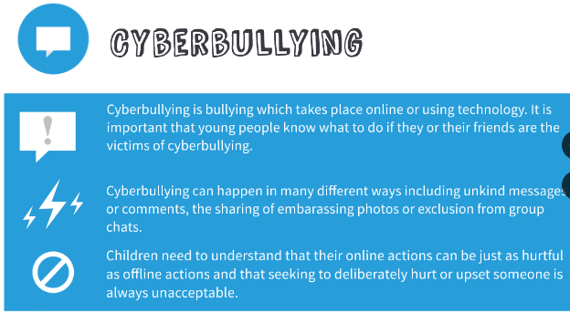

Slide 20
Useful links
https://saferinternet.org.uk/
https://parentzone.org.uk/advice/parent-guides
https://www.parents.parentzone.org.uk/morearticles/screen-time-everything-you-need-to-know
https://www.internetmatters.org/

