Slide 1
Welcome to LKS2 Year 3 and 4
The LKS2 Team
Year 3 Red Squirrel class - Miss Reed with Mrs Brooker
Year 3/4 class – Mrs Haden and Miss Parry with Mrs Smith
Year 4 Dormouse class – Miss Lloyd with Mrs Tang

Slide 2
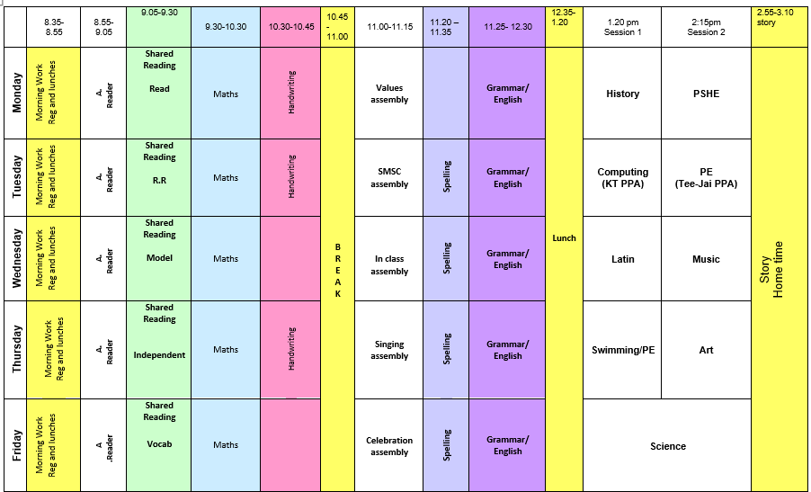
A weekly timetable in LKS2

Slide 3
Reading
It is expected that children will read daily at home. When children have completed their book, they will complete a quiz on Accelerated Reader in school. Children can record their reading in their Reading Record and teachers will check these frequently.
Accelerated Reader helps teachers manage and monitor children’s independent reading practice. Your child picks a book at his/her own level and reads it at his/her own pace. When finished, your child takes a short quiz on the computer. Passing the quiz is an indication that your child understood what was read. Accelerated Reader gives both children and teachers feedback on the quiz results, which the teacher then uses to help your child set targets and direct ongoing reading practice.
Children who read 20mins+ per day make better progress academically. Some children will also have regular 1:1 reading at school.
Reading to your child at home is also beneficial.

Slide 4
Shared Reading lessons
We will have a 30-minute whole class reading session at the start of each day. Each class has a high-quality text that they read together. We follow a structured program that includes reading the text fluently, working out the meaning of unknown words and asking and answering questions on the text to develop comprehension skills.
This half term our Shared Reading text will be ‘Anglo-Saxon Times.’
Our class book that we read at the end of each day will be ‘The Firework Maker’s Daughter.’

Slide 5
Writing
In English, we follow the two-week unit of the writing stages based on our shared reading or class book:
Read text 1 lesson
Analyse text 1 lesson
Planning 1 lesson
Shared drafting 2 lessons
Read second text 1 lesson
Planning Independent piece 1 lesson
Independent drafting 2 lessons
Edit and revise
When a child produces a piece of independent writing, we identify the next step in their writing development and feed that back to the child.
We give the child strategies or scaffolding resources to support the child to meet the next steps in a variety of forms of feedback.

Slide 6
Spelling
Each child has a spelling journal which they use to record the spelling rules we learn and practise in our daily spelling lessons. The spelling journals also contain a list of the statutory Year 3 and 4 words and key phonics sounds for them to refer to in English lessons.
Learning the spelling rules enables pupils to apply them when spelling a range of words.
E.g. -able/-ible
If the root word can stand alone, it is probably –able: collectable. If it can’t, it is probably –ible: edible
Children will receive weekly set tasks on Spelling Shed to practise further.

Slide 7
Maths
A huge focus in LKS2 is times tables.
By the end of Year 3, children are expected to know the facts for the 2, 3, 4, 5, 8 and 10 times tables, with corresponding division facts.
By the end of Year 4, children are expected to know all multiplication facts up to 12 x 12, and their related division facts.
In the Summer term, children in Year 4 will be completing a Multiplication Tables Check consisting of 25 questions on a device in order to test their speed and fluency with the times tables up to 12x12.
We will be regularly practising times tables and will use Times Tables Rock Stars to help us. Practising daily at home will significantly support children’s progress in learning the times tables so that they confidently recall them without relying on counting up in multiples.
In LKS2, we will continue to follow White Rose Maths for our maths lessons and children will be provided with problem solving and reasoning in order to deeper their knowledge and provide them with opportiunties to mathematically reason.

Slide 8
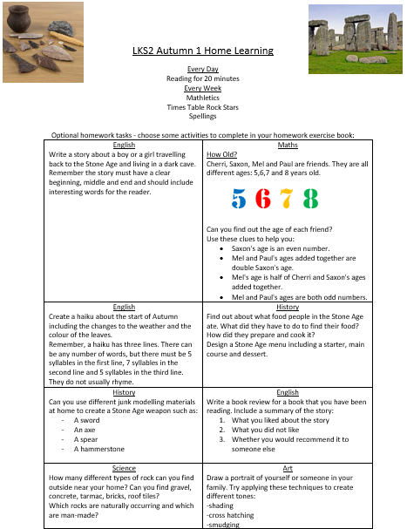
Homework Expectations
Daily reading for 20 minutes
Complete a weekly task on Spelling Shed
Complete a weekly task on Times Tables Rock Stars or Mathletics
You will also continue to receive half termly activity bank of homework tasks that children can choose to do at home if they wish. We will be providing each child with a homework book that they can record their work in.
Aspire ~ Succeed ~ Excel​​​

Slide 9
PE Kit
PE will be twice a week and will begin from next week. Children will continue to come to school in their PE kit.
Red Kite and Red Squirrel PE days are Tuesday and Thursday
Dormouse PE days are Monday and Thursday
For PE children should wear:
Plain navy shorts - no logos or cycling shorts
Gold printed School PE T-shirt with navy school logo
All black plimsolls/trainers – no high tops or brightly coloured logos
Plain navy track suit or jogging bottoms - no logos, leggings or hoodies
All long hair to be tied up at all times
Please make sure all clothing (including school uniform) is clearly named.

Slide 10
Additional Information
Medical Lists
If your child has any medical conditions or allergies, please make sure our records (and their medications) are up-to-date. Please make sure to check this with the office.
Children should not bring in any lip balms, hand gels or hand creams/sprays etc unless they have been approved by the office.
Jewellery and valuable belongings should not be worn or brought to school. If children have pierced ears only one stud earring in each ear may be worn at school. Earrings must be removed for PE/games or micropore tape used to cover them. Analogue watches may be worn but must have a dark colour strap. For safety reasons no other jewellery may be worn.
Make-up of any kind is not permitted, this includes nail varnish. Uniform check will be carried out daily and if children are not wearing the correct uniform they will be sent to the school office to borrow the correct item to use for the day. If a child is not wearing correct uniform, including accessories or make-up, a uniform slip will be sent home with the child.
Other information
Children bring in their own healthy break time snack which must be either fresh fruit or vegetables and a water bottle. Bananas must not be brought into school.
Whilst we welcome parents to speak to class teachers at the end of the day, please wait until all the children have been released to their parents.

Slide 11
Be Ready to Learn
Children benefit from:
A good night’s sleep (including an early enough bedtime)
A healthy diet including a good breakfast
Being clean and comfortable
Being in school on time
We hope our Year 3/4 children continue to enjoy their learning journey at Bearwood ☺

Slide 12
Any questions?

