Slide 1
Welcome to UKS2!
2024/25

Slide 2
UKS2 Staff Team
Year 5 Badger Class
Miss C Cowdell
UKS2 Lead and
Year 6 Grey Wolf Class Teacher
Mr L Marshall
Year 5/6 Otter Class Teacher
Miss K Muller
LSAs
Mrs Fenton
Mrs Weaver
Miss Rai
Mr Willmott

Slide 3
Our Vision
We aspire to be an outstanding, values-based school at the heart of our diverse community.
Striving for excellence, our focus is to enable our children to be resilient and independent learners whilst also considerate of others.
Through an all-encompassing curriculum, our children will achieve their highest potential and have a firm foundation on which to build successful and productive lives in an ever-changing world.
Aspire Succeed Excel

Slide 4
High Expectations
Keep up, not catch up.
Expect all children to achieve.
Leading children to a way of thinking that allows them to grow, developing their minds in order to achieve more than they might at first believe possible.
We want our children to be determined and learn from their mistakes as an important part of the learning process.

Slide 5
Voice 21
Improving students’ oracy skills
Every child has the opportunity to develop strong communication skills.
Become more confident, articulate their ideas in discussions, talk like an expert.
Prepared for future challenges.

Slide 6
The importance of attendance
Academic Success
Social Development
Good Habits

Slide 7
SATs – Year 6
Will take place between Monday 12th May and Thursday 15th May
Pupils will be tested on grammar, spelling and punctuation, reading and mathematics.
Allow the school to see progress made over KS2.
Presentation in early spring 2025 for more information.

Slide 8
Reading
Focus on comprehension skills
Shared reading lessons
Accelerated Reader
Reading across the curriculum
Reading at home

Slide 9
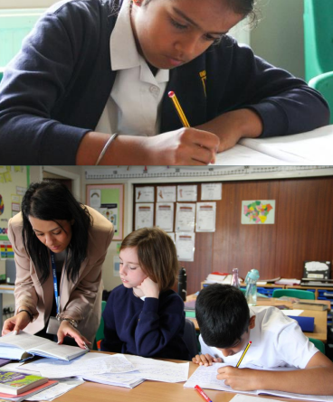
Writing
Write clearly, accurately and coherently
Adapt language and style for a range of purposes and audiences
Understanding and manipulating punctuation and grammar
Apply spelling rules
Excelling throughout the curriculum

Slide 10
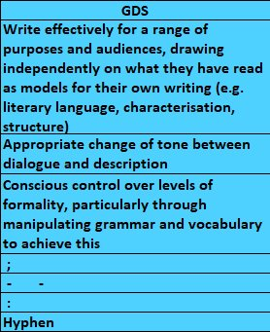
Writing criteria

Slide 11
Maths
We aim for pupils to develop a mastery of maths by allowing them to develop a long, deep and secure understanding of mathematical concepts.
We do this by:
Small, manageable steps.
A variety of representations
Helping pupils make connections, spot patterns and ask questions.
Encouraging pupils to be clear in their reasoning.
Be fluent in the fundamentals of mathematics

Slide 12
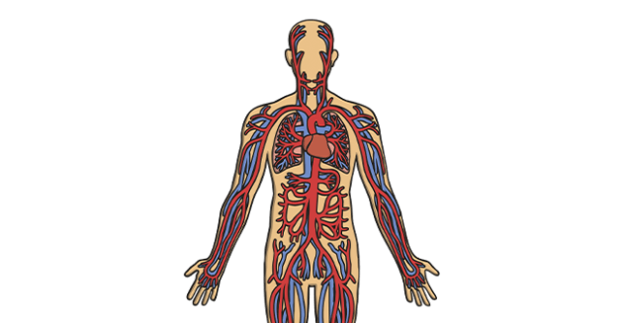
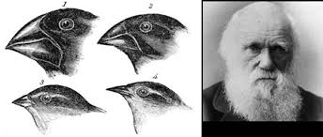
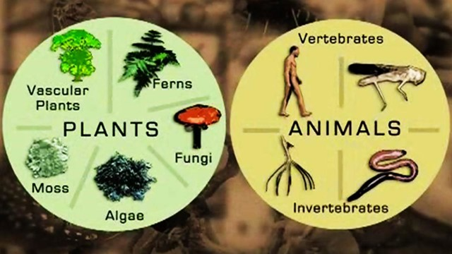
Science
Computing
Light | Electricity
The Circulatory System | Evolution and Inheritance
Classification of Living Things | Looking after our environment
Keeping safe online |  | Coding | Blogging
Spread-sheets | Text Adventures | Networks | Quizzing

Slide 13
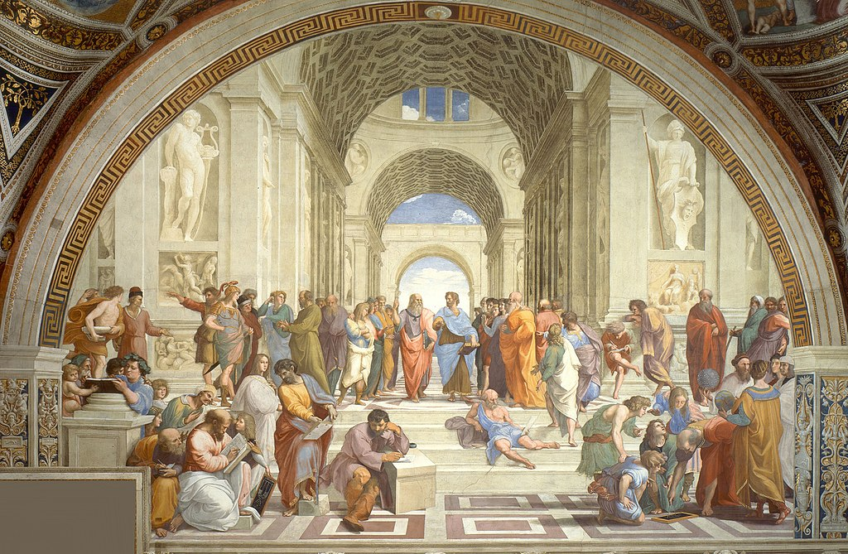
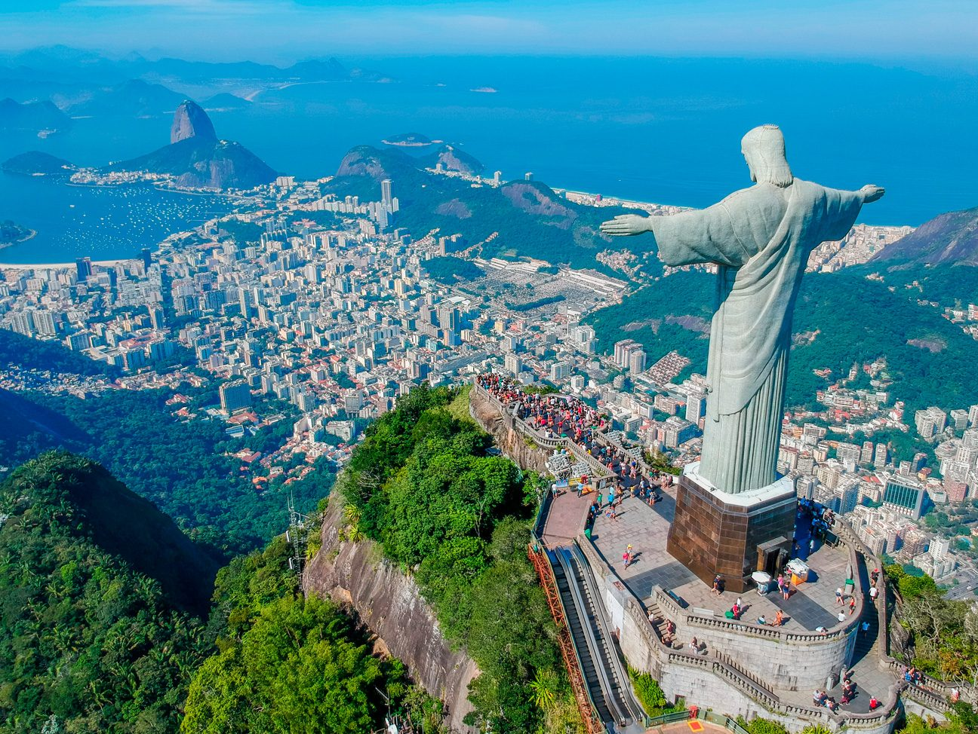
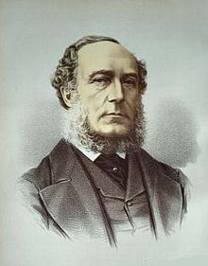
History
Geography
Ancient Greece
Reading and Rio de Janeiro
A History of Winnersh
Fair Trade

Slide 14
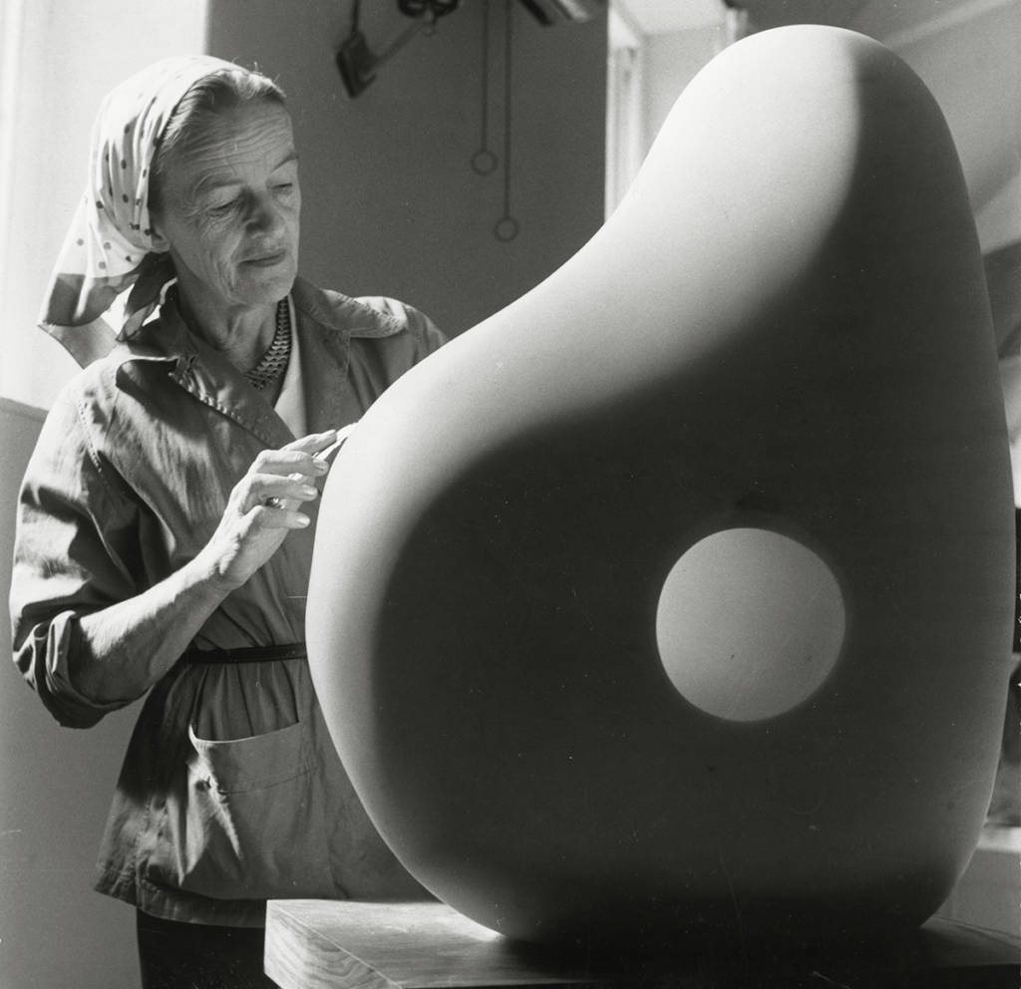
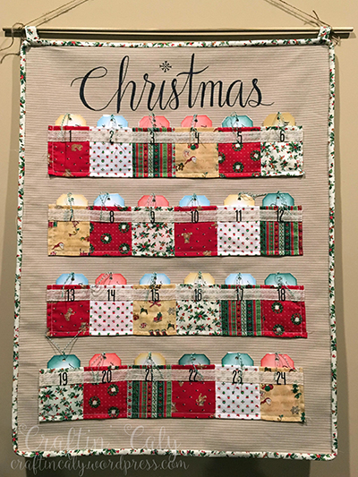
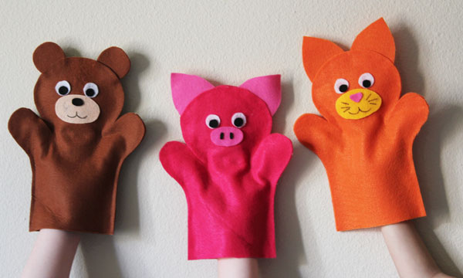
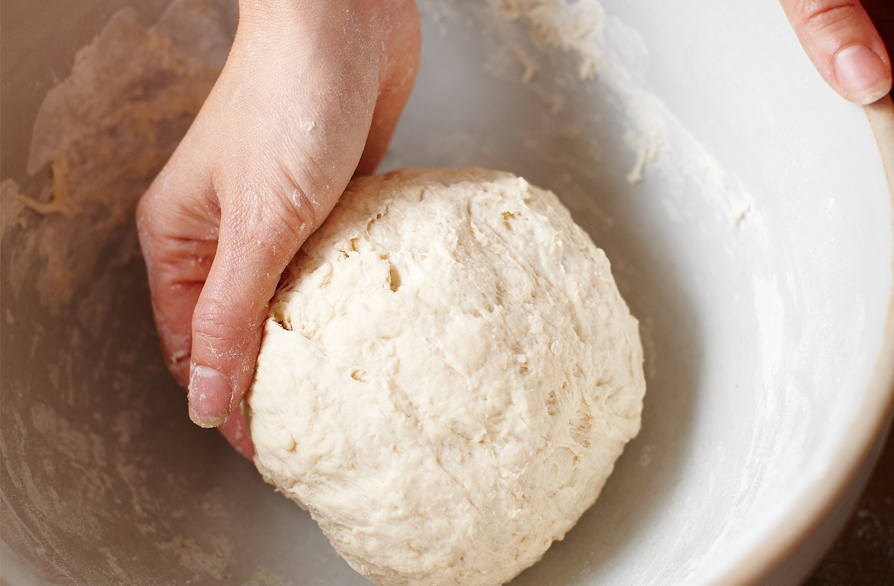
Art
Design and Technology
Sculpture
Textiles: Advent Calendar
Digital Media: Holiday Presentation
Puppet Display
Lino Painting
Bread Making

Slide 15
Religious Education
PSHE
How can we keep healthy as we go? Physical and mental wellbeing, drugs and alcohol education, staying safe
How can the media influence people?
Relationships and Sex Education (RSE): Year Five – Growing and Changing Year Six – Puberty and Reproduction
What will change as we become more independent?
How do friendships change as we grow?
Christianity | Islam
Is anything ever eternal? How significant is it that Mary was Jesus’ mother? Is Christianity still a strong religion 2000 years after Jesus was on Earth? | What is the best way for a Muslim to show commitment to God? Does belief in Akhirah (life after death) help Muslims lead good lives?
Our RSE Policy is on the school website. Before we teach the RSE units, we will invite parents to come to a meeting where we will share what we will cover and the resources we will use with the children.

Slide 16
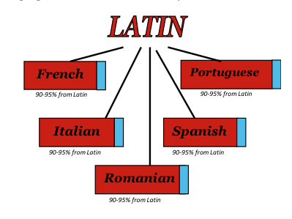
Music
Latin
Latin supports the development of spelling, grammar and vocabulary.
Research shows children who are require additional support experience the greatest gains in Latin.
Music and Technology | Developing Ensemble Skills
Creative Composition | Musical Styles
Improvising with Confidence | Performance (Y6 show)

Slide 17
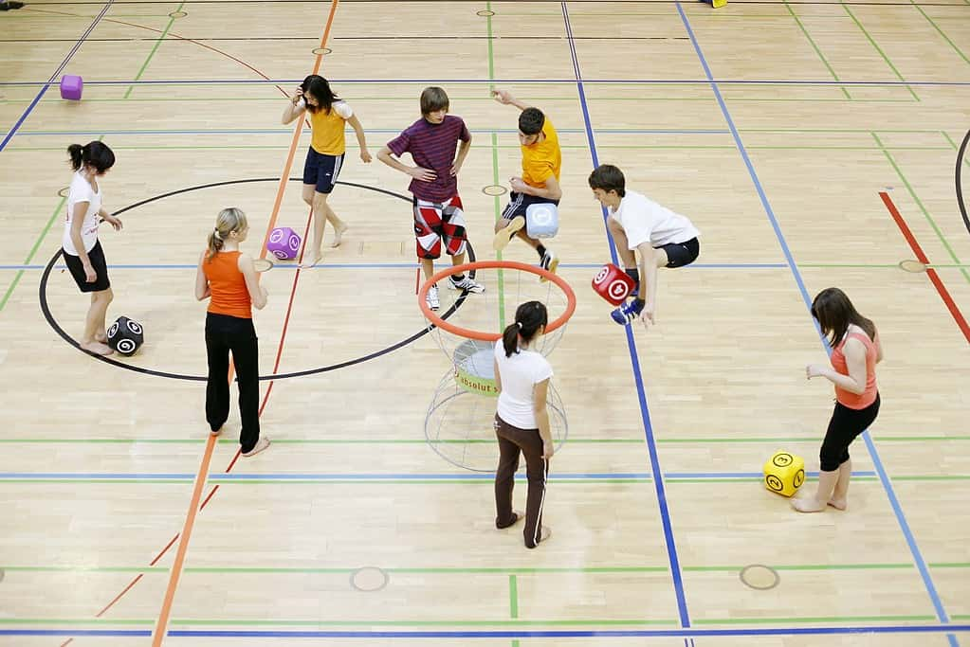
Physical Education (PE)
Class | PE Days
Badger (Y5) | Monday and Thursday
Otter (Y5/6) | Wednesday and Friday
Grey Wolf (Y6) | Wednesday and Friday
Games Skills
Tennis
Gymnastics
Hockey
Netball
Dance
Football
Rugby
Country Dance
Athletics
Striking and Fielding

Slide 18
Homework
Children should:
Read every day for 20 minutes. They should record the books they are reading in their home/school reading book.
Complete the set Spelling Shed activities 3 times a week. These include spelling and grammar exercises.
Complete set tasks on either Mathletics or Times Tables Rock Stars 3 times a week.
Your child will have their logon details for the learning platforms.
Each half-term, we will also email to you a range of additional homework tasks your child can complete. We will send home an exercise book for the homework to be completed in.

Slide 19
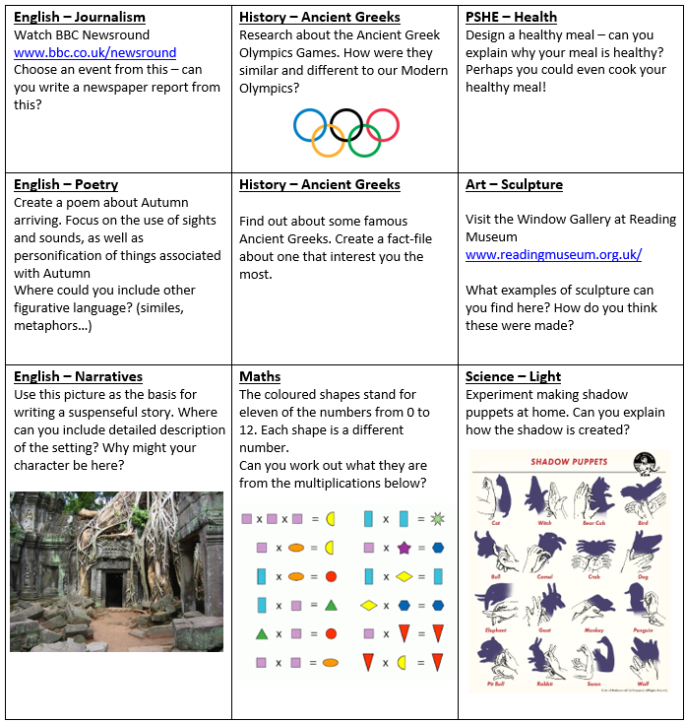

Slide 20
How else can I support my child at home?
Reading – the key to learning and progress
Fluency – times tables!
Homework
Communication!
A note on after-school activities
Year 6 - SATs
SATs are important, but they are only a snapshot of your child’s educational life. Try not to worry or over-stress your child with additional homework or pressure to perform.
No past papers!

Slide 21
Enrichment Activities
University of Reading Greek Archaeology Workshop
Reading Field Trip
Brazilian Carnival
Reading International Solidary Centre – Fairtrade Workshop
Year 6 – Residential
And more!

Slide 22
Additional Information
Water Bottle
Fruit or vegetable break snack
Lip balms, hand gels or creams,
Jewellery or valuable belongings.
Make-up
School uniform
Going home alone
Mobile Phones

Slide 23
We’re looking forward to a great year!
Any questions?

