Slide 1






Teaching Early Reading
Bearwood Primary School 2025

Slide 2
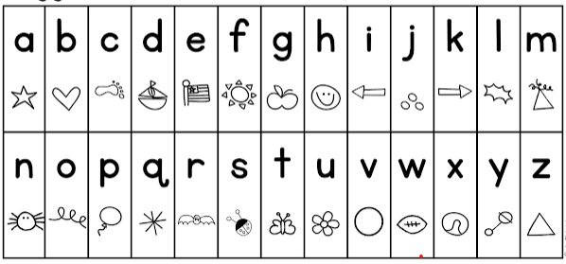

Slide 3
Learning to read is hard.
Your child needs your help, support and encouragement.
Parental involvement in reading is beneficial.

Slide 4
Parental involvement significantly impacts children’s reading comprehension, motivation, and attitudes towards reading.
US Department of Education

Slide 5
Children benefit from parental involvement in reading programs, with higher fluency and effort.
Intech Open

Slide 6
Active parental engagement in reading related activities such as reading together and providing access to books, contributes to reading development.
United International Journal for Research & Technology

Slide 7
Parental engagement in early reading techniques significantly enhances children’s early literacy skills. These findings underscore the importance of fostering a reading environment at home and the positive impact of parental involvement on children’s reading abilities and performance.
Research Schools Network

Slide 8
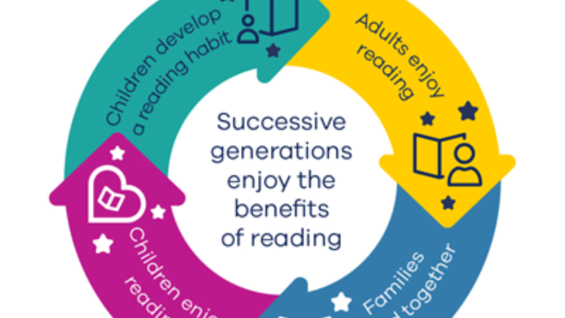
BookTrust research: Children are 40% more likely to enjoy reading if their parents or carers do

Slide 9
At Bearwood we use a phonics- based approach where children are given decodable books using sounds they have already been taught. This method focuses on the relationship between letters- graphemes and sounds - phonemes.
Steps to decoding a word
Step 1: Identify the symbol.
Step 2: Recall the associated sound.
Step 3: Blend consecutive sounds into a word.

Slide 10
c | a | t

Slide 11
c | a | t

Slide 12



c | a | t

Slide 13
Pros of Phonics Instruction | Cons of Phonics Instruction
Strong Research Base: Extensive research supports its effectiveness, especially for beginning and struggling readers. Decoding Independence: Gives students the tools to decode new words independently. Foundation for Literacy: Improves spelling and writing skills by building an understanding of letter-sound relationships. Targeted Intervention: Highly beneficial for students struggling with reading. | Potential for Mechanical Reading: Exclusive use of phonics can lead to a focus on decoding without comprehension. Insufficient for Comprehension: Phonics alone doesn't develop reading comprehension; it must be combined with other reading strategies. Challenges with Irregular Words: English has many irregular words that don't conform to phonetic rules (e.g., "said," "does"). Limited Engagement for Visual Learners: Highly visual learners might not find traditional phonics instruction engaging.

Slide 14
Developing Fluency – Reading a Sentence
sit and nap

Slide 15
Teaching irregular words
Not all words can be decoded; irregular words need to be automatically identified. These words are phonetically irregular as they do not follow the phonic or spelling “rules”. Interestingly approximately 25% of the most frequently used words in children’s books are irregular. www.sightwordsgame.com

Slide 16
Teach irregular words that your child will encounter regularly.
Phase 2 – the, to , no , go, I
Phase 3 – he, she, we, me, be, was , my , you, they, her, all, are
Phase 4 – said, so, have, like, some, come, were, there, little, one, do, when, out, what

Slide 17
Games you can play to teach Tricky Words;
Flashcards
Word snap
Dominoes
Bingo
Quick read – How many can you read in a minute
Which one is the correct spelling
Mnemonics and rhymes

Slide 18
Useful tips;
1. Teach the irregular words prior to reading them.
2. Review tricky words on a daily basis.
3. Provide your child with opportunities to use the newly taught words.

Slide 19
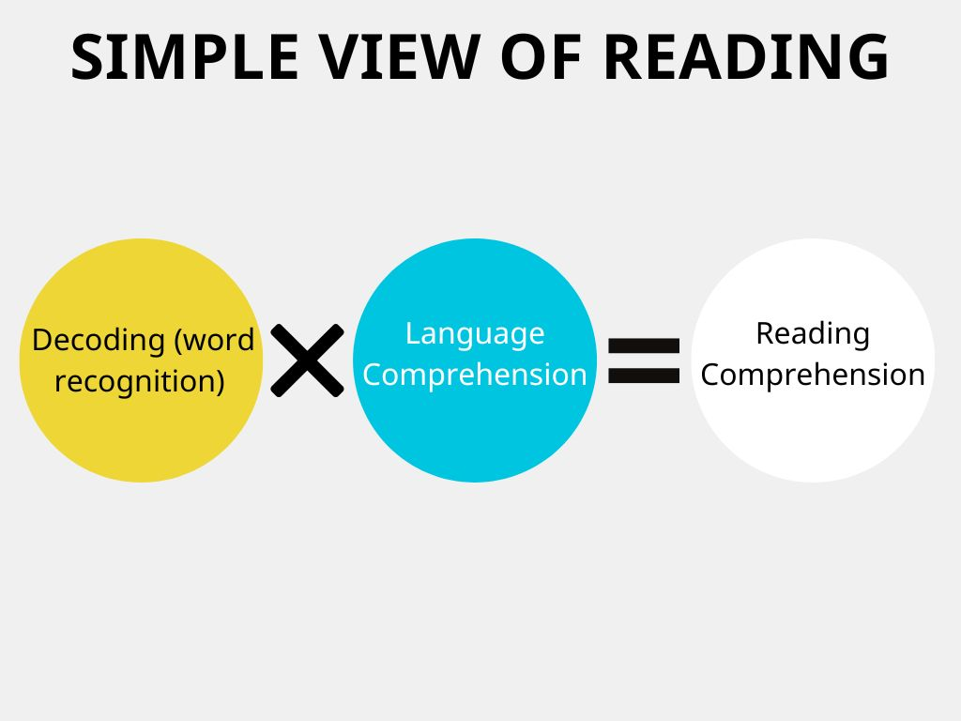
If either decoding or language comprehension is weak, reading comprehension suffers. Since the formula uses multiplication, any gap—whether in sounding out words or understanding their meaning—impacts the overall ability to comprehend text.

Slide 20
The magic of sharing stories at home

Slide 21
My child doesn’t want to read at home.

Slide 22
Indicators on Learners' Reading Attitude
1. Establishing a Reading Routine.
2. Providing rewards.
3. Modelling Good Reading Habits.
4. Encourage Reading.
5. Reading with them.
6. Discussing the book.
7. Setting goals to improve the reading level.
8. Exploring different genres of books.
9. Reading Aloud.
10. Reading for fun. Carina Arancillo Gino, 2023.

Slide 23
Top Tips when hearing your child read.
Before the read | During the read
Choose a place that is quiet and not in a space where you are going to be disturbed lots - this will help both you and the child focus. ● Be prepared - if you can, look at the book that the child is reading so that you have an overview of it. ● Talk about the book as a whole before you start - look at the front cover discuss what you are expecting to happen in the book from the clues on the front cover. ● Start by reading a small section of the book to the child to get the reading going and draw their interest. ● If it’s a book that they have already started, ask them to review what has happened so far. | ● Be patient, give them time rather than filling in the blanks for them, try to count to 10 before intervening. ● When you are offering help try to give them tools rather than just tell them the word. Use phrases such as: “Well done, you had a go” “Well done you used expression” “Good, you corrected yourself”, “Good, but did that sound right?” “I like the way you read that” “Listen, and I will demonstrate this sentence” ● Really praise self-correction and solving their own sounding out problems – this will encourage them to do it more. ● Encourage the segmentation and blending of sounds to support the sounding out process. ● Ask some prediction questions as you are hearing them, read – possibly before the turn of a page.

Slide 24

Questions

Slide 25

Let’s practise – let’s invite your child to come and read with you.

