Slide 1
Welcome to KS1!
Bearwood Primary School 2024-2025

Slide 2
Our Vision
“We aspire to be an outstanding, values based school at the heart of our diverse community.
We are striving for excellence, our focus is to enable our children to be resilient and independent learners whilst also considerate of others.
Through an all-encompassing curriculum, our children will achieve their highest potential, and have a firm foundation on which to build successful and productive lives in an ever-changing world."

Slide 3
Key Stage One Staff
KS1 Lead/Year 2 Teacher – Miss Davis
Year 1 Teacher – Ms Brannigan
LSAs – Mrs Davis and Mrs Rowland

Slide 4
Transition
Most parents and carers understand the importance of preparing their children for starting school, but the move from Reception to Year 1 can be a big change too.
Some children move on without a backward glance, but others can find some aspects a challenge.
We put support in place to help our children with this transition, and there are things you can do to prepare your child for this next stage in their school life.

Slide 5
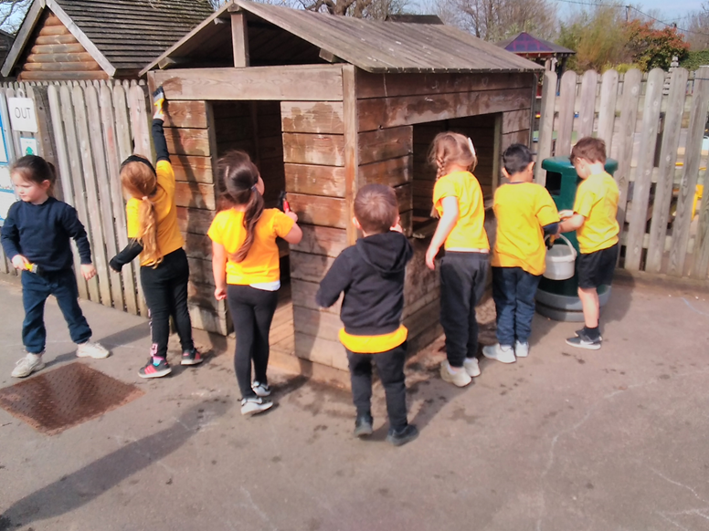
Why is it a big change?
Learning in reception is play-based. Children have lots of freedom to choose their own activities and can move on to something else when they choose. In year 1, learning becomes more formal, subject-based and adult-directed.
Expectations increase in Year 1. Children need to be able to follow instructions, focus for longer periods and become more independent.
Alongside this, there are other changes, such as a new teacher, a new classroom, new bathroom and cloakroom, some new classmates, and many other little things.
Home learning expectations increase.

Slide 6
What we do to support transition in Year 1
Fully aware of the ELG expectations and the starting points for the children
Continue to teach Phonics effectively
Aware of experiences in EYFS
Year 1 children have an opportunity to see EYFS staff at lunchtime
Build positive relationships with all children
Circle time discussions about how Year 1 is going so far
Discovery based learning in the afternoons in Autumn 1.

Slide 7
What can you do to support transition into Year 1
Talk positively about the move to year 1 and play down your own anxieties if you have them. For example, instead of saying things like, ‘You’ll have to work a lot harder in year 1’, say, ‘It will be exciting to learn about new things, won’t it?’
Read, read, read. Reading with and to your child is the single most powerful thing you can do to support their learning and progress at school.
Encourage your child to write, but make it fun and meaningful. For example, writing a shopping list for a meal they have chosen, writing a diary or sending a postcard to Granny and Grandad.
Practise telling the time to the hour and half hour on a clock with hands.
Practise counting in 2s, 5s and 10s (songs are a great help for this!), talk about ‘more than’ and ‘less than’ and look for 2D and 3D shapes in the world around you.
Practise handwriting and letter formation. If your child has a weak grip or struggles to hold a pencil, strengthen their fingers using activities such as playdough, bead and lace threading, construction with bricks as well as their shoulders with climbing, pulling, pushing and carrying.

Slide 8
Reception to Year 1 Transition Once the new term starts
Continue to talk positively about school and focus on your child’s good experiences.
Build a good, communicative relationship with the new teacher.
Plan in some relaxed time at home each evening so that your child still has opportunities for undirected ‘play’ time.
Don’t build in too many organised activities, such as after-school clubs, until you know your child is settled.
If there is homework to be completed, make sure your child has chance to wind down and let off some steam first.
If you are concerned, speak to the teacher.

Slide 9
Typical KS1 Timetable
Day | 8:45 – 9.00 | 9.00-9.30 | 9.30-10.30 | 10.30-10.45 | 10.45-11.00 | 11.00-11.20 | 11.20-12.20 | 12.20-1.20 | 1.20-2.15 | 2.15-3.05 | 3.05-3.15
Monday | Register | Reading | Maths | Whole School Assembly | Break | Phonics/ Spelling | English | Lunch | Science | Science | Story
Tuesday | Register | Reading | Maths | Key Stage Assembly | Break | Phonics/ Spelling | English | Lunch | History/ Geography | Art/D&T | Story
Wednesday | Register | Reading | Maths | Singing Assembly | Break | Phonics/ Spelling | English | Lunch | PE-outdoor | Music | Story
Thursday | Register | Reading | Maths | Class Assembly | Break | Phonics/ Spelling | English | Lunch | RE | Computing | Story
Friday | Register | Reading | Maths | Celebration Assembly | Break | Phonics/ Spelling | English | Lunch | PE-hall | PSHE | Story
Notes:
Although the structure of the day is the same for Year 1 and Year 2 there will be some difference in how the day works.
For Reading – Year 1 will do a Reading workshop with activities to help support their Early Reading, linking to sounds they have been learning in their phonics lessons
Year 2 will do Shared Reading lessons – these lessons are designed to help develop comprehension skills about text they are reading – as well as discussing texts using different skills (prediction, questioning, summarising etc.
Maths – both year groups will have access to concrete, pictorial and abstract resources in their lessons. Year 1 will be much more practical based learning, linking to continuous provision activities that will be set up for them.
Phonics/Spellings – Both year groups will continue to work through the Leslie Clarke programme. Year 1 will do phonics lessons, the beginning of the year will be focused on revising sounds the learnt in Reception and then learning all new phase 5 sounds – as well as alternative pronunciations. Year 2 will do Spelling lessons – focusing on spelling rules to enhance their written work.
English -

Slide 10
Attendance
Every day in school really does count. If your child misses a day, they will miss out on lots of learning, and will need to catch-up when they return.
There is a strong correlation between attendance rates and attainment.

Slide 11
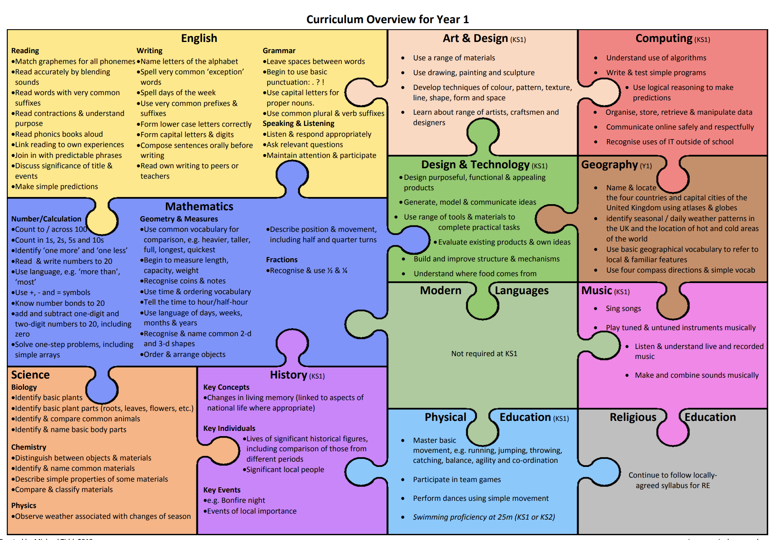

Slide 12
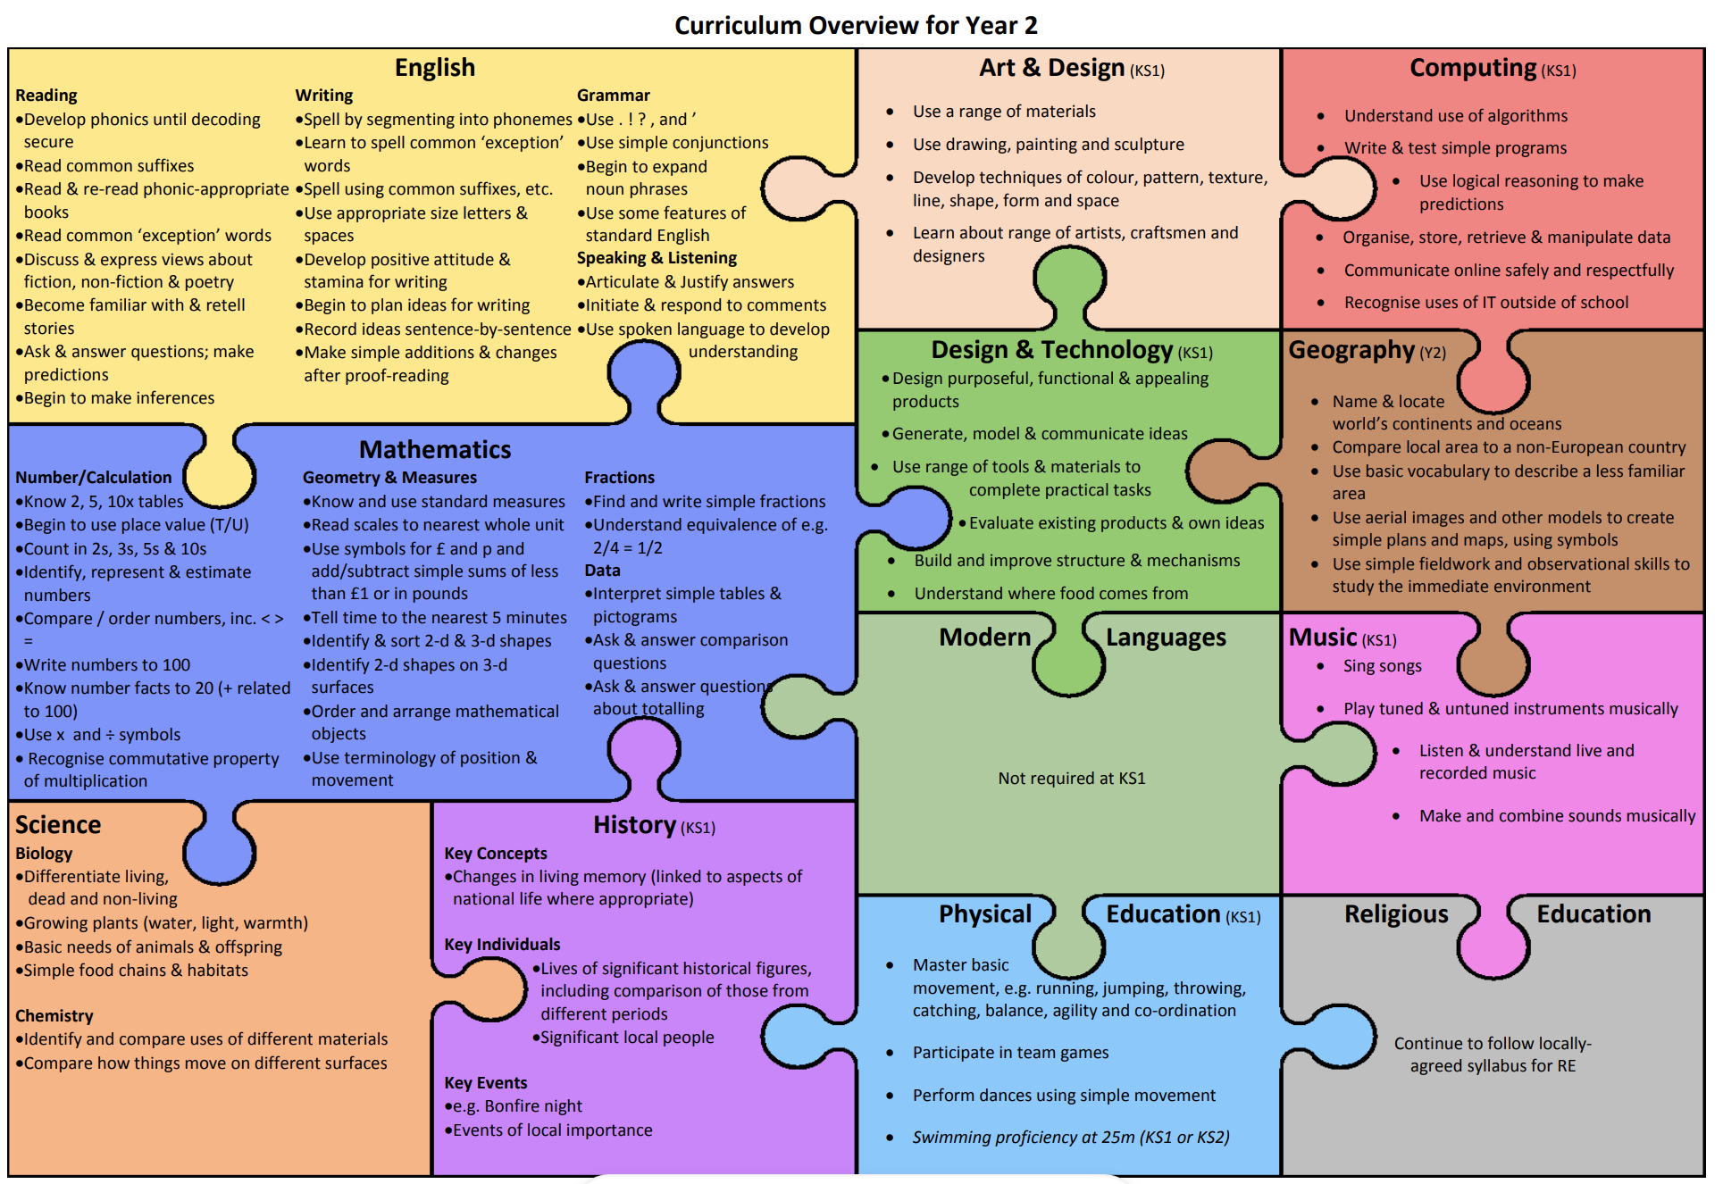

Slide 13
Year One Phonics Screening Check
In 2024, 90% of our Year One children passed the Phonics Screening Check. This is above the National and Wokingham Average. Those who did not pass, will retake it in Year 2.
20 minutes daily – whole class
Phonics, Word Recognition and Spelling Rules
Sounds, Segmenting and Blending
https://www.lesleyclarkesyntheticphonics.co.uk/index.php/parents
Lesley Clarke’s Synthetic Phonics

Slide 14
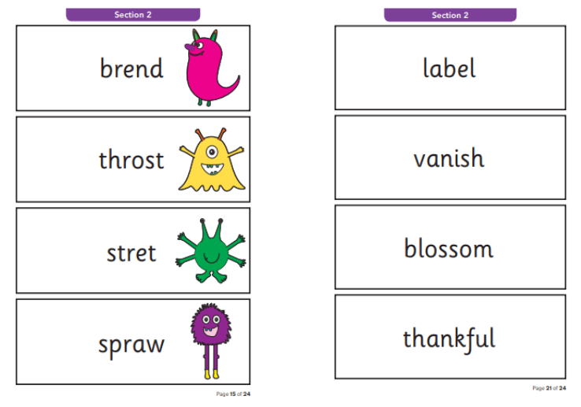
Phonics Screening Check – Statutory Assessment (June 2025)
Notes:
Children are expecting to decode both Real and Alien words and then blend sounds together correctly.

Slide 15
Reading
Year 1 Read to an adult
Focused reading activities
Year 2 Read to an adult/Accelerated Reader
Shared Reading
English lesson
Reading across the curriculum
Class story at the end of the day
Reading Diary
Record reading at home
Teachers will check and stamp when they hear a child read

Slide 16
How to support reading at home
Walk through the book-
First discuss the pictures and the important words. Always remember to keep reading aloud to your children even when they can read independently.
Encourage your child to read to you-
Follow the words with your finger and sound out the words (c-a-t: cat) See if they can pronounce each sound and then blend them together.
Praise your child for trying hard at reading-
Let them know it is okay to make mistakes.

Slide 17
Writing
Story maps – retelling the story using pictures
Orally rehearse sentences before writing
Modelling writing
Spellings and spelling rules
Finger spaces, capital letters in the correct places
Year 1 encourage phonetically plausible attempts
e.g. happee
Handwriting – Year 1 – printed letters
Year 2 – pre- cursive letter formation

Slide 18
Maths
Number formation ​
Concrete/physical resources ​
Pictures to represent numbers​
Problem solving and reasoning​
Maths in the environment e.g. shapes around us, laying the table, coin recognition​, times of day

Slide 19
How to help at home
Reading at home – 10 minutes per day (school book as well as a book from home)​
Book change when necessary ​
Spellings - common exception words (assessed in school) - Spelling Shed​
Diary writing​
Practising counting in 2s, 5s, and 10s for Year 1 ​
Practising x2, x5 and x10 for Year 2 on TTRS​
Mathletics​
https://whiterosemaths.com/1-minute-maths​
Home learning activities linked to topic​
Correct PE kit (make sure to check PE days at the beginning of each term!)

Slide 21
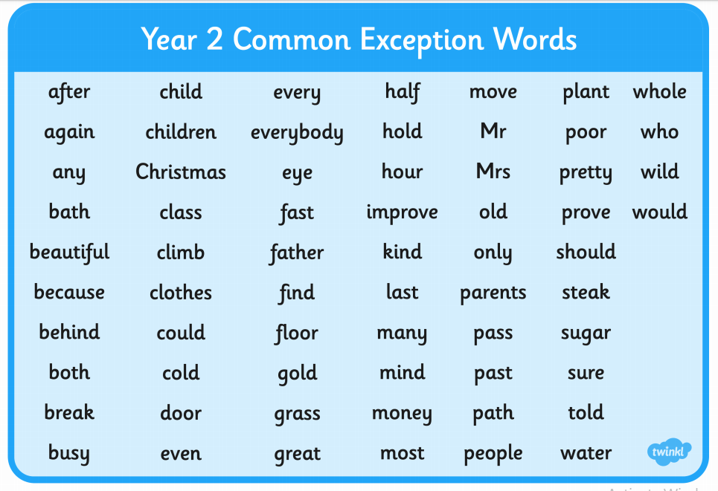

Slide 22
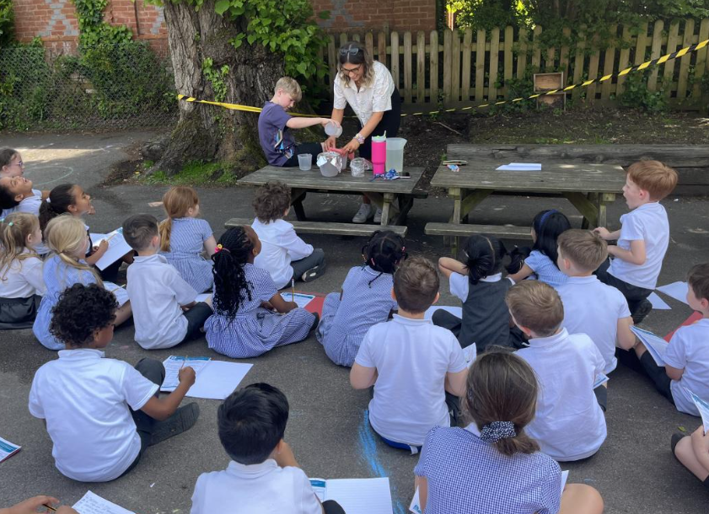
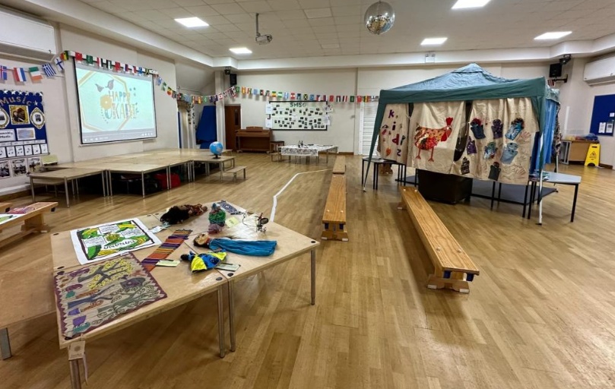
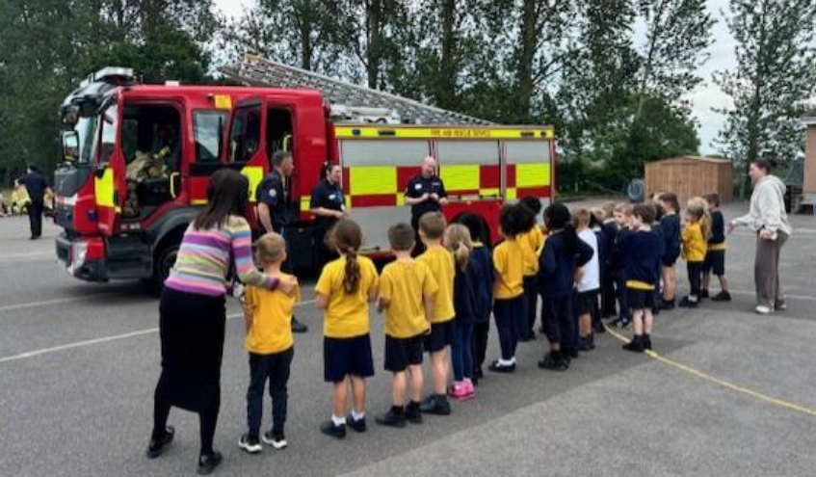
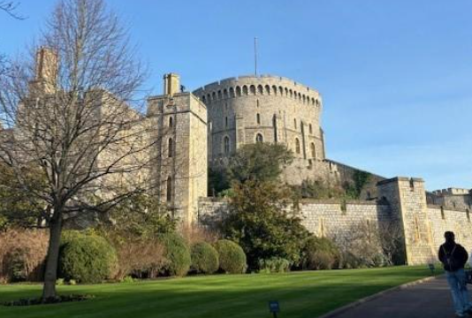
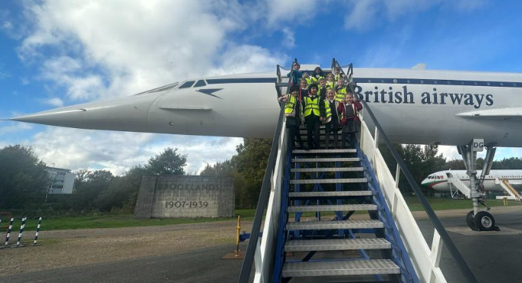
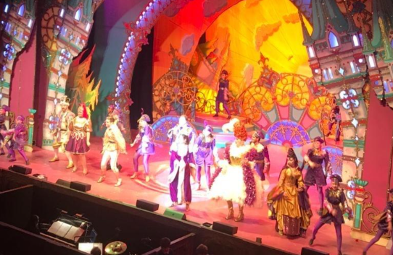

Slide 23
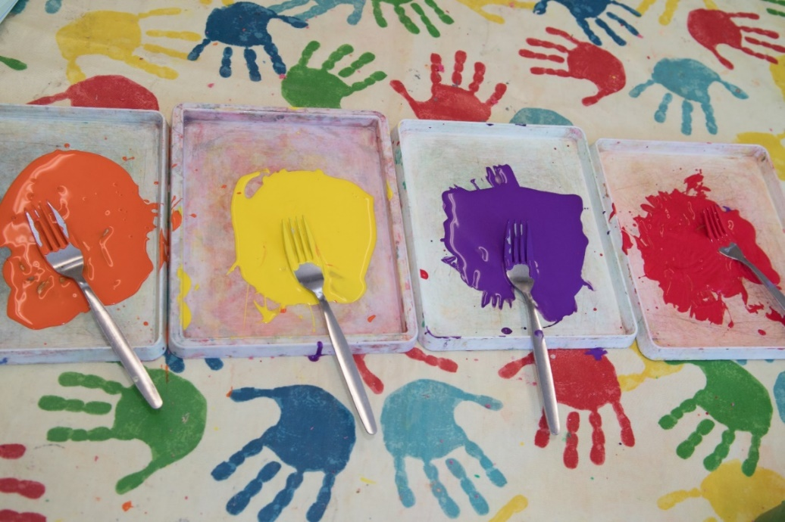
We aspire to be…. OUTSTANDING IN ALL AREAS!
We will strive to ensure every child is at age-related+
All of the KS1 Teachers are looking forward to a productive and fun filled year with your children!

