Slide 1
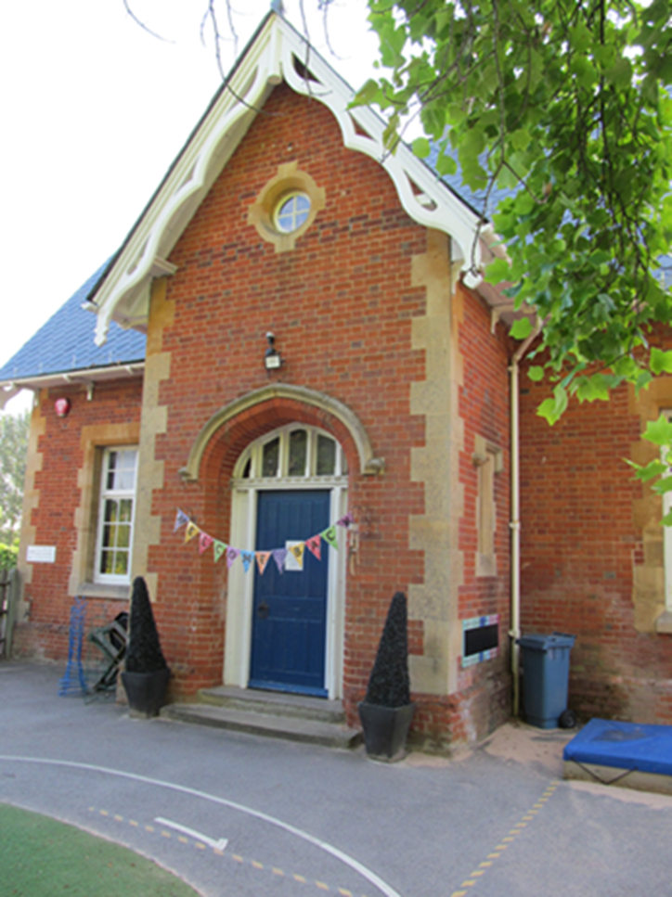
Welcome to Bearwood Primary School Early Years Foundation Stage Nursery and Reception September 2024

Slide 2
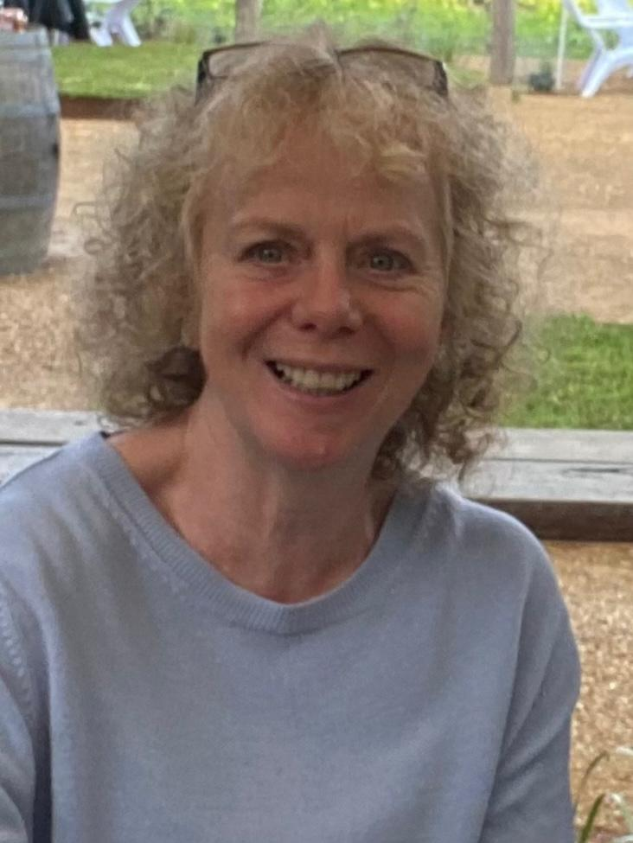
Foundation Stage Staff
Mrs Johnson-
Foundation Stage Lead
Koda class teacher
Miss McNulty
Orsa class teacher
Plus two additional LSA’s to support each class of children.
Mrs White
Nursery Nurse

Slide 3
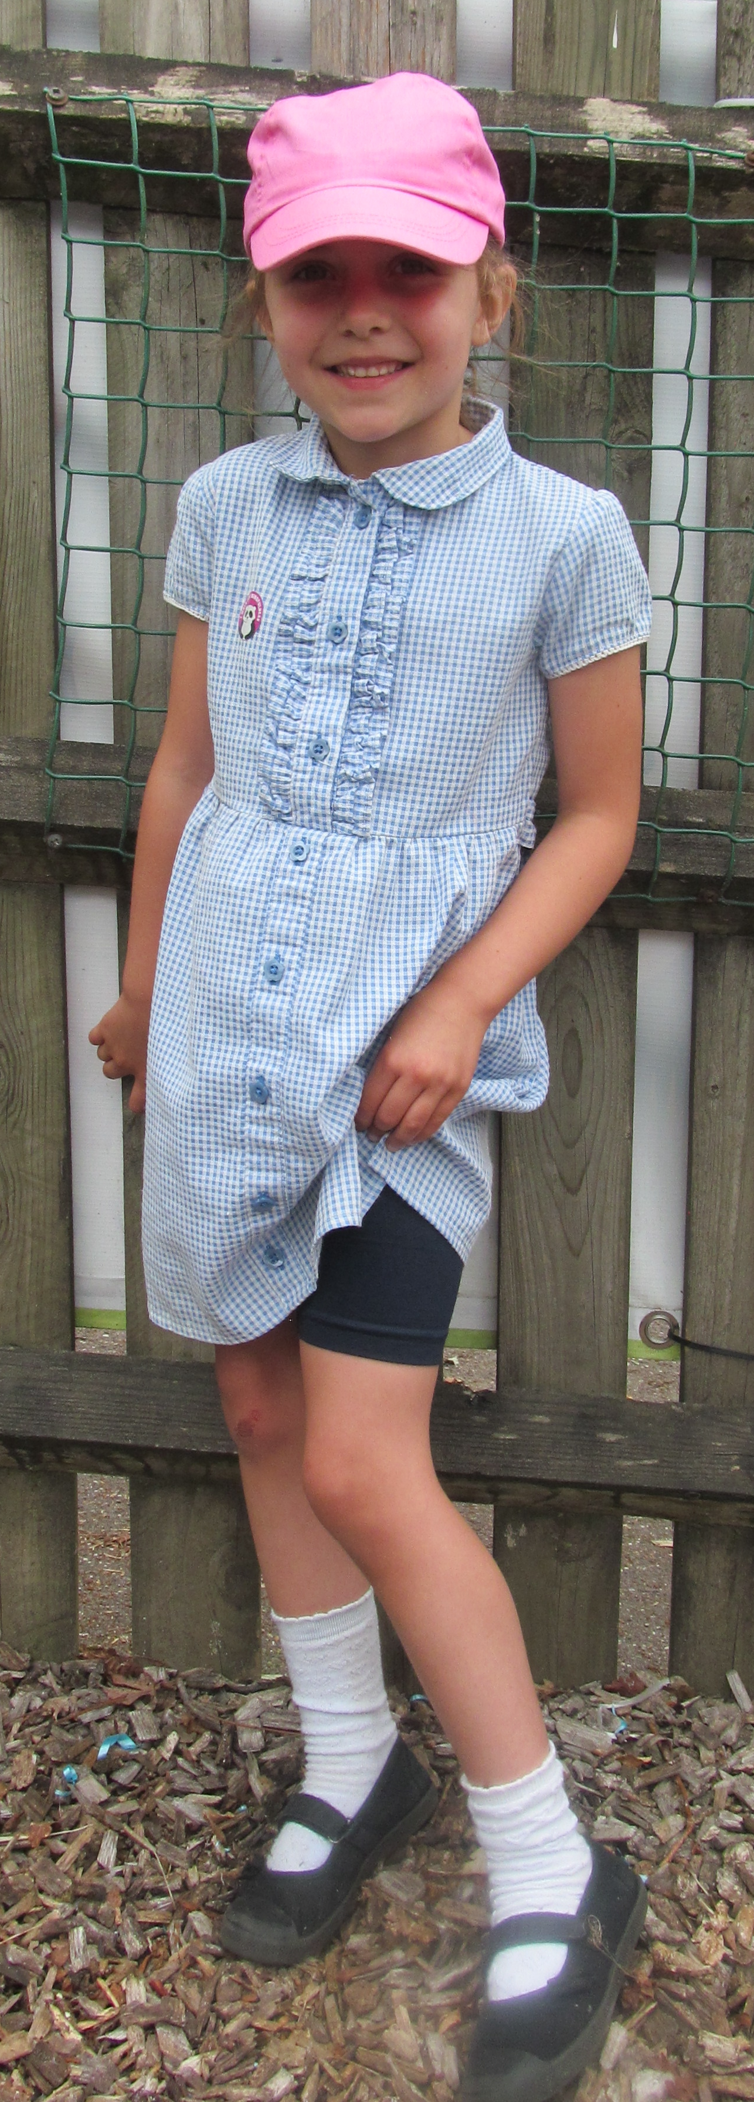
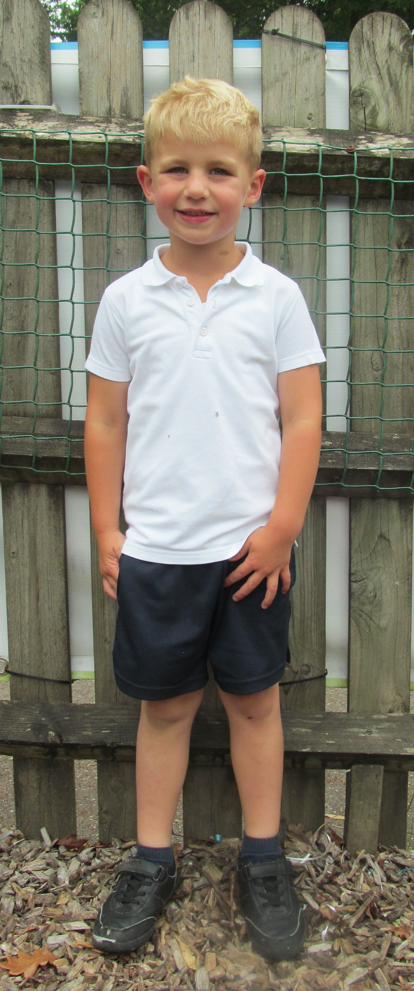
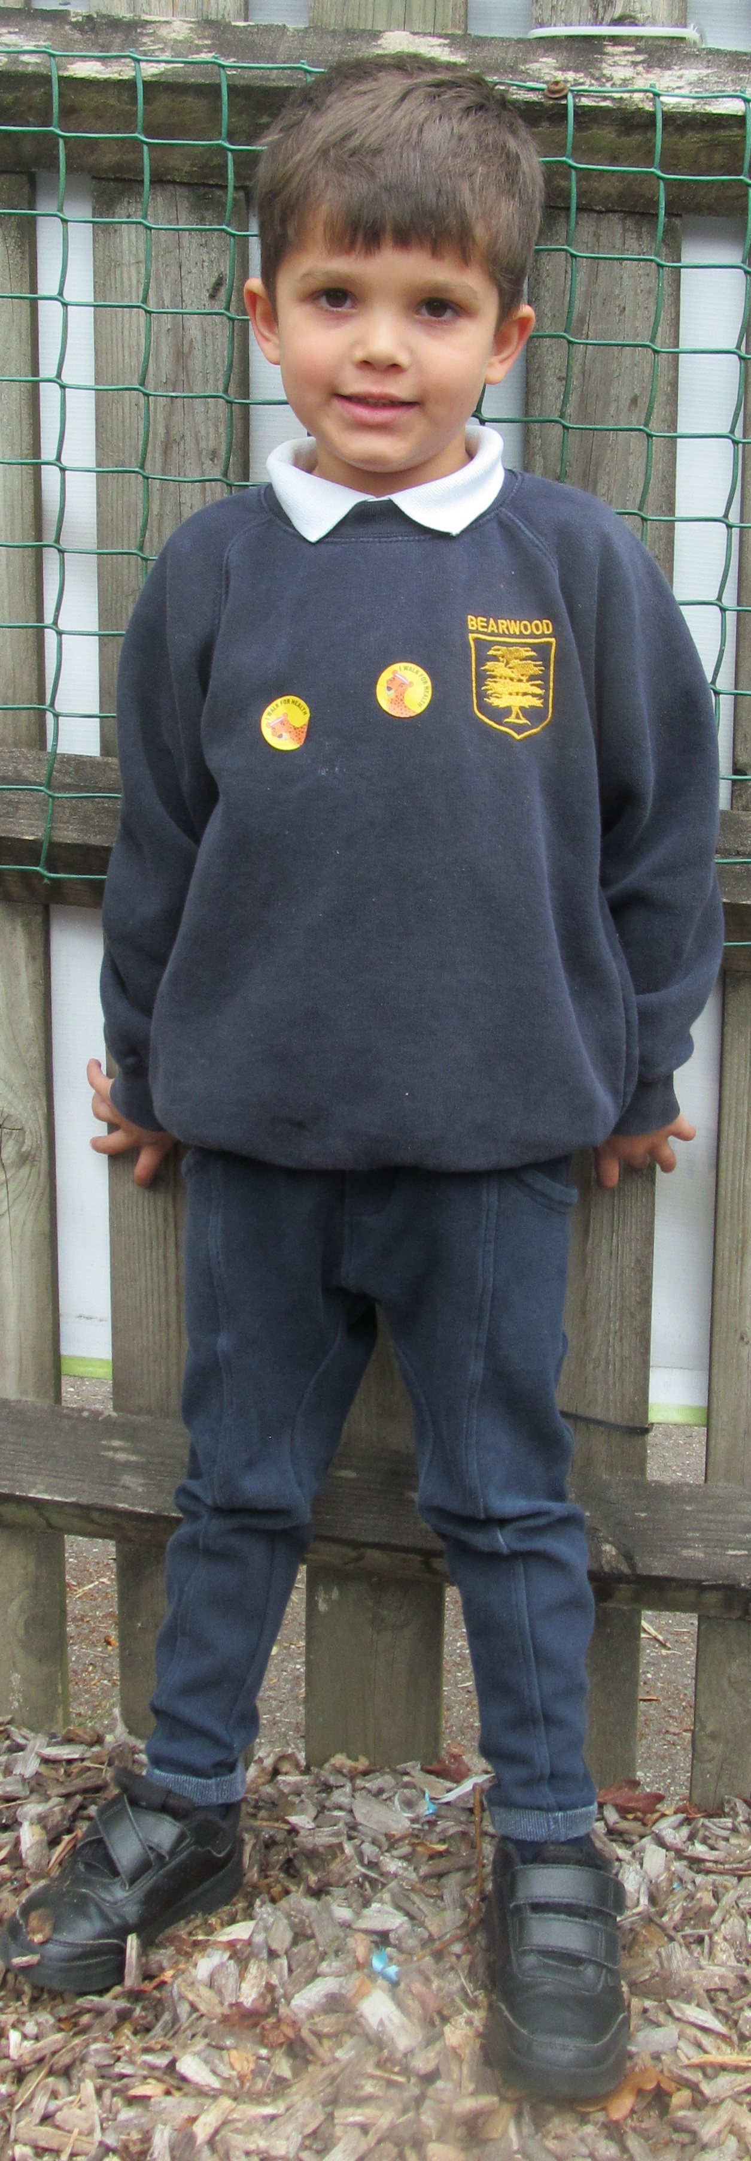
Uniform
Please label EVERYTHING!
Our EYFS uniform is slightly different to the rest of the school because our curriculum is much more active and based outside in all weathers.
Navy jumper or cardigan with school logo
White polo shirt
Black or navy shorts or jogging bottoms
Black trainers
Girls may choose to wear a blue gingham summer dress with cycle shorts in summer
Navy puddlesuit

Slide 4
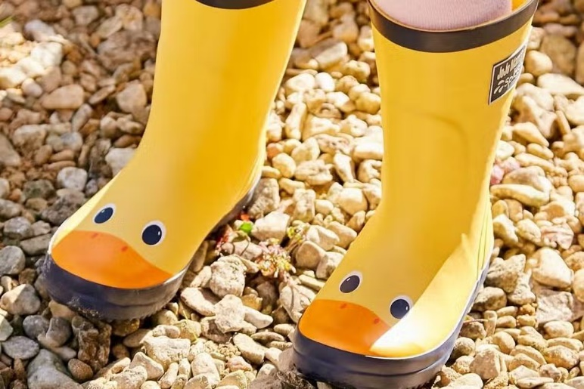
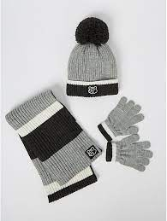
What else does my child need to bring?
A water bottle filled with water (no squash or flavoured drinks please!)
A book bag
A named coat
Weather appropriate extras (sun hat, woolly hat, gloves etc.)
In a small bag that lives AT SCHOOL- A complete set of spare clothes. Wellies should also come to school and stay there all year.

Slide 5
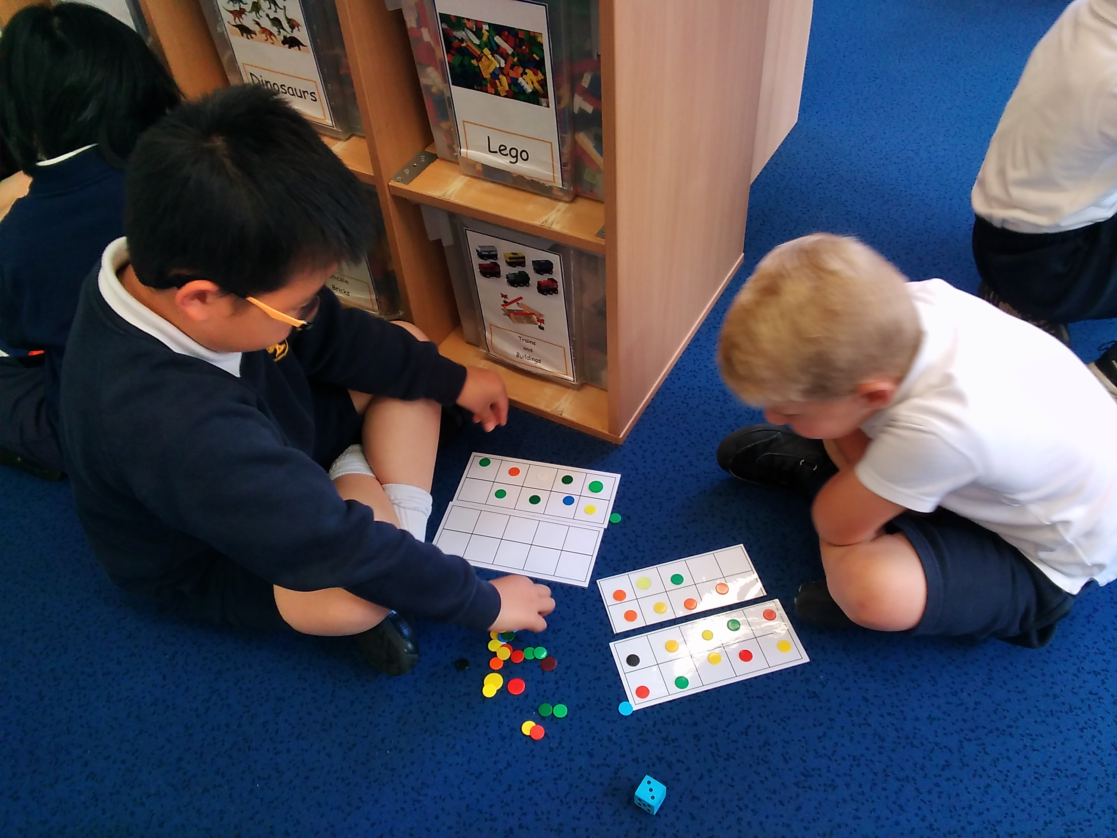
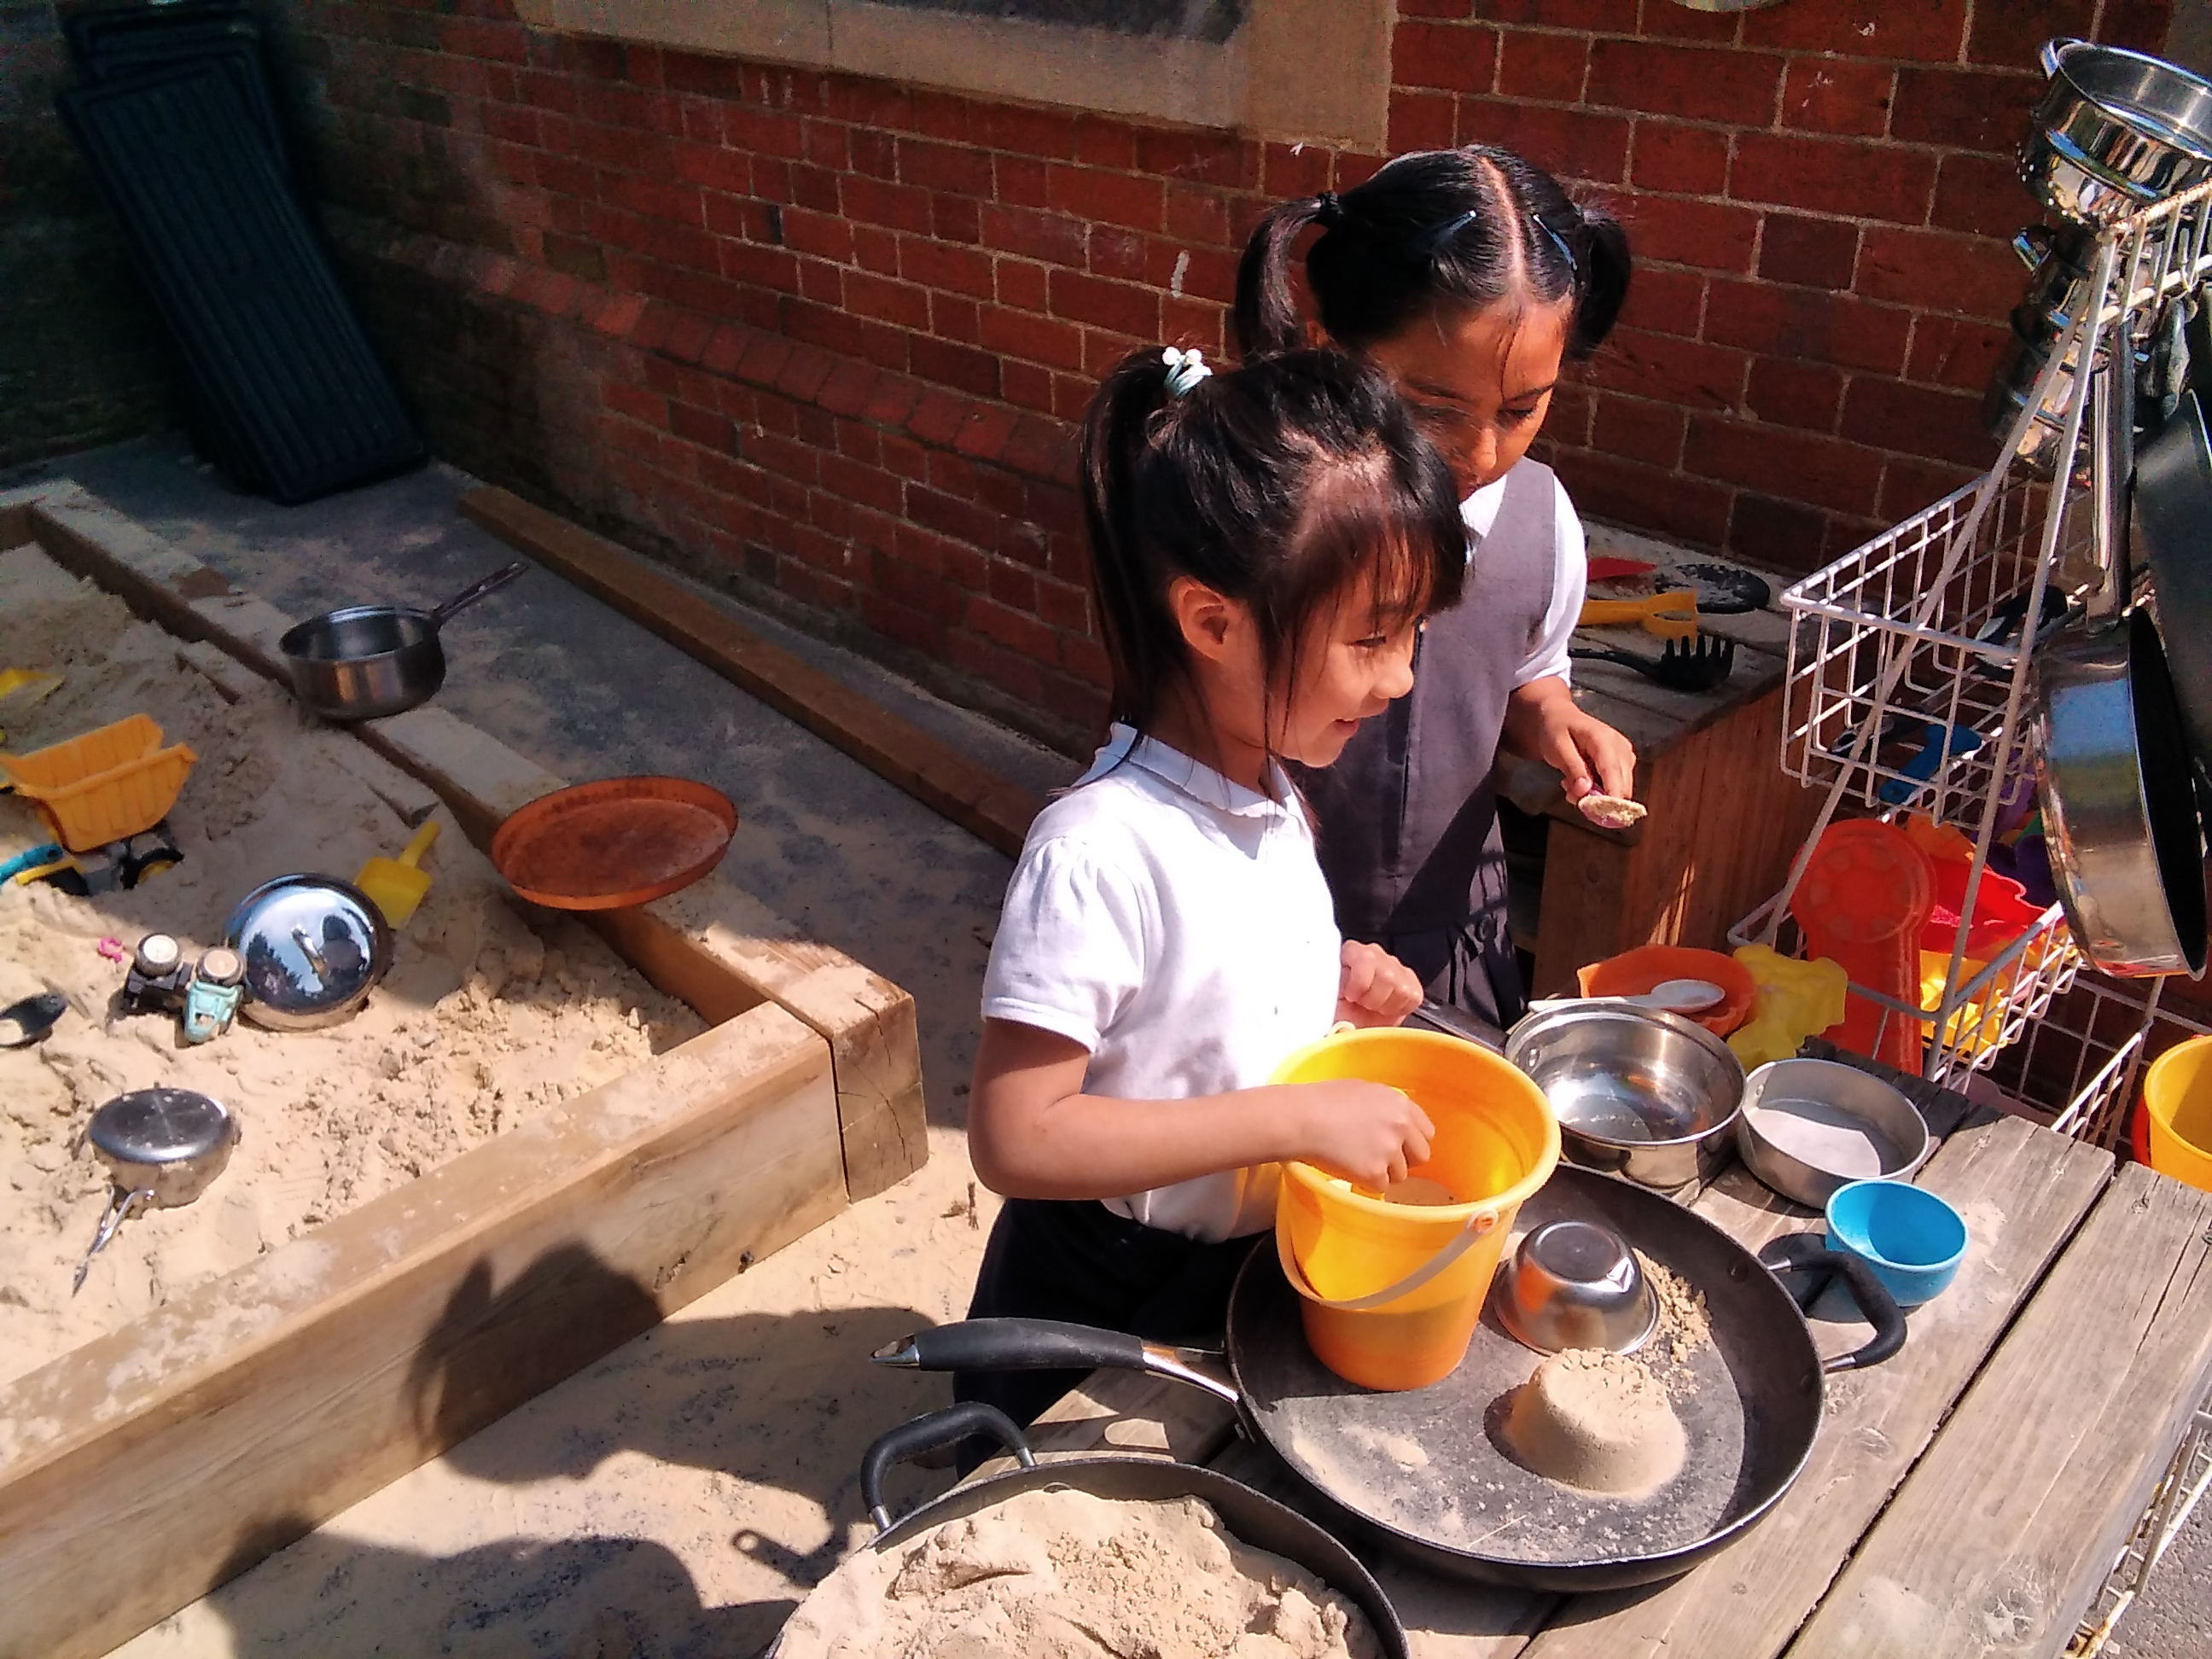
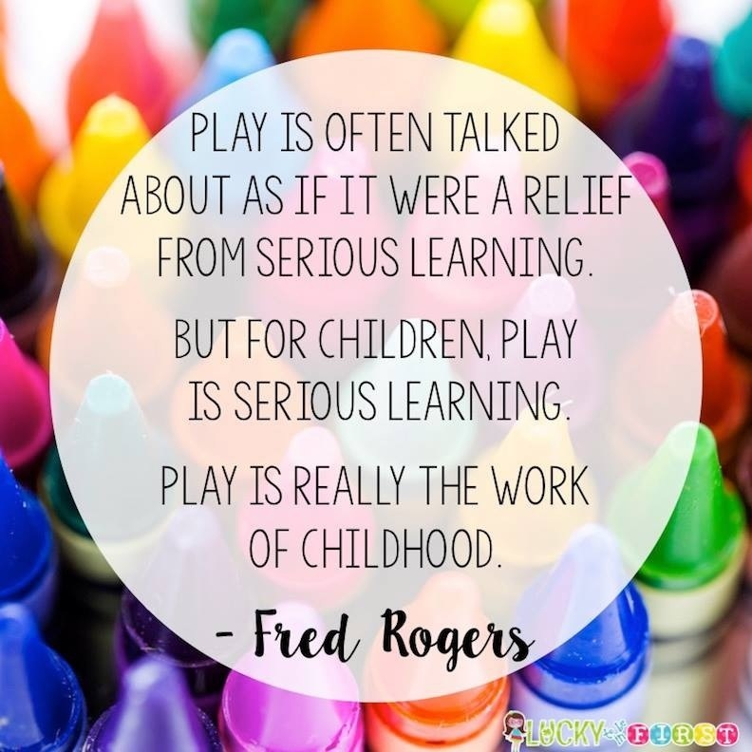
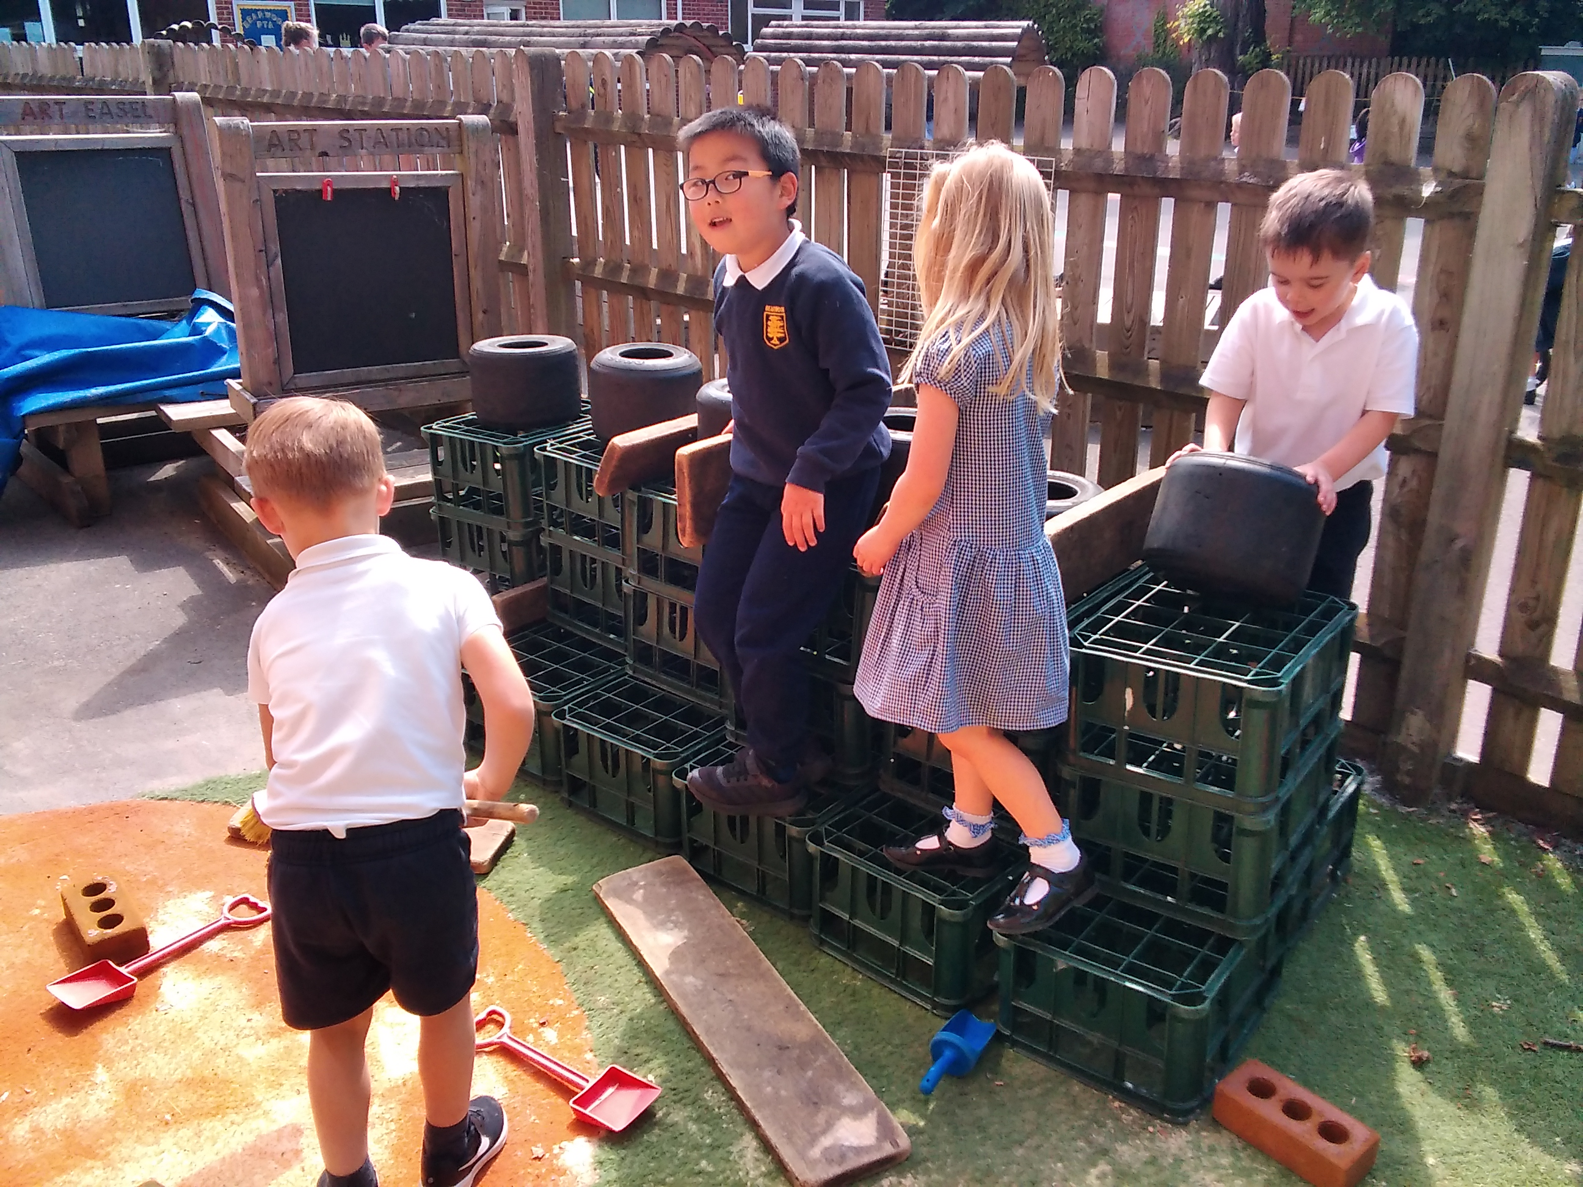
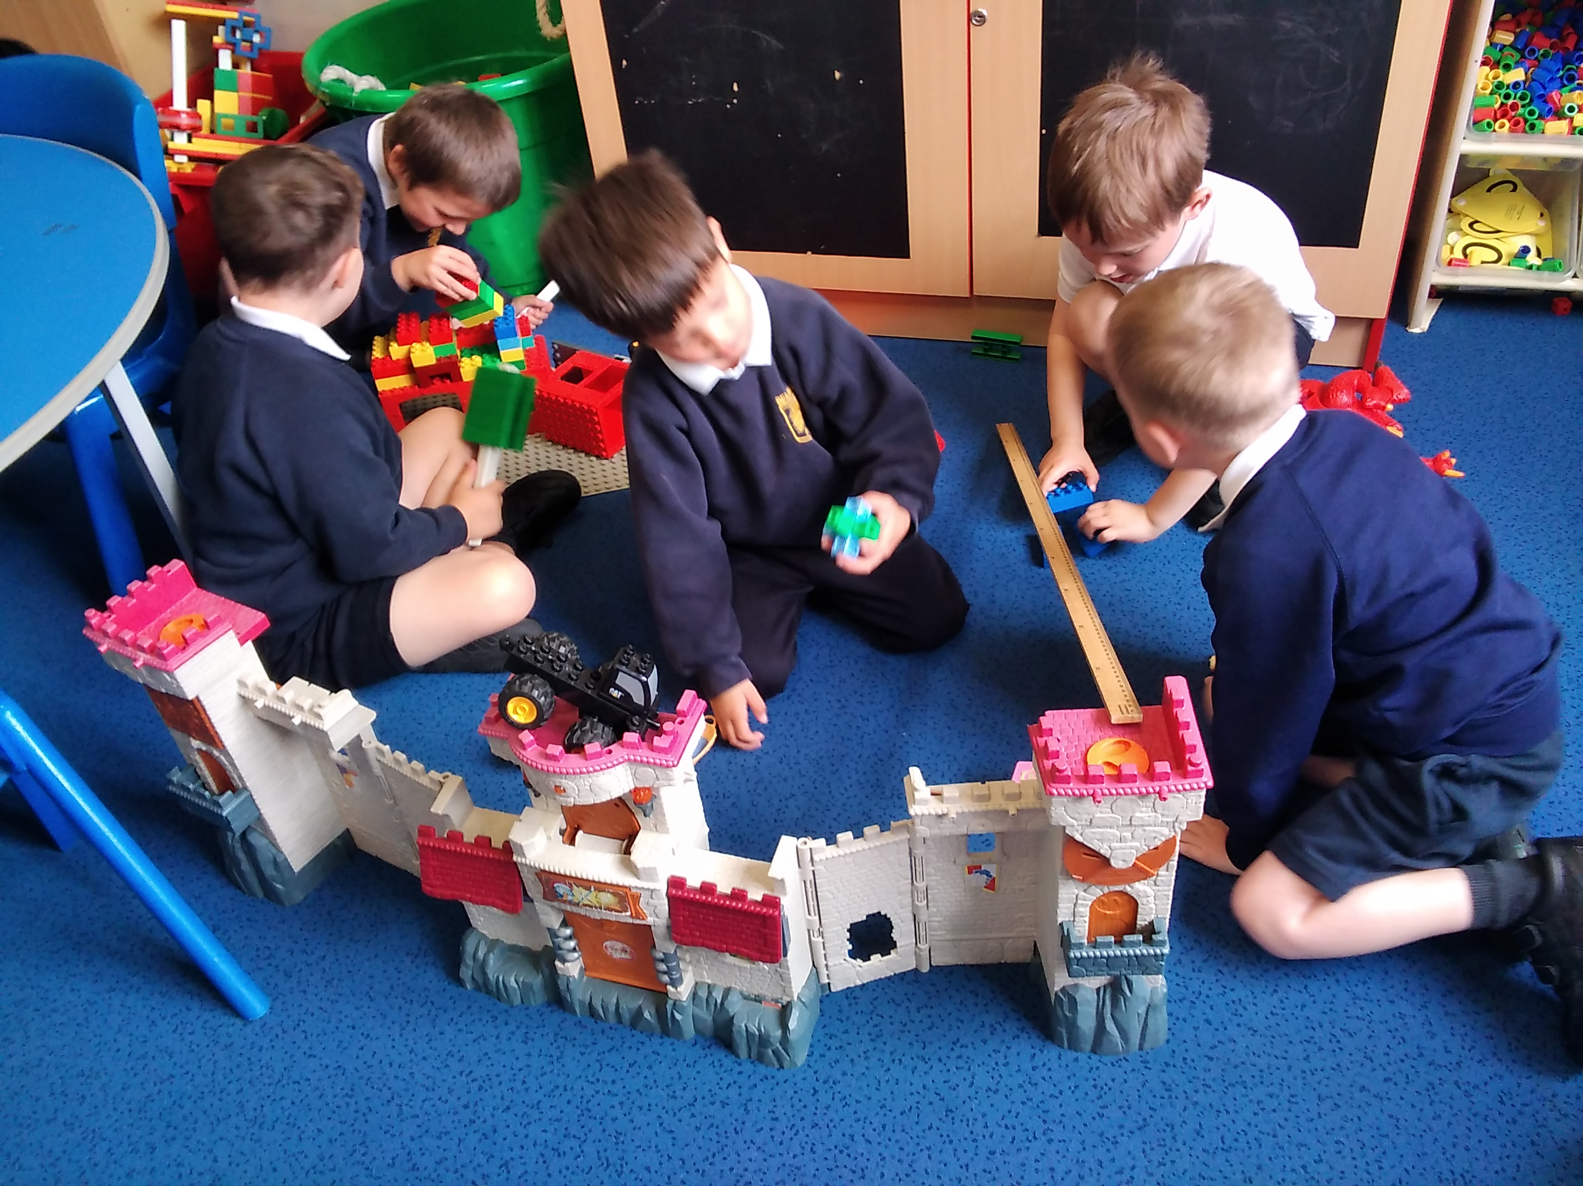
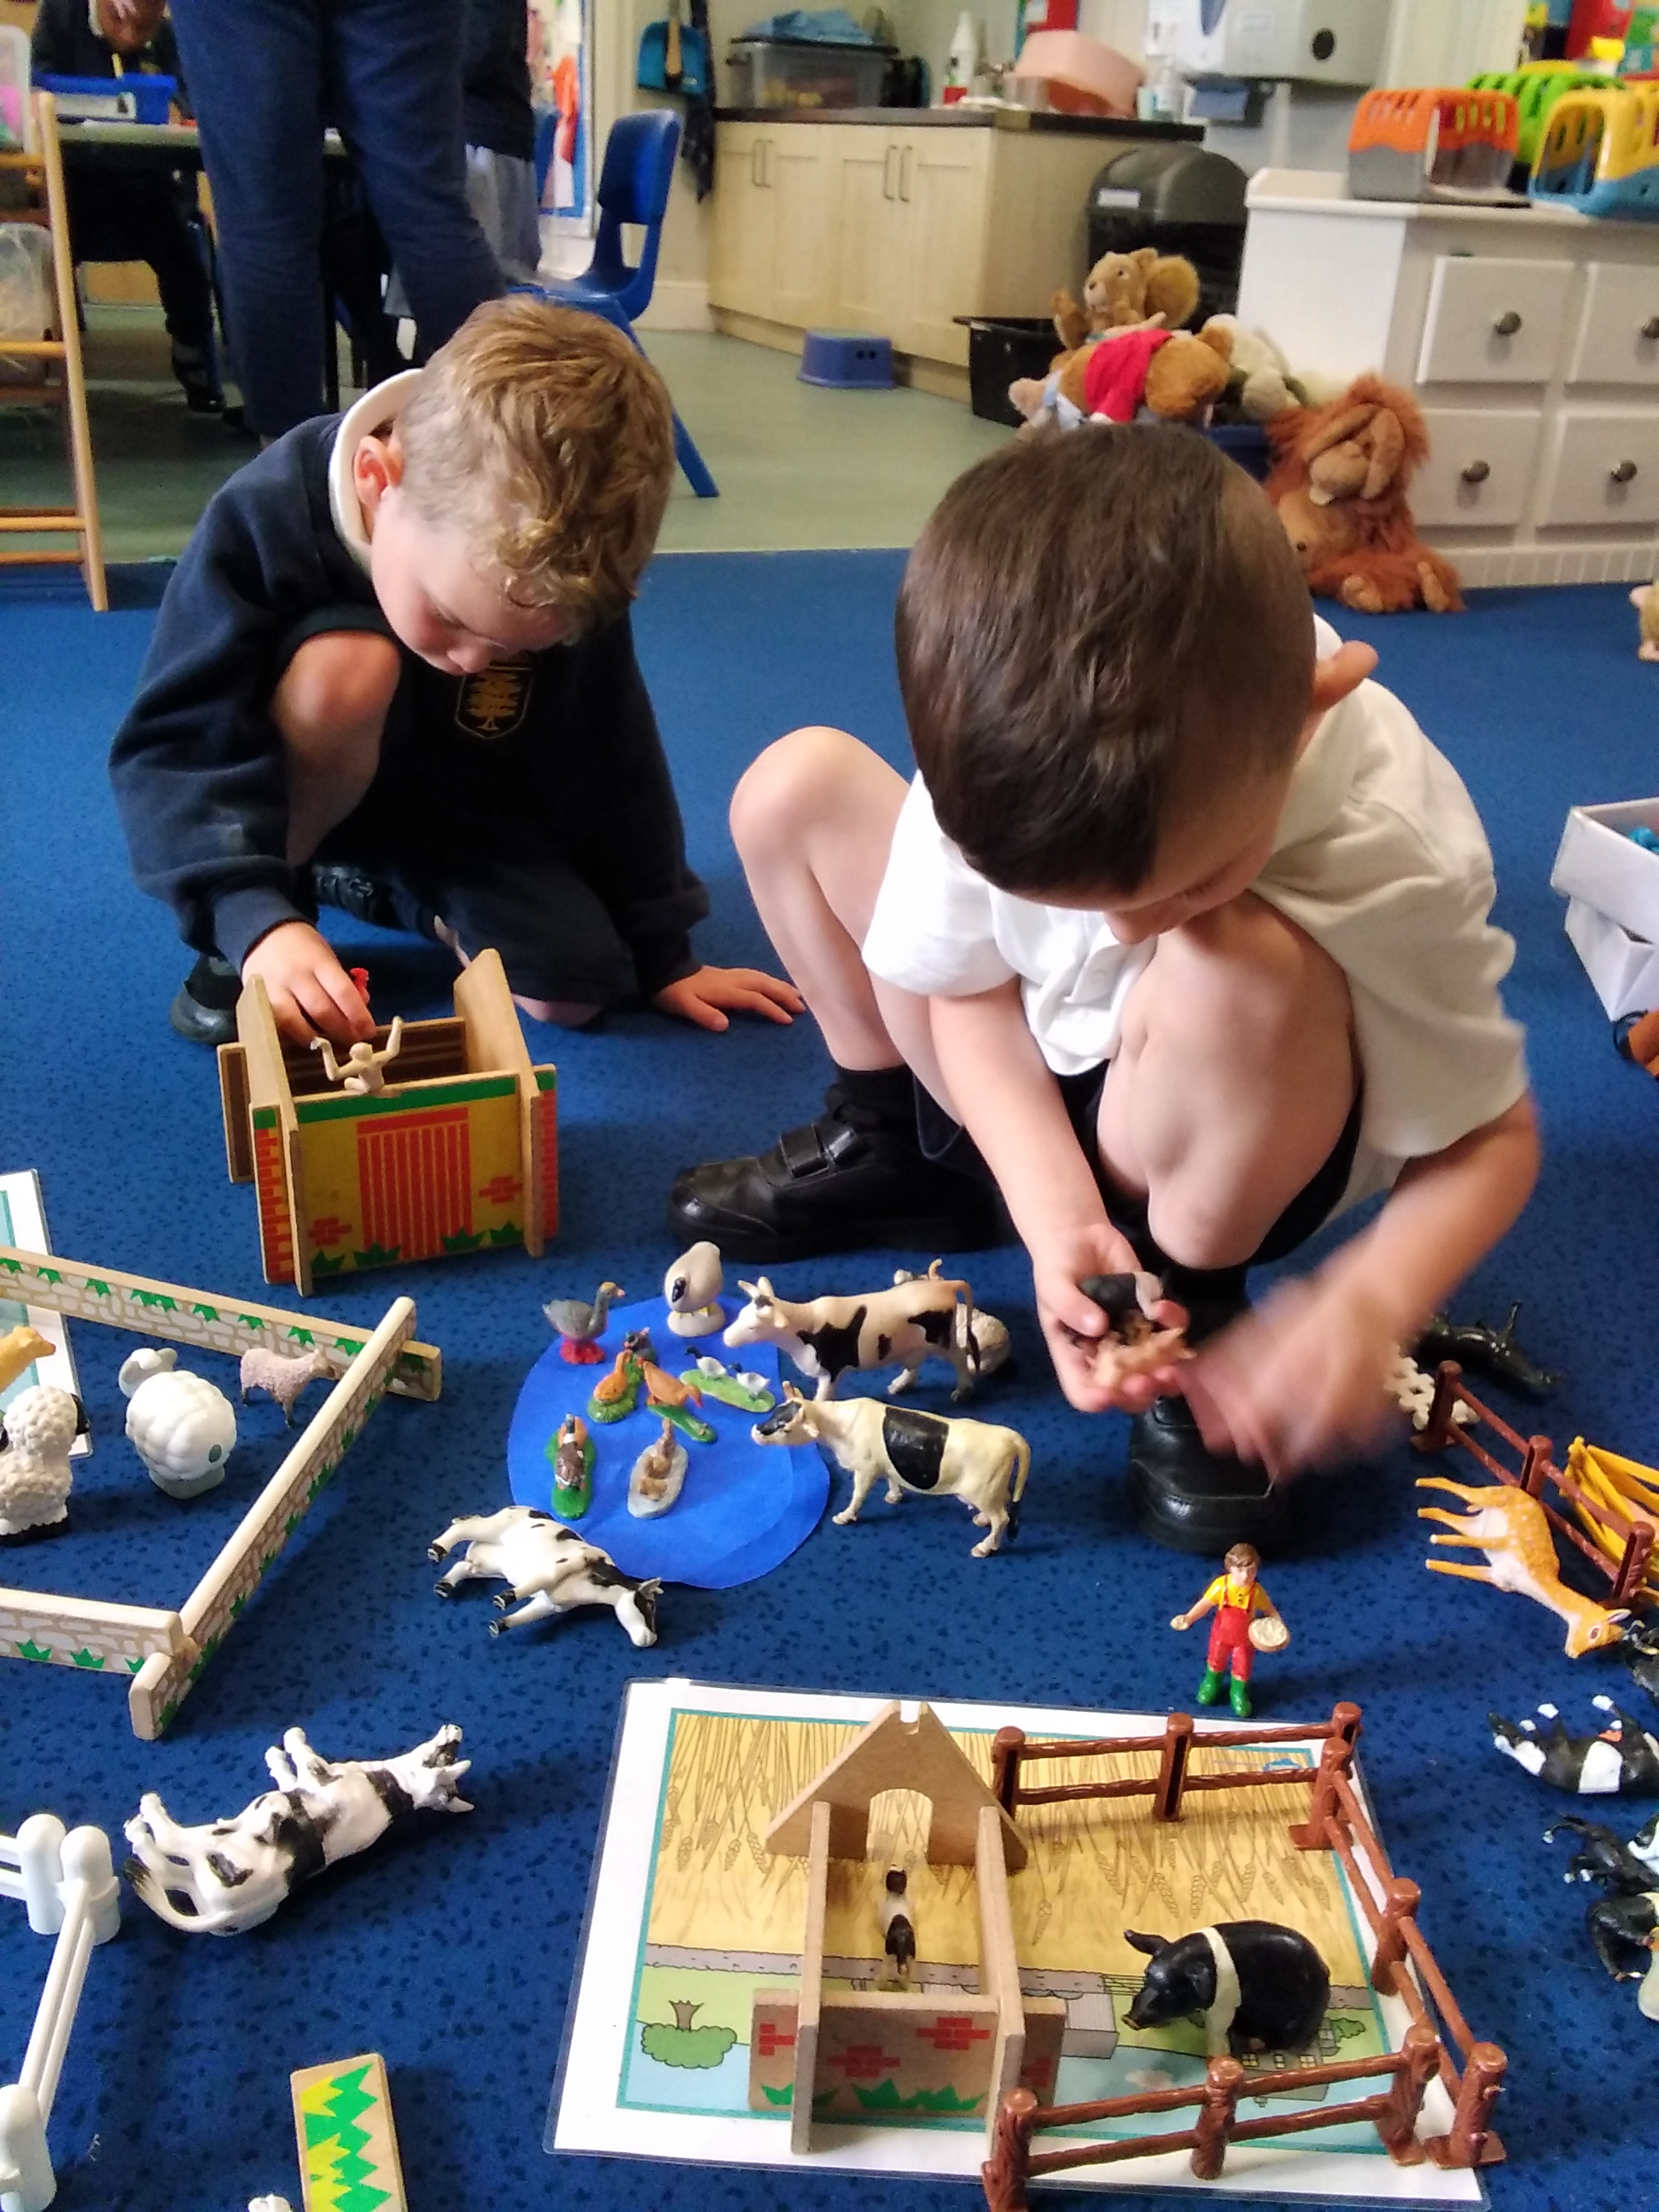
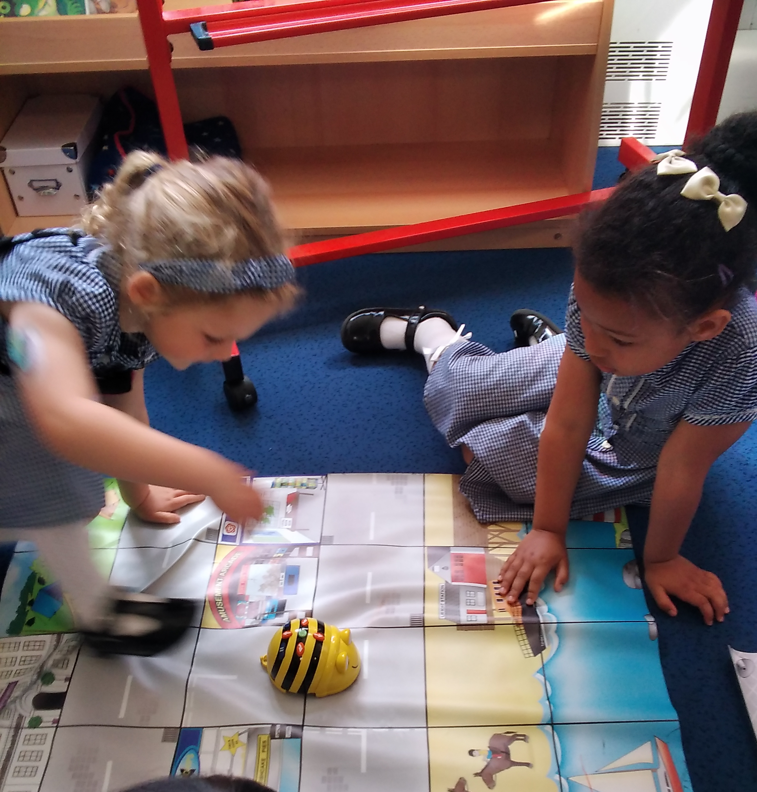
Learning through play

Slide 6
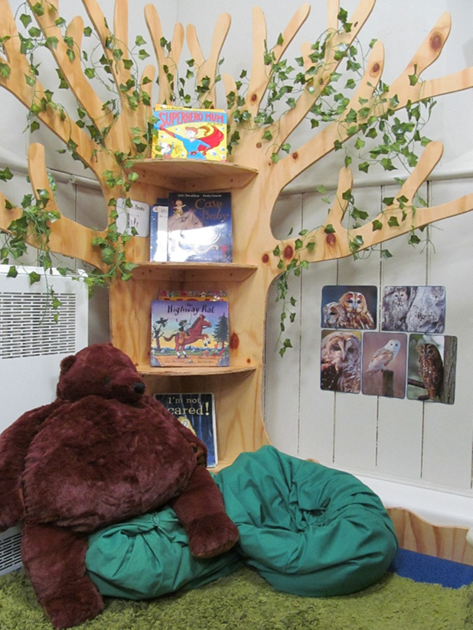
The Foundation Stage Curriculum
Characteristics of Effective Learning:
Playing and Exploring
Finding out and exploring
Playing with what they know
Being willing to ‘have a go’
Active Learning
Being Involved and concentrating
Keeping on trying
Enjoying achieving what they set out to do
Creating and Thinking Critically
Having their own ideas
Making links
Choosing ways to do things

Slide 7
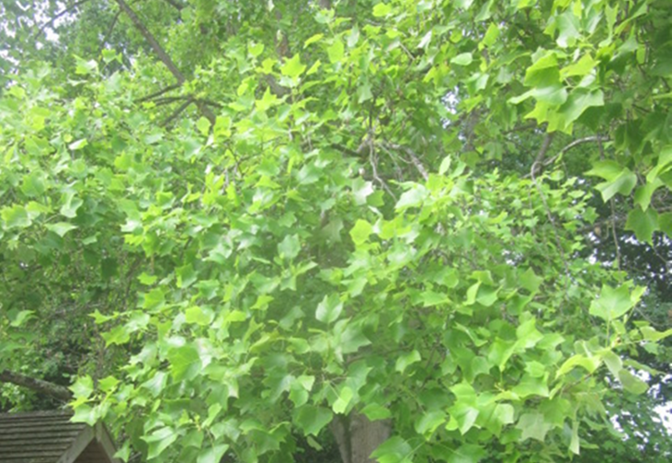
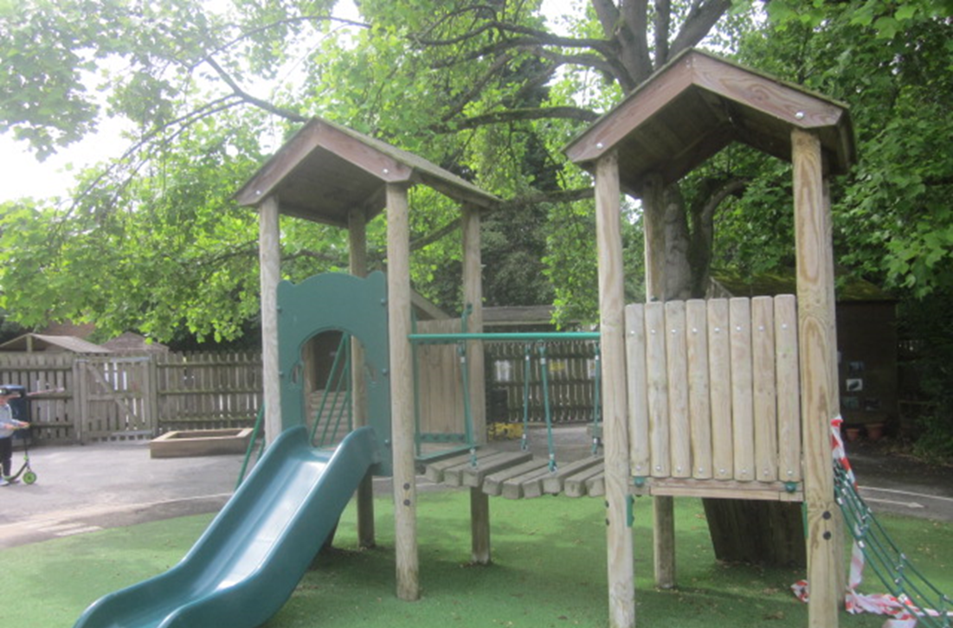
The Foundation Stage Curriculum
Prime areas of learning:
Communication & Language Development
Speaking
Listening, Attention and Understanding
Physical Development
Gross Motor Skills
Fine Motor Skills
Personal, Social & Emotional Development
Self-Regulation
Managing Self
Building Relationships

Slide 8
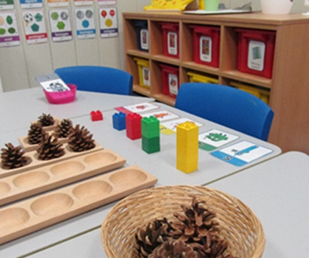
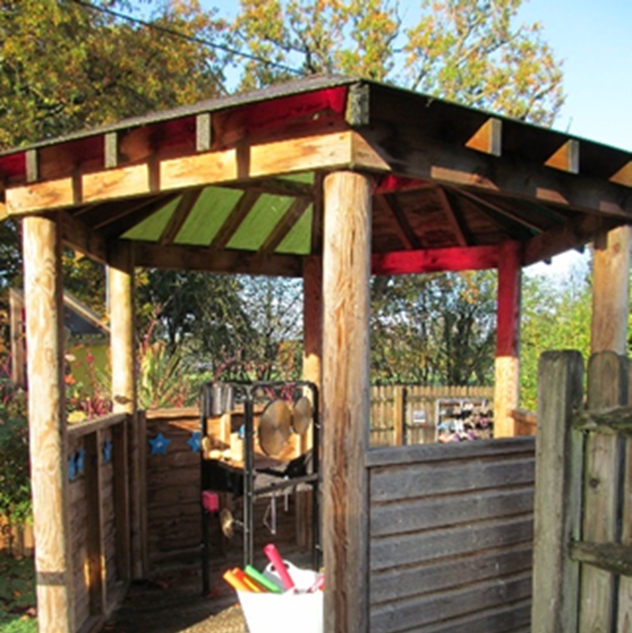
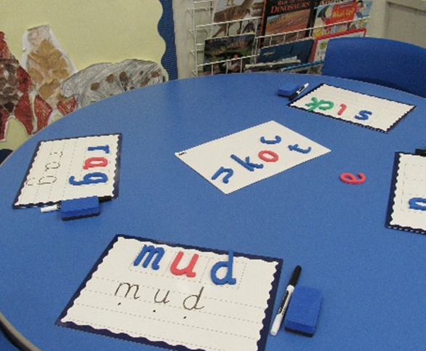
The Foundation Stage Curriculum
Specific areas of learning:
Literacy
Comprehension
Word Reading
Writing
Mathematics
Number
Number Patterns
Understanding the World
Past and Present
People, Culture and Communities
The Natural World
Expressive Arts & Design
Creating with Materials
Being Imaginative and Expressive

Slide 9
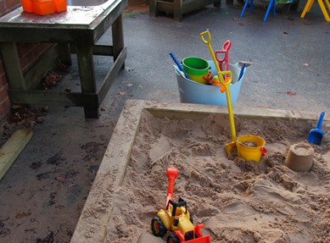
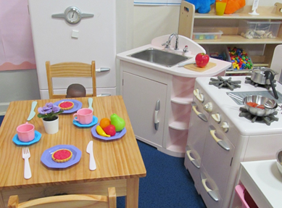
Statutory Assessments in Reception
Reception Baseline Assessment (RBA) – at the beginning of the year
Early Years Foundation Stage Profile (EYFSP) – at the end of the year
Reception Outcomes 2024…
90% of our Reception children attained a ‘Good Level of Development’ (GLD) in 2024 which is well above the national and Wokingham averages.

Slide 10
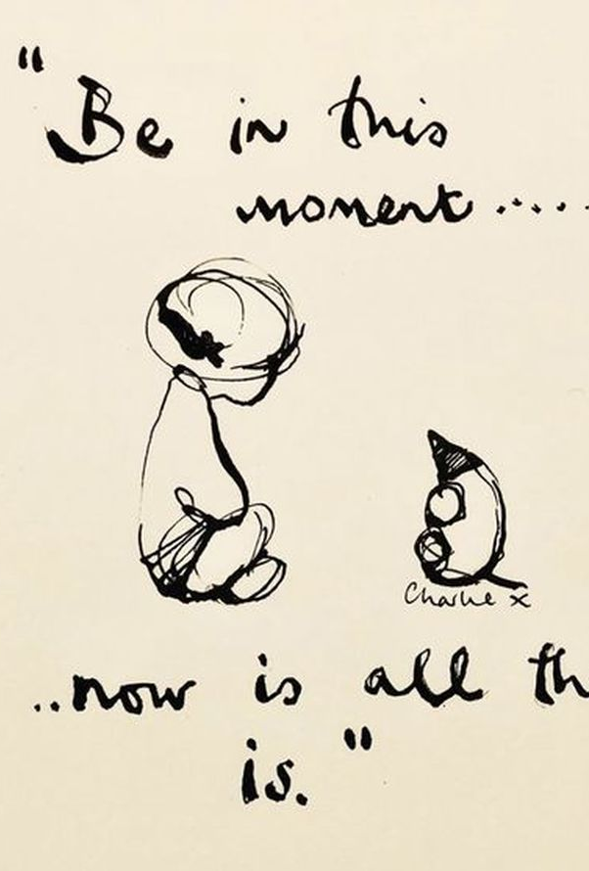
In the moment planning
At Bearwood EYFS, we plan our topics and activities ‘in the moment’. This means children take control of their own learning.
Each week, we observe and interact with the children during their play and make notes on what things interest them and what skills they may be keen to develop. We also note down those things that are necessary next steps such as pencil grip.
We use Floor books to record what the children are learning.
Teachers then plan a set of lessons dedicated to the interests and needs of your children specifically. This means that we may learn about dinosaurs, light and dark, superheroes…anything your children can dream of!
Learning should be fun, engaging and exciting in this way.

Slide 11
Our CLasses
Our Foundation Stage is called Brown Bears because we are the beginning of the Bearwood journey.
Our Classes are called Koda and Orsa (2 words that mean little bear derived from Latin).
Classes are now mixed age groups to encourage collaboration and team work and enhance the development of all children in our EYFS. 75% of the day was always mixed before, now it is 90%!
Nursery children are our BEAR CUBS as they are the youngest members of Bearwood Primary School. Your child will refer to themselves as a Koda CUB or a Koda BEAR depending on which age group they are in. They will remain in this class until they move up into KS1 enabling them to create strong and meaningful relationships.

Slide 12
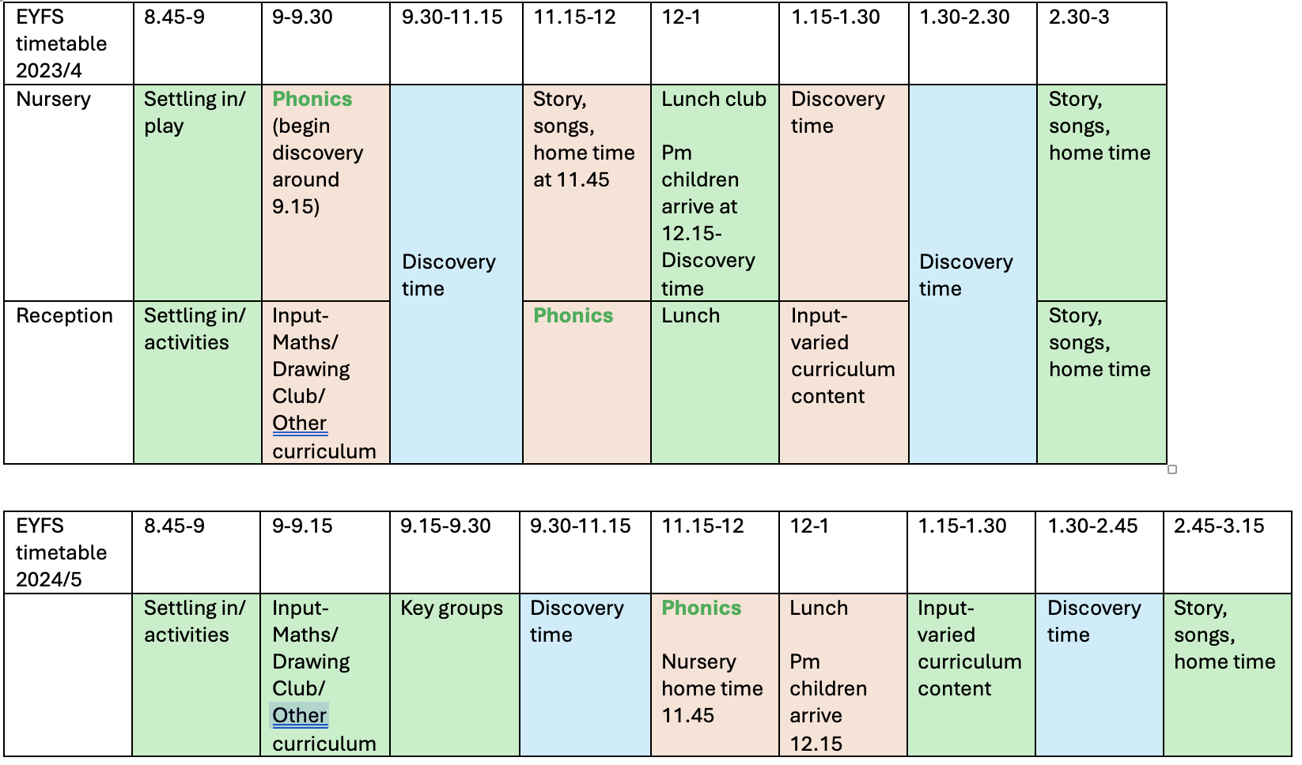
Timetable

Slide 13
The notion that children are easier to teach in chronological age groups denies the known value that children get from being with children who are both older and younger than them. There is no doubt it can be more difficult to teach across rigid curriculum boundaries, but that is perhaps a fault of curriculum design and an over-insistence on artificial targets, rather than any inherent fault in the practice itself.- Nursery World magazine
Why?
Younger children learn by watching older children as well as adults. In a mixed-age classroom, older children who are completing challenging lessons are an example to the younger children; they show what is possible.- Maria Montessori
Mixed-age play has been shown to help children extend their zone of proximal development, as younger children are challenged to play and carry out tasks they wouldn’t be able to do alone or with others of their own age group. The older children model and extend the play in a way that younger children wouldn't be able to as they can't challenge each other the same way.- Bronagh McGearty (founder of Famly app for EYFS)
It is recognised that there is more turn-taking, social responsibility and sensitivity in mixed-age group children.’ (Chase and Doan, 1994)
For example, social interactions take on a whole new level, with more experienced (not necessarily older) children leading the way with organising games, sharing, turn-taking, ‘they learn to be both leaders and followers’.- Kathy Brodie

Slide 14
Benefits for the children
Nursery children
Reception children
Vicarious learning experiences
Modelling of language and behaviour
Mixed social opportunities
Shared vision on child led planning
Separate group time to focus on key nursery skills
Personal learning journey for each child- differentiation per class- Stage not age
Chance to become a role model of language and behaviour
Mixed social opportunities
Shared vision on child led planning
Separate Reception level learning each day such as phonics
All children can work at their experiential level for longer allowing for their own personal development at their own pace

Slide 15
How?
Example planned activity:
Maths- counting and subitising
Teacher teaches and models concept of counting resources moving finger at same speed as saying number names, children help and join in. Play a game where teacher shows spots on a dice and children have to say how many without counting.
Split into key groups where each group has a separate counting activity.
Expectation of nursery child: to join the group for 2-5 minutes, participating in some simple counting to 5.
Expectation of a Reception child: to join the group for 5-10 minutes, participating in accurate counting to 10 with some subitising skills
Example planned activity:
Drawing Club (Literacy)
Teacher reads story and teaches high level vocabulary through actions. Models story language and drawing a picture. Models writing some words/sentences.
Children encouraged to visit the Drawing Club table to have a turn.
Expectation of nursery child: to build story language into their play, encouraged to join playdough table for fine motor practice.
Expectation of a Reception child: to remember some key vocabulary, to draw a picture and begin mark making using recognisable letters

Slide 16
Phonics
At Bearwood we use the Lesley Clarke synthetic phonics scheme to teach our phonics.
In Nursery, children will participate in Phase 1 phonics activities such as listening games, rhymes, songs and robot talk.
In Reception children will begin formal phonics lessons mid September and will work through Phase 2 and 3.
Each child will have a slightly different pace in their learning, we focus on helping each child to understand the sounds and skills that phonics teaches.
Once children have begun learning the first few sounds of phase 2 we will begin sending home some reading books. This is usually around the October half term. These will be matched to the child’s ability but should be able to be read fairly fluently. We want to encourage a love of reading in your child.
There will be a phonics workshop for Reception parents to help you to understand what phonics is, and how we teach it to the children. Please look out for this information.
Reading at home is an ESSENTIAL part of a child’s development and should happen as much as possible. In Nursery this should be an adult and child sharing a picture book together at a convenient time of day for you as a family. In Reception, this should continue to happen, alongside encouraging the children to look for sounds, find words or read their reading book. Your child will visit the EYFS library every week to encourage book sharing at home.

Slide 17
Communication
Communication is so key to us understanding your child. Every morning and afternoon, a teacher will be present on the EYFS gate to take any messages and answer any questions. If you need to speak to us in more detail you can arrange a meeting through the office, or send an email.
We use Seesaw to send reminders specific to EYFS and to share photos of what we are learning. Log ins for these are available to take away tonight.
All letters and communication will be sent via the school office.
We will also hold parent workshops, stay and play and special activities to involve parents in our school life, please keep an eye out for these and participate where you can.

Slide 18
Transition
Nursery
All children joining Bearwood for the first time will have a 1:1 meeting with Mrs Johnson to go through personal information.
Nursery children will be invited to a Stay and Play (with their parent) during the week of 2nd September, in the afternoon.
Start dates will then begin from Monday 9th September with a staggered entry of children starting with those attending 30 hours.
Reception
All children in our current Nursery who are moving up to Reception will have story times with their new teachers. If you wish to speak to your child’s new teacher, please schedule a meeting at the office.
All children joining Bearwood for the first time will have a 1:1 meeting with Mrs Johnson (tomorrow) to go through personal information.
Class transition Day on Wednesday 3rd July at 2pm.
Stay and Play (without their parent) on Friday 19th July.
Thursday 5th September 9-12
Friday 6th September 8.45-1
Monday 9th September all day
If you think your child requires additional transition please speak to Mrs Johnson ASAP.

Slide 19
What can I do at home?
The best thing you can do with your child is to talk to them, about anything and everything! Narrate your day, share stories of your activities, ask rhetorical questions or wonderings to get children thinking. Share back and forth conversation about things that interest them or about starting school.
Encourage your children to be independent in their morning routine as much as possible. Can they do their shoes themselves, can they put their coat away.
Ensure children are independent in toileting and hand washing. Please speak to Mrs Johnson if you require a toileting plan for your child.
Read! Reading TO your child is just as important as them reading to you. The expression you use in your voice, the way you stop at punctuation...all of this makes for a much more confident reader in your child.
Play alongside your child. Play board games, Lego building, dinosaurs, craft... anything that interests them. Our lives are so busy with work, school, activities, seeing family...that sometimes we forget to stop and play with our children. Modelling this helps with their emotions and their ability to take turns.

Slide 20
Thank you for your time.
Please let me know if you have any questions.

